Slide 1

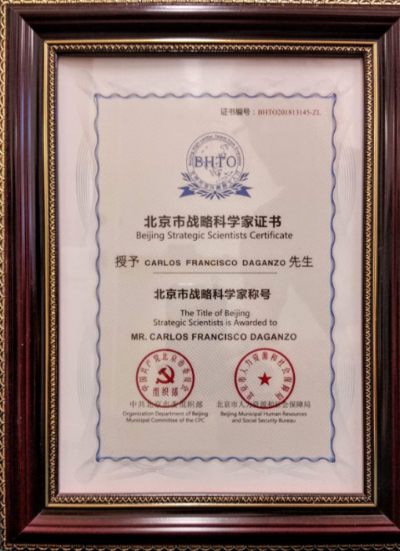

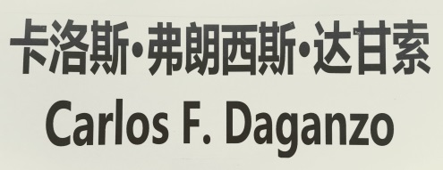
FOUR PHYSICS STORIES AND THEIR EFFECT ON CHINA’S FUTURE URBAN MOBILITY
Notes:
Slide 1 (Title/Humor)
Thank you friends for having me here.
Today I want to highlight the kinds of things that are in my mind.
I will introduce my ideas using 4 short stories that seem to have resonated in China.
Let me explain.
About two years ago, I was invited to Beijing to give a keynote at an event attended by some of the most senior transportation authorities in the country.
I thought this was a big deal so I prepared some stories like the ones I’m going to tell you and flew there.
I think my hosts liked what they heard because after a few months they asked me to come back, and on this second visit they gave me this plaque. POP1 (plaque).
I should also tell you that before this second trip a Chinese friend had told me that “Daganzo” in Chinese sounds like POP2 “Approach the mountain”.
I don’t know how much truth there is in this, but I think there could be some because with the plaque my Chinese friends also bestowed on me POP3 a mountain of work to do.
I thought this was a strange coincidence, and made me wonder if it was my name and not my stories that got me the plaque.
I still lean toward the stories, because I’m sure my hosts realize that approaching a mountain of work is not the same as completing it.
So let me tell you the stories and then you can decide for yourselves.

Slide 2
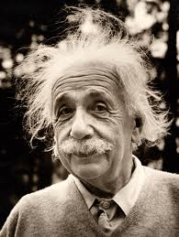

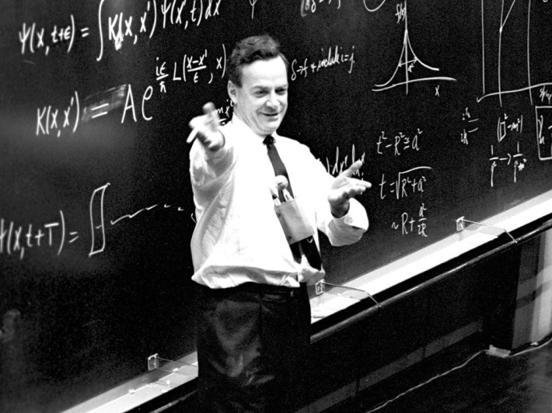

FOUR PHYSICS STORIES AND THEIR EFFECT ON CHINA’S FUTURE URBAN MOBILITY
“At the same time the thoughts are restricted in a strait jacket, so to speak, limited to be consistent with everything which has been seen before.”
— Richard P. Feynman
“Imagination is more important than knowledge”
Notes:
My stories have an idea in common. That any solution you imagine cannot just solve a problem on paper. For an idea to work as expected it must be consistent with all the mechanistic laws of transportation.
And it is not just me saying that … POP1 (Einstein) A smart guy I like once said that imagination was more important than knowledge…
And another smart guy… POP2 (Feynman)… clarified that we are not free to imagine anything, however. He used a strait jacket metaphor to stress that scientific imagination must be always restrained by empirical knowledge.
This straitjacket POP3 (straightjacket) applies to any engineering creation be it a structure, an environmental plan or a new transportation system.
Imagination and creativity are particularly important when we approach unique problems, as China is facing, because then there is nothing to copy. But to create something that works as imagined one must know how things work and use this knowledge in the act of creation.
This should be obvious, but unfortunately is ignored all the time.

Slide 3
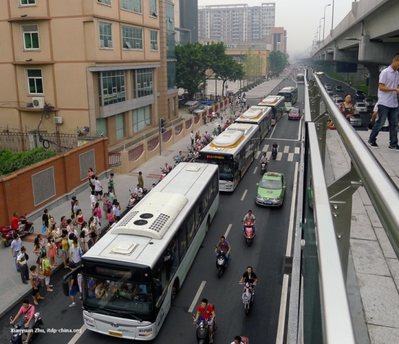
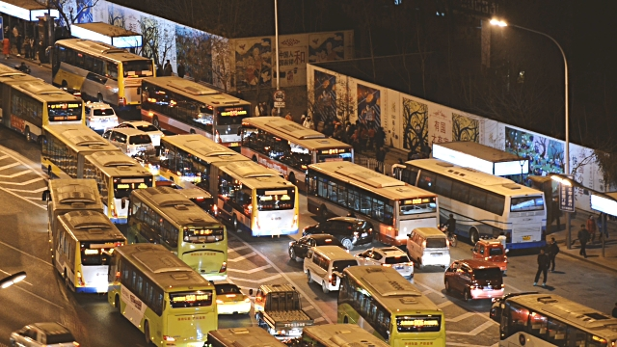
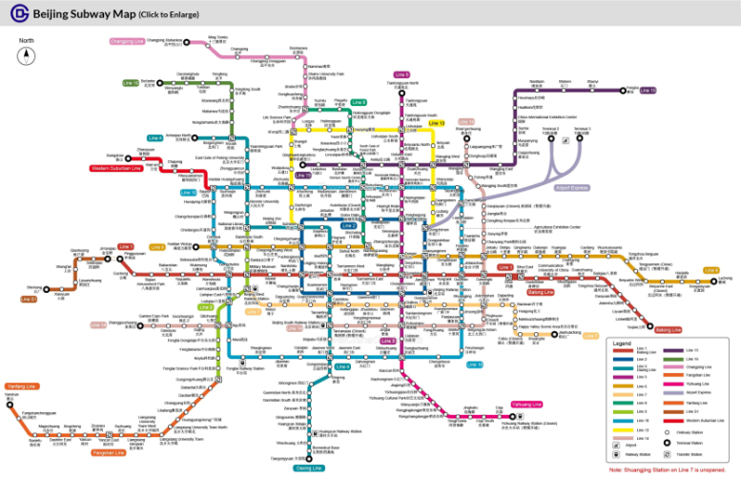
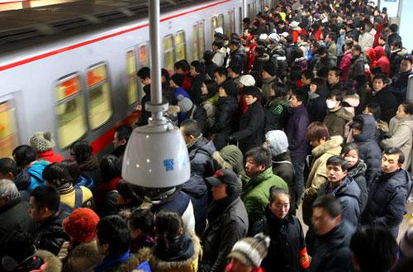
FOUR PHYSICS STORIES AND THEIR EFFECT ON CHINA’S FUTURE URBAN MOBILITY
Lack of
curb space
BRT station: bus stop congestion
(Chengdu, China)
Aerial View of Public Transport Bus Traffic Jam (Beijing, China)
Short
station
platforms
Beijing subway map
Taking a ride on the Beijing subway
“The only requirement for passengers is to have both strength and flexibility. Otherwise, you'll have to wait for the next train” (China.org.cn)
Notes:
An example, again returning to China, is the urban structure of many Chinese cities. They have few but very wide streets. This means POP1 that the amount of curb space per unit area is very low.
As a result there is not enough room for buses to stop, and POP2 bus stops get overrun with buses.
Another example is Beijing’s subway system, POP3 (map).
It was designed with station platforms that are POP4 too short.
The result… POP5 (picture with quote) as you can see is not desirable…
And, of course, examples of similar follies can be found in every corner of our planet, including our own corner. In my opinion, this occurs because plans are often made by people with limited knowledge of the straitjacket of how things work.
My four stories will illustrate how urban transportation can benefit from a dose of imagination -- of course, restricted by the straitjacket.

Slide 4

Four stories and four questions
Story 1: Why are big cities so congested?
Story 2: Can buses be organized to provide an urban mobility solution as convenient as cars?
Story 3: How should emergent systems like Uber and Lyft be regulated?
Story 4: Can the capacity of a subway be increased without building stuff?
Notes:
All the stories will be told without equations. The first POP1 explains why big cities are so congested, and what to do about it;
the second POP2 how bus transportation should be organized to provide a complete mobility solution;
the third POP3 how to understand and regulate emergent transportation services like Uber and Lyft;
and the fourth POP4 how to increase the capacity of a subway without building anything.
The stories have in common (i) that they answer real questions;
(ii) that they are relevant to both China and many other countries, including the US;
And (iii) that the answers fit within the straitjacket of physics laws POP5 (straightjackets)
So without further ado, I will now start the first story.

Slide 5
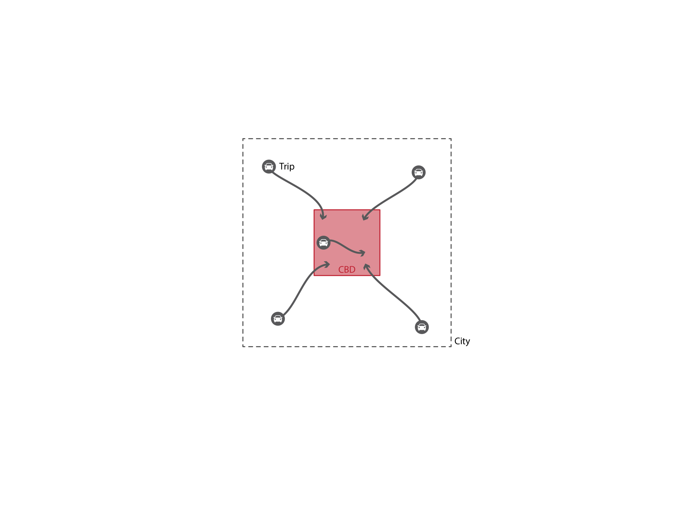
STORY 1: Why are big cities congested?
Scaling Analysis
City bigness
Destination concentration
Trip into CBD
CBD
Morning commute in a monocentric city
City Boundary
Notes:
To understand why big cities are so congested, I will use a simple physics idea POP1 called “scaling analysis”.
I will show that the root causes for this phenomenon are: city bigness; and the concentration of destinations in central areas.
To quantify these ideas I will examine the morning commute in monocentric cities POP2 such as the one in the picture.
Note how all trips start within the city boundary and go into a concentrated central business district (or CBD).

Slide 6
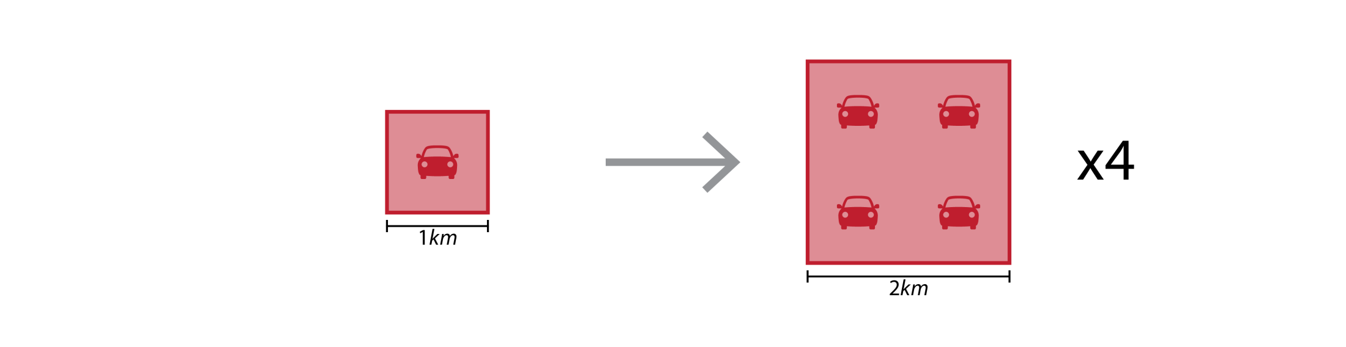
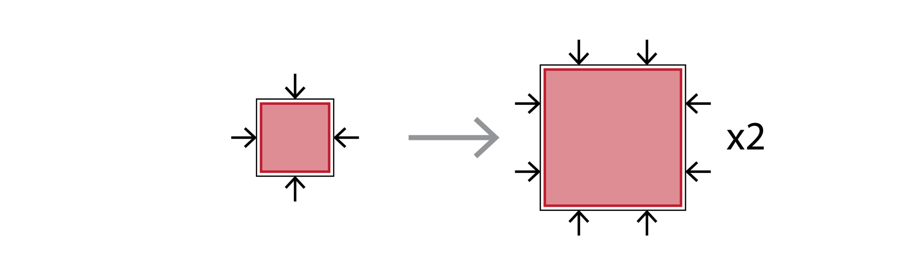
The Conundrum of Scale
Demand: Trips proportional to area of CBD.
x4
Supply: Trips that can enter proportional to perimeter
S1: Why are big cities so congested?
Notes:
So consider now cities with CBDs of different sizes.
POP1 It stands to reason that if the density of office space stays constant, then the number of trips demanded should be proportional to the area of the CBD.
In other words POP2 that if the linear dimension of the CBD doubles, as shown by these two squares,
Then POP3 the demand should quadruple.
In contrast POP4 the number of trips that can enter the CBD should be proportional to the length of its perimeter.
This occurs because the perimeter’s length POP5 determines the number of streets and transit lines that cross the perimeter into the CBD. Unfortunately for us, and as shown by the figure, the perimeter’s length only doubles if the linear dimension of the CBD doubles.
Taken together, POP6 the two parts of the figure illustrate that as the size of a CBD grows its ability to absorb trips increases less rapidly than the demand. Thus, for sufficiently large cities demand will surely outstrip supply and congestion will rear its ugly head. The conundrum is made worse by the fact that larger CBDs also usually have taller buildings, and therefore more demand per unit area.

Slide 7
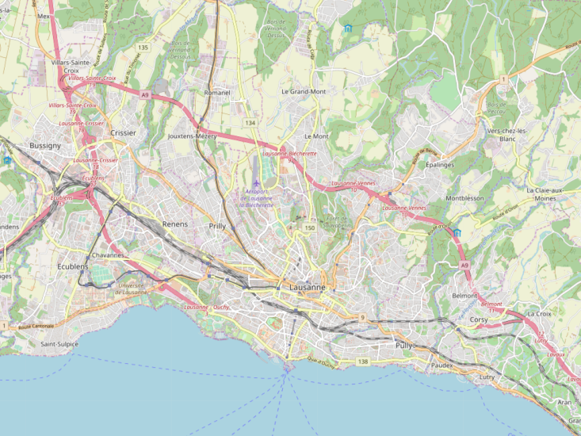
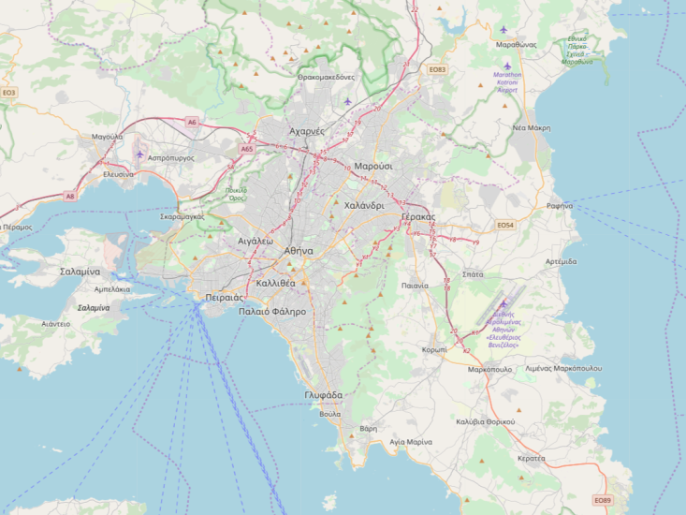
Results: Concentrated CBDs
Trip
Without subway
(diameter < 7 km)
With subway
(diameter < 20 km)
CBD
City
Lausanne
Athens
S1: Why are big cities so congested?
Notes:
I have run some numbers for cities such as Beijing, Boston or Madrid, which have similar population densities. In doing this I assumed POP1 that the CBD encompasses one 10th of the city’s area as in this diagram.
I found that if a city of this type does not have a subway system then awful congestion rears its ugly head once the city’s diameter reaches about 7 kilometers. POP2
As a point of reference, this is the size of Lausanne (Switzerland), which by the way does have a small rail system.
Fortunately, if the city has an extensive subway network, things improve markedly although there is still a limit.
In this case POP3 awful congestion arises when the diameter reaches 20 kilometers. This is representative of Athens (Greece).
Since these cities are not so huge, you may ask… Carlos you are assuming that the CBD is very concentrated in one tenth of the city. Aren’t real destinations more spread out? And wouldn’t this be better?
The answer to these questions is yes as you may imagine.

Slide 8
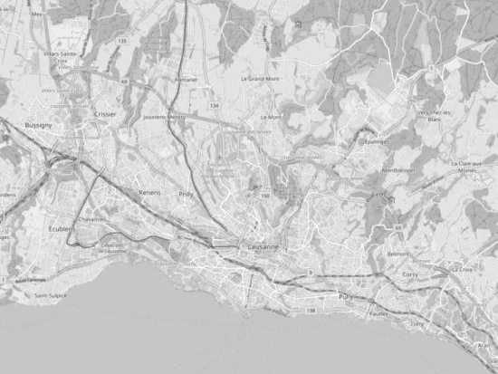
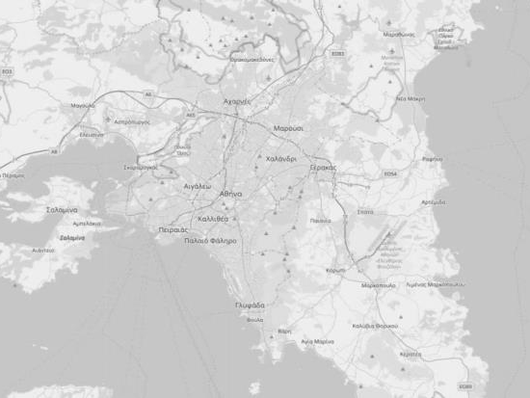
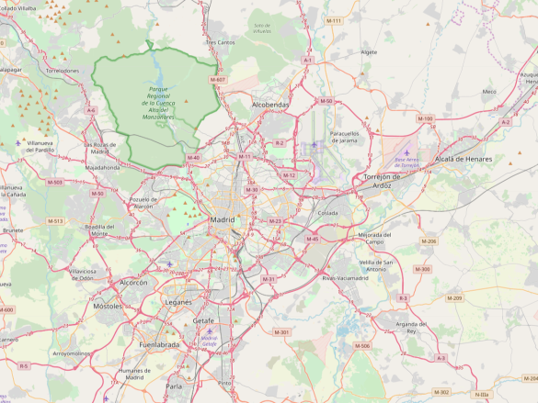
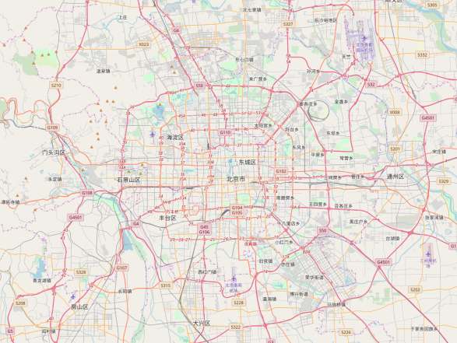
RESULTS: DISPERSED DESTINATIONS
Cars + Buses
d < 7 km
Cars + Buses + Subway
d < 20 km
Concentrated CBD
Limits city size
Dispersed Destinations
Still limits city size
Lausanne
Athens
Cars + Buses
d < 25 km
Cars + Buses + Subway
d < 75 km
Madrid
Beijing
8
Notes:
Unfortunately, however, the conundrum of city size persists even if work destinations are dispersed through the city. Similar physics calculations lead to the results in the picture. As expected, in this case cities can be larger. However, awful congestion inevitably arises in mega-cities such as Beijing.
The results strongly suggest that we should manage the urban structure by encouraging decentralization, providing subways if a city is large enough, and most importantly limiting city sizes. Since this is hard to do, congestion is often the result. This is the curse of bigness.

Slide 9
Key Ideas
Causes
City bigness
Destination concentration
Manage urban structure
Decentralize
Limit city sizes
Remedies
Expand supply
Subways that go everywhere
Reduce demand
S1: Why are big cities so congested?
Notes:
In summary, two simple physics principles have taught me that the root causes of congestion are: POP1 city bigness and destination concentration.
The ideas also suggest possible remedies. POP2
First, we should manage the urban structure POP3 by encouraging decentralization and limiting city sizes.
Second, POP4 we should expand transportation supply by providing extensive subway systems that allow travel from anywhere to anywhere—not just to the center.
And then, for the very large cities it may be necessary to POP5 reduce the demand with pricing or rationing schemes.
As you can imagine, these conclusions are very relevant for China, which has twelve megacities with more than 10 million people.
And this brings me to my second story.

Slide 10
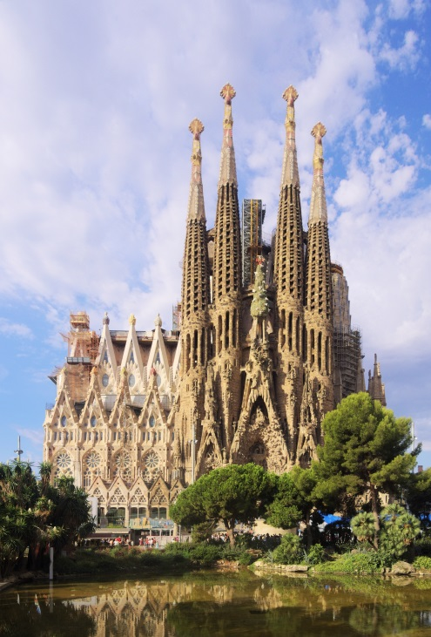
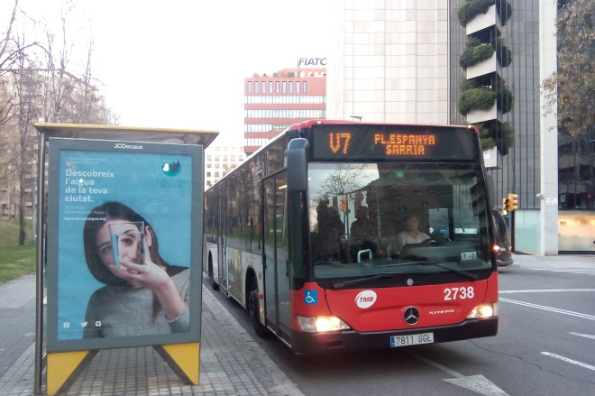
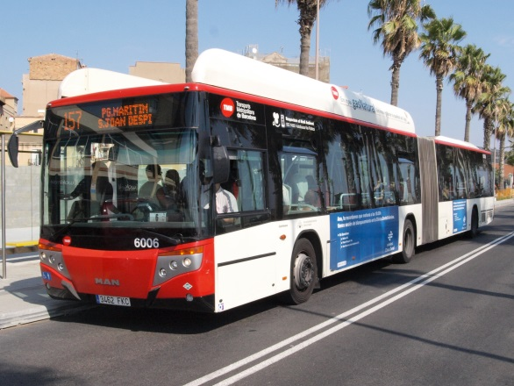
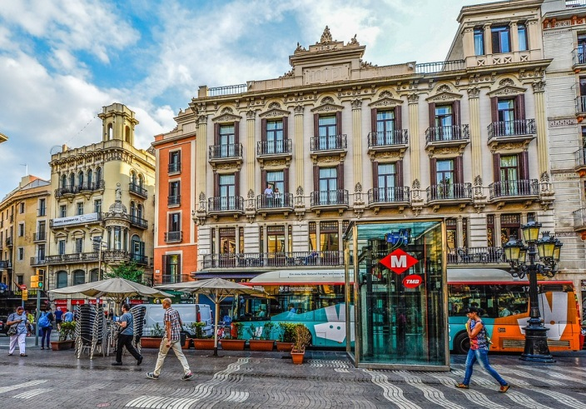
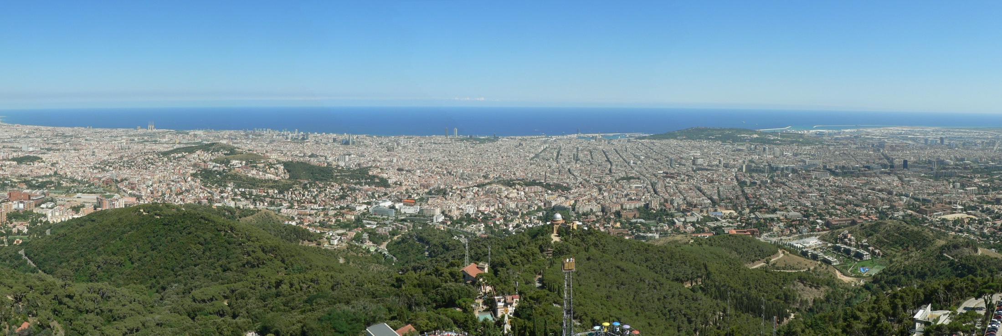
Story 2: A bus-based mobility solution
Barcelona
Notes:
We have just seen how imaginary experiments can lead to big picture insights. I will now show how imagination restricted by the straitjacket can also help us create new transportation solutions to specific cities, and optimize their configurations.
I will illustrate this idea with a case study from the city of Barcelona where buses have been successfully organized to provide a full mobility solution. The new bus concept had never been tried anywhere, so Barcelona had nothing to copy.
As an aside I want to mention that this story is very meaningful to me because Barcelona is where I grew up. I was actually baptized in the famous church you see on the left; and am a super fan of Barcelona’s soccer team. As you know, the best in the world!
And the story is especially meaningful because I was the inventor of the new bus system.

Slide 11
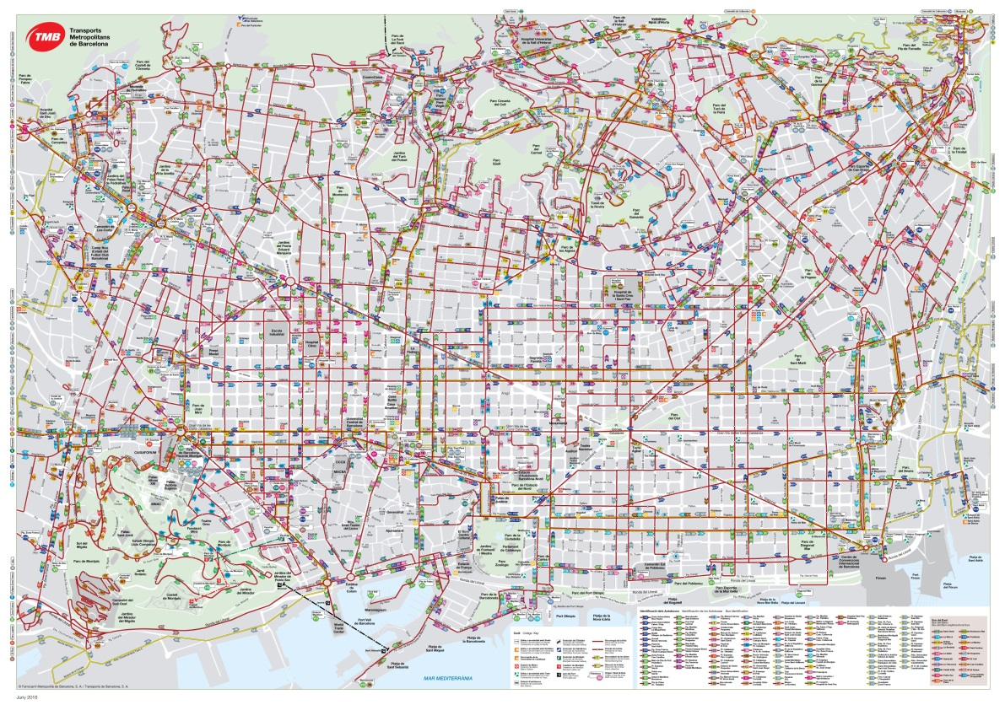
The Pre-existing Bus System
Disadvantages
Many buses
Infrequent service
Multi-line trips not easy
(expensive)
(slow travel)
(incomplete coverage)
S2: A bus-based mobility solution
Notes:
But back to our topic… As is typical of most cities, Barcelona’s pre-existing bus network POP0 looked like a plate of noodles.
Its lines were twisted and their stops were closely spaced. This has many disadvantages. POP1
To cover so many lines POP2 many buses are needed.
As a result individual lines cannot be populated with many buses. Therefore, POP3 service had to be infrequent.
Moreover, a confusing network and long service intervals discourage transfers. Therefore, POP4 passengers avoided multi-line trips, and only went where individual lines went.
Furthermore, with many stops buses traveled slowly. As a result of all this, POP5 service was expensive, slow and incomplete.
Therefore something had to be done.
During one of my visits I convinced Barcelona’s authorities that a new system could fix these problems, and they asked me to lead a local design team. The key idea behind the concept I proposed was a basic scaling argument from Euclidean geometry…

Slide 12
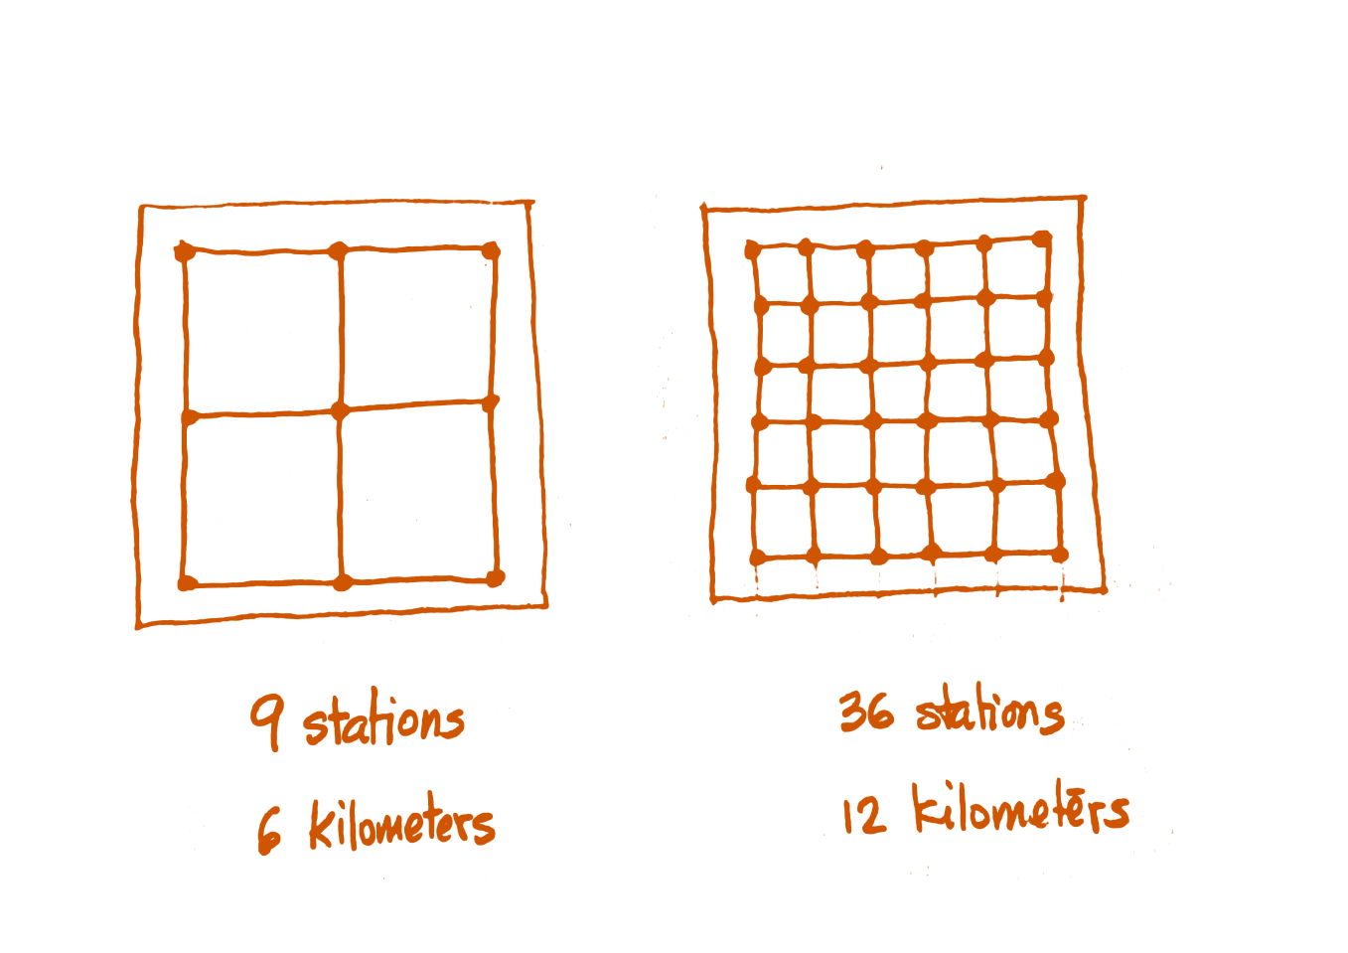
A Scaling Principle
“The length of a bus network is proportional to the square root of the number of stops.”
Reducing the number of stops made sense for Barcelona.
S2: A bus-based mobility solution
Notes:
The principle relates the length of a bus network to the number of stops that it needs to cover. It says POP1 that “The length of a network in a region of fixed area is approximately proportional to the square root of number of stops”.
This is an illustration. POP2
Note how the network on the right has 36 stations and is 12 kilometers long, whereas the one on the left has 9 stations and is only 6 kilometers long.
Given Barcelona’s long network and many stops, it made sense POP3 to reduce the number of stops.

Slide 13
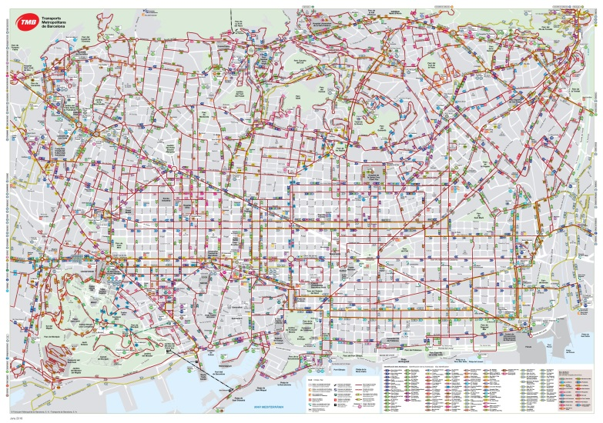
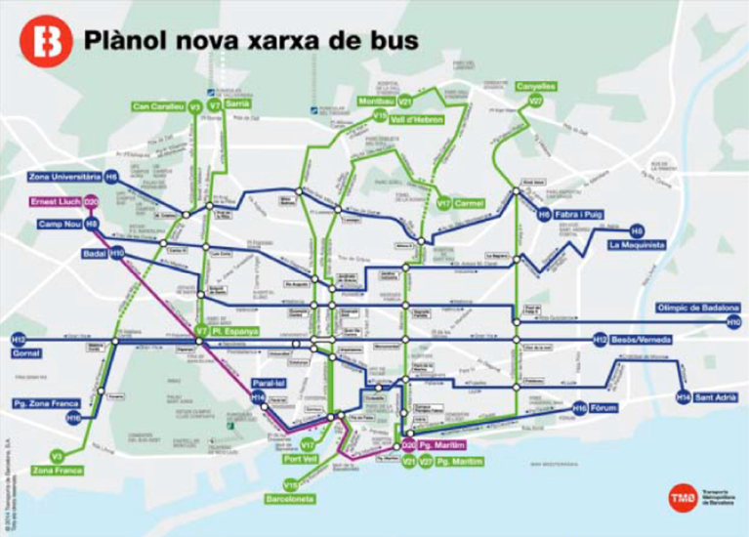
A New Bus System Concept
OLD PLAN
NEW PLAN
Disadvantages
Many buses (expensive)
Infrequent service (slow travel)
Multi-line trips not easy (incomplete coverage)
Advantages
Fewer buses (cheaper)
Frequent service (fast travel)
Transfers are easy (complete coverage)
S2: A bus-based mobility solution
“Structure of competitive transit networks.” Trans. Res. Part B 44, p434 (2010)
“Design and implementation of efficient transit networks” Trans Res. Part A 45, p935 (2011)
Notes:
Here is the old plan again as a basis for comparison. The new one was optimized with physics formulas derived for the occasion. The references on the bottom right give the details. Here is the result. POP1
Note how easy it is to understand the new network. And how it overcomes the disadvantages of the old POP2.
Because the network is shorter fewer buses are needed to cover it with super high frequency. And this is cheaper for the city.
The passengers also benefit. Although they have to walk longer distances to access the new stations, these distances are shorter than for the subway system. This slight disadvantage is more than compensated by shorter waits and faster travel. (In case you wonder: people unable to walk are served with other systems.)
In addition, the network simplicity and its high frequency make transfers easy. Therefore people use the bus network as an integrated system that gives them access to the whole city unlike the old system. Let me show you some evidence.

Slide 14
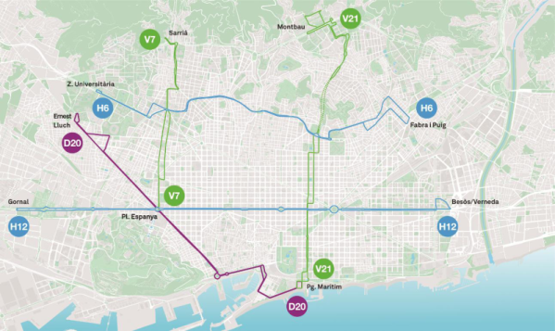
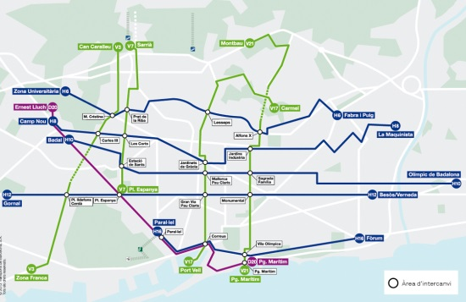
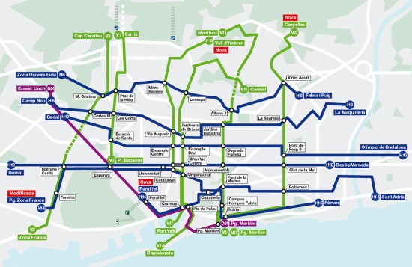
Deployment Phases for the New Bus System
Phase I 2012
Phase II 2013
Phase III
2014
S2: A bus-based mobility solution
Notes:
To check, we tracked the project over its first three implementation phases. The first lines were opened in late 2012, and then new sets of lines in late 2013 and in late 2014.
To determine if people use the system as a system and not as a set of individual lines we looked for evidence of transfers.

Slide 15
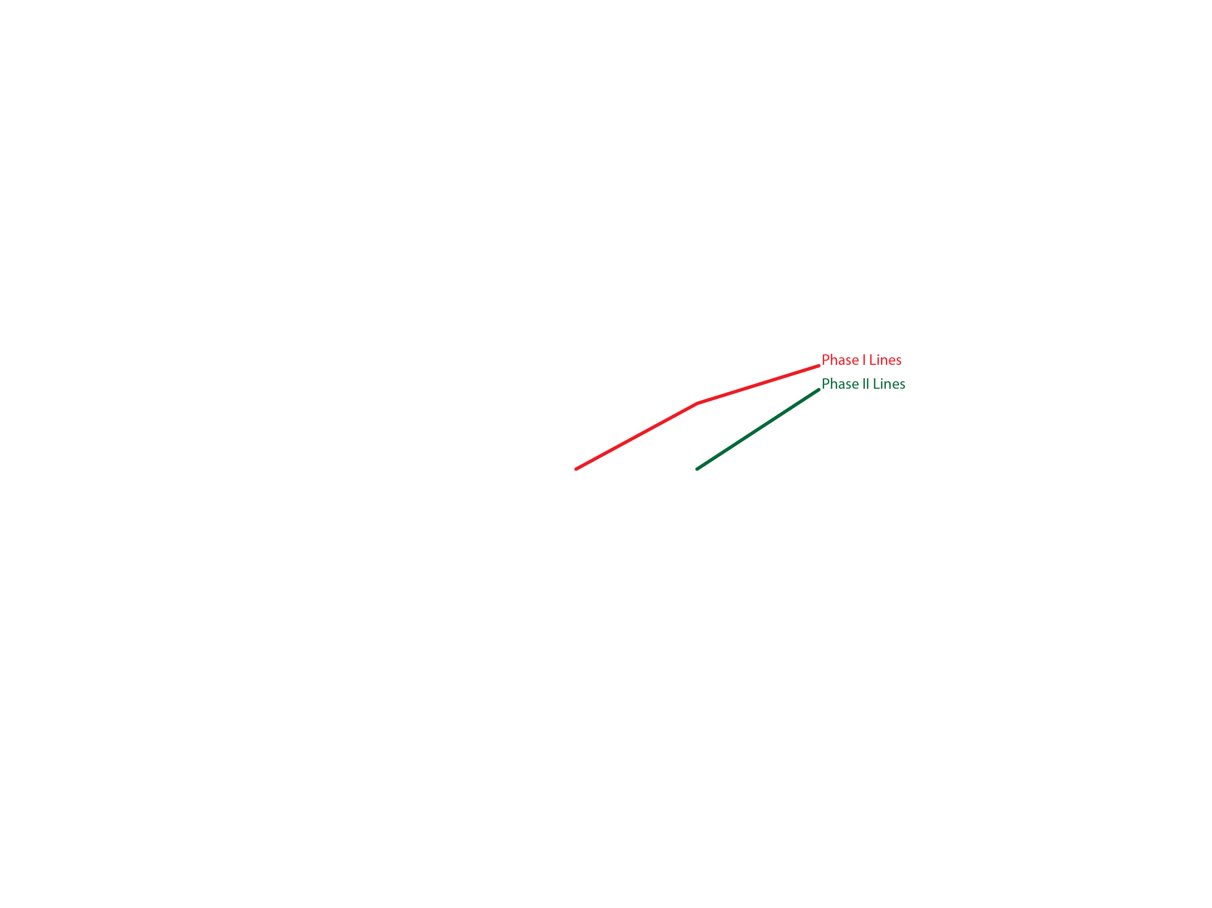

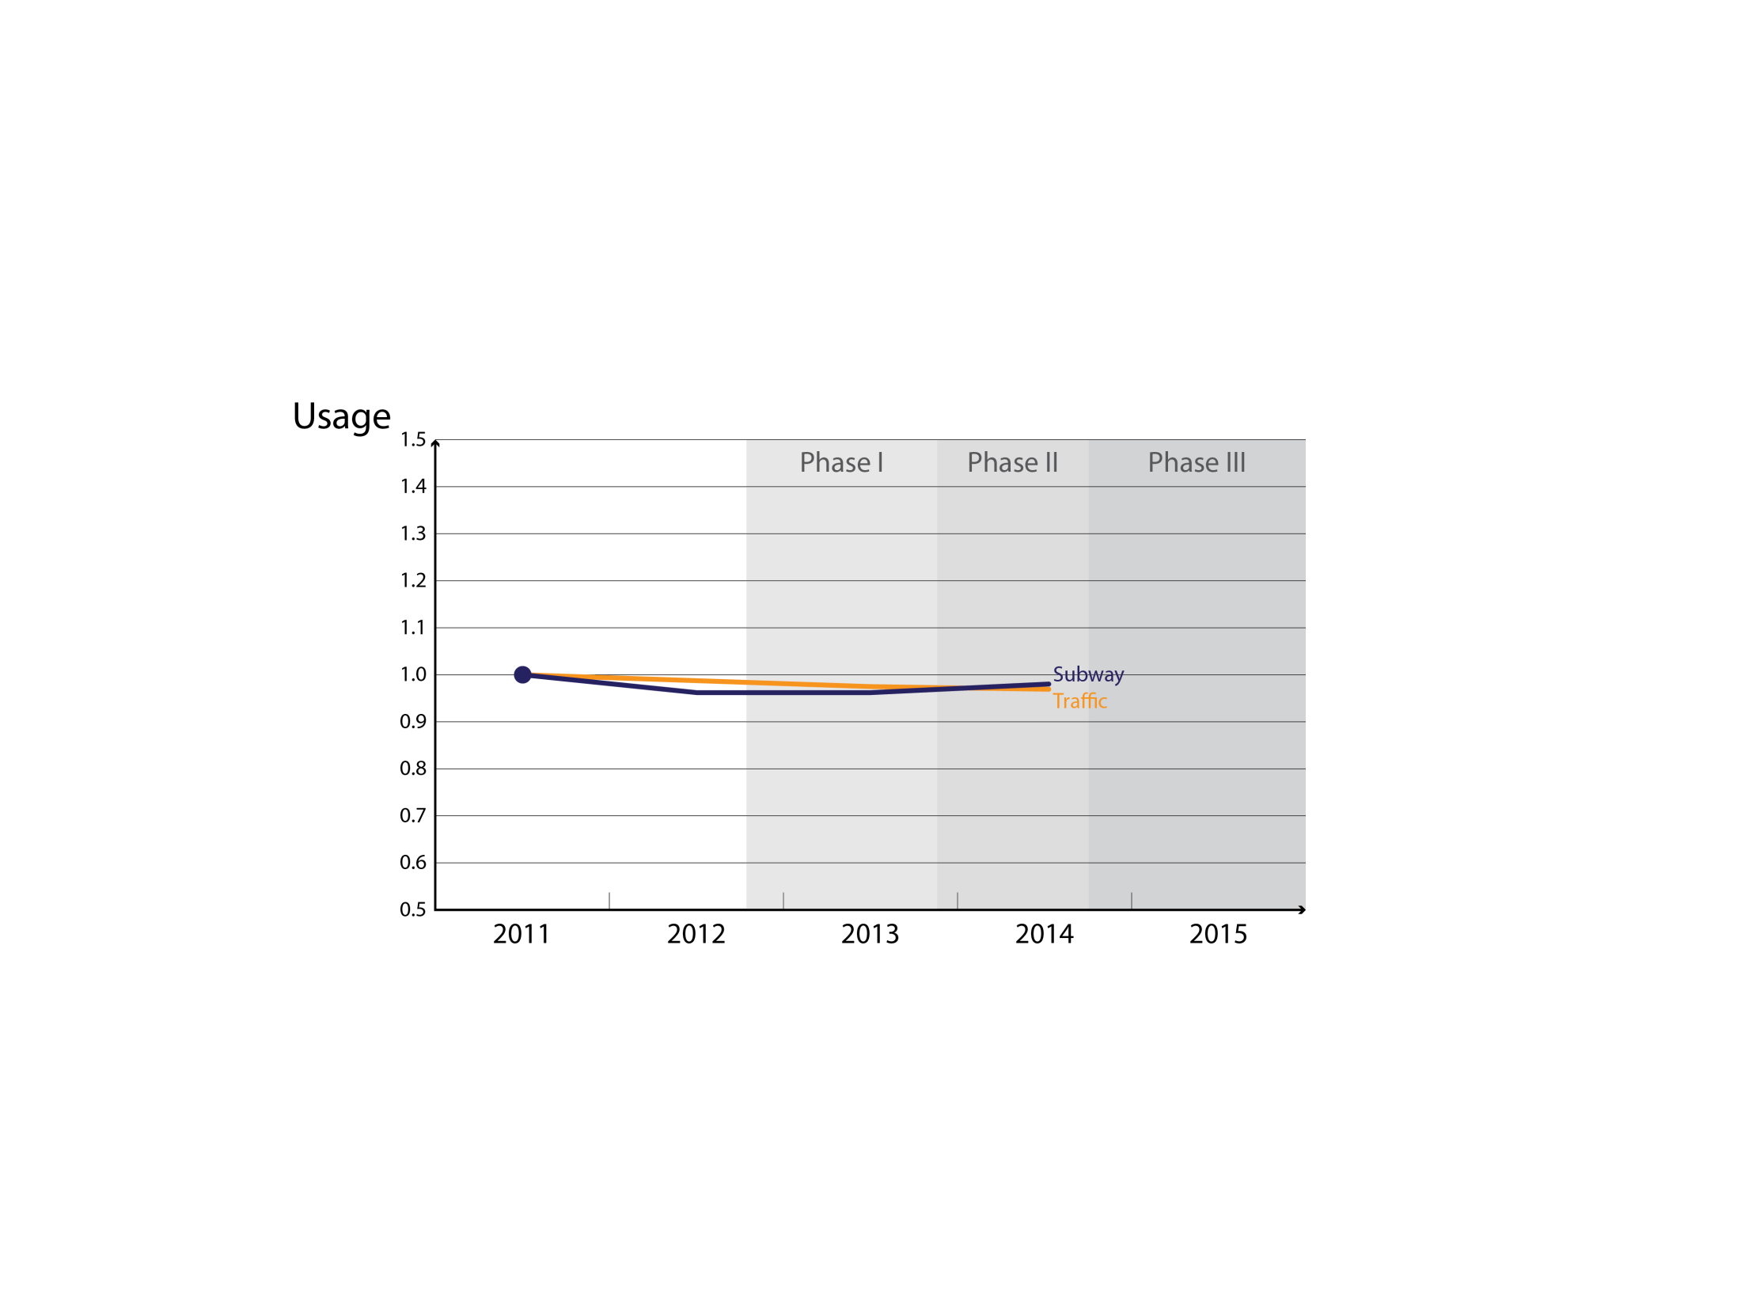
Evidence of Transfers
Transfers occur if the usage of existing lines rises when other lines open.
S2: A bus-based mobility solution
Source: "How network structure can boost and shape the demand for bus transit”
Trans Res 103A, 83–94 (2017).
Notes:
We wanted to be objective so we let the raw data speak for themselves. Transfers were detected by observing POP1 whether the usage of existing lines jumped when other lines were opened in later phases.
Transfers are the only explanation for this phenomenon because travel in Barcelona by all modes was very steady. POP 2
This chart shows the number of trips carried by the subway and the amount of car traffic during the three phases. The vertical axis has been rescaled so the initial values are “1” for both forms of travel. Usage is definitely steady.
Now let’s look at the new bus system. POP 3 We will use red for the lines built in phase 1 and green for those built in phase 2. These red and green dots show their initial usage levels before other lines were opened. The question is whether these usages increased or not as new lines were opened in later phases.
Well, this is what happened. POP 4 These large increases can only be explained by a high level of transfers.

Slide 16
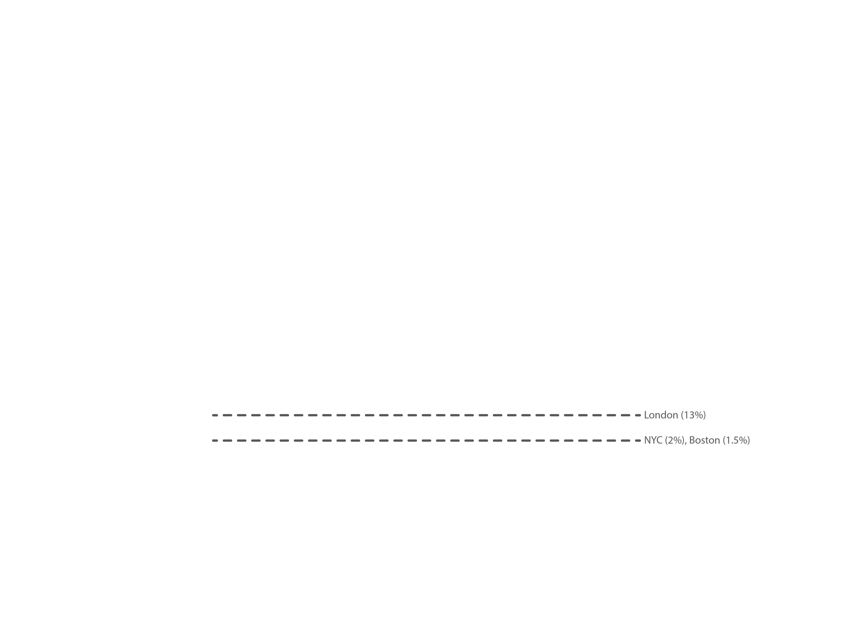
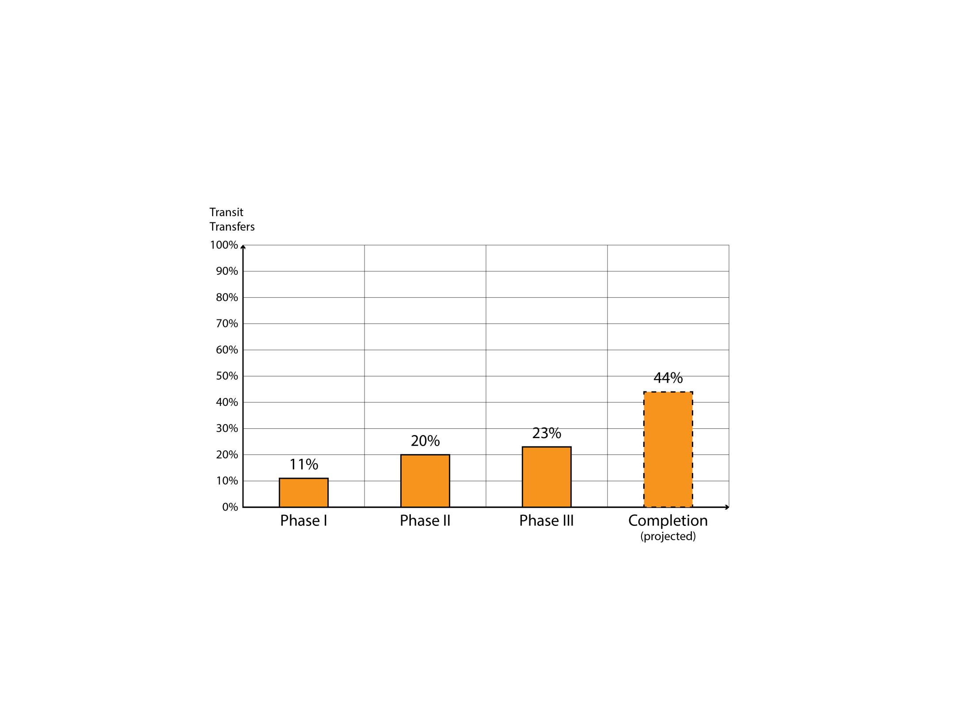
System-wide Transfer Percentages
S2: A bus-based mobility solution
Source: "How network structure can boost and shape the demand for bus transit”
Trans Res 103A, 83–94 (2017).
Notes:
Simple models also produced this chart. The reference is on the bottom right.
Note how the percentage of transfers increases as the network expands, and the large number at completion. These numbers are comparable to those of subways.
And they are much larger than for other bus systems in the world.
As a point of comparison, here are some benchmarks. POP… London, which has one of the highest bus-to-bus transfer rates on record, weighs in at 13% whereas New York City and Boston, which are more typical, have rates below 2%.
Today Barcelona’s new system is working as was imagined and carrying more demand than anticipated.
This case study illustrates how imagination within the straitjacket can help us tailor solutions to unique situations.
This premise is particularly relevant for China because its largest cities have many unique features. Mobility improvements to Chinese cities require a strong dose of scientific imagination.
Let me now share with you the third story.

Slide 17
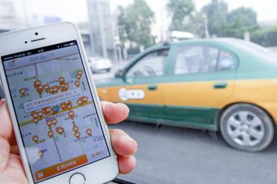

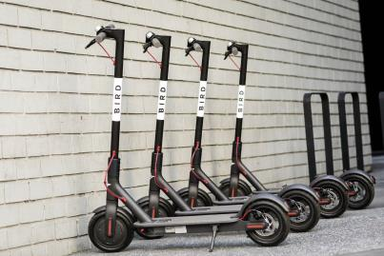
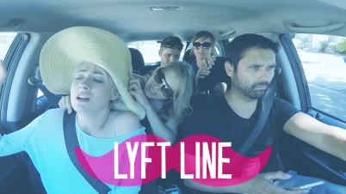
STORY 3: HOW SHOULD EMERGENT SERVICES BE REGULATED?
Scientific imagination is Mandatory!!!
Example: Ride-sharing
Notes:
It shows how imagination can also help us understand emergent and future systems, such as those provided by Uber, Lyft, Didi, Jump, Lime and other tech companies, so cities can regulate them—or not.
Scientific imagination is POP1 actually mandatory in these cases because there is little or no prior experience to rely on.
As an example POP2 I will show how the taxi ride-sharing services provided by tech companies fit with other forms of service such as solo-ride taxi and mass transit.
I will do this for all types of cities as I’ll explain, so we can see what to do with each city type.

Slide 18
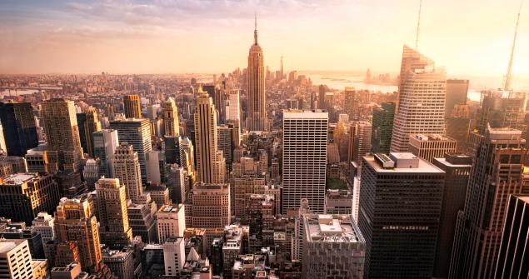
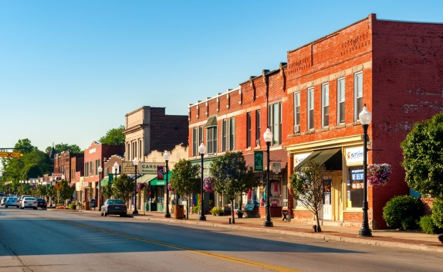
Dimensional Analysis: Reducing the Question to its Essence
Cities classified according to “Bigness” index
Performance indicators:
Fleet size
Door-to-door speed
Big bigness
Small bigness
(cost)
(level of service)
S3: How should TNC’s be regulated?
Notes:
A physics tool called “dimensional analysis” allows us to reduce the question to its essence. It allows us to classify cities using a single index that we call “bigness”. POP1
This number encapsulates important things such as the city’s area, its population and its transportation demand level.
Dimensional analysis also allows us to evaluate a transportation technology such as ride-sharing in terms of only two performance indicators: POP2
(i) the fleet size (defined as the number of vehicles in circulation required to provide the service); and (ii) the average door-to-door travel speed users experience, including waiting and walking.
The fleet size is a proxy for cost POP 3 and the door-to-door speed for level of service.
Having reduced the problem to its essence we then modeled the systems, within the straitjacket, with a combination of analysis and simulations.

Slide 19
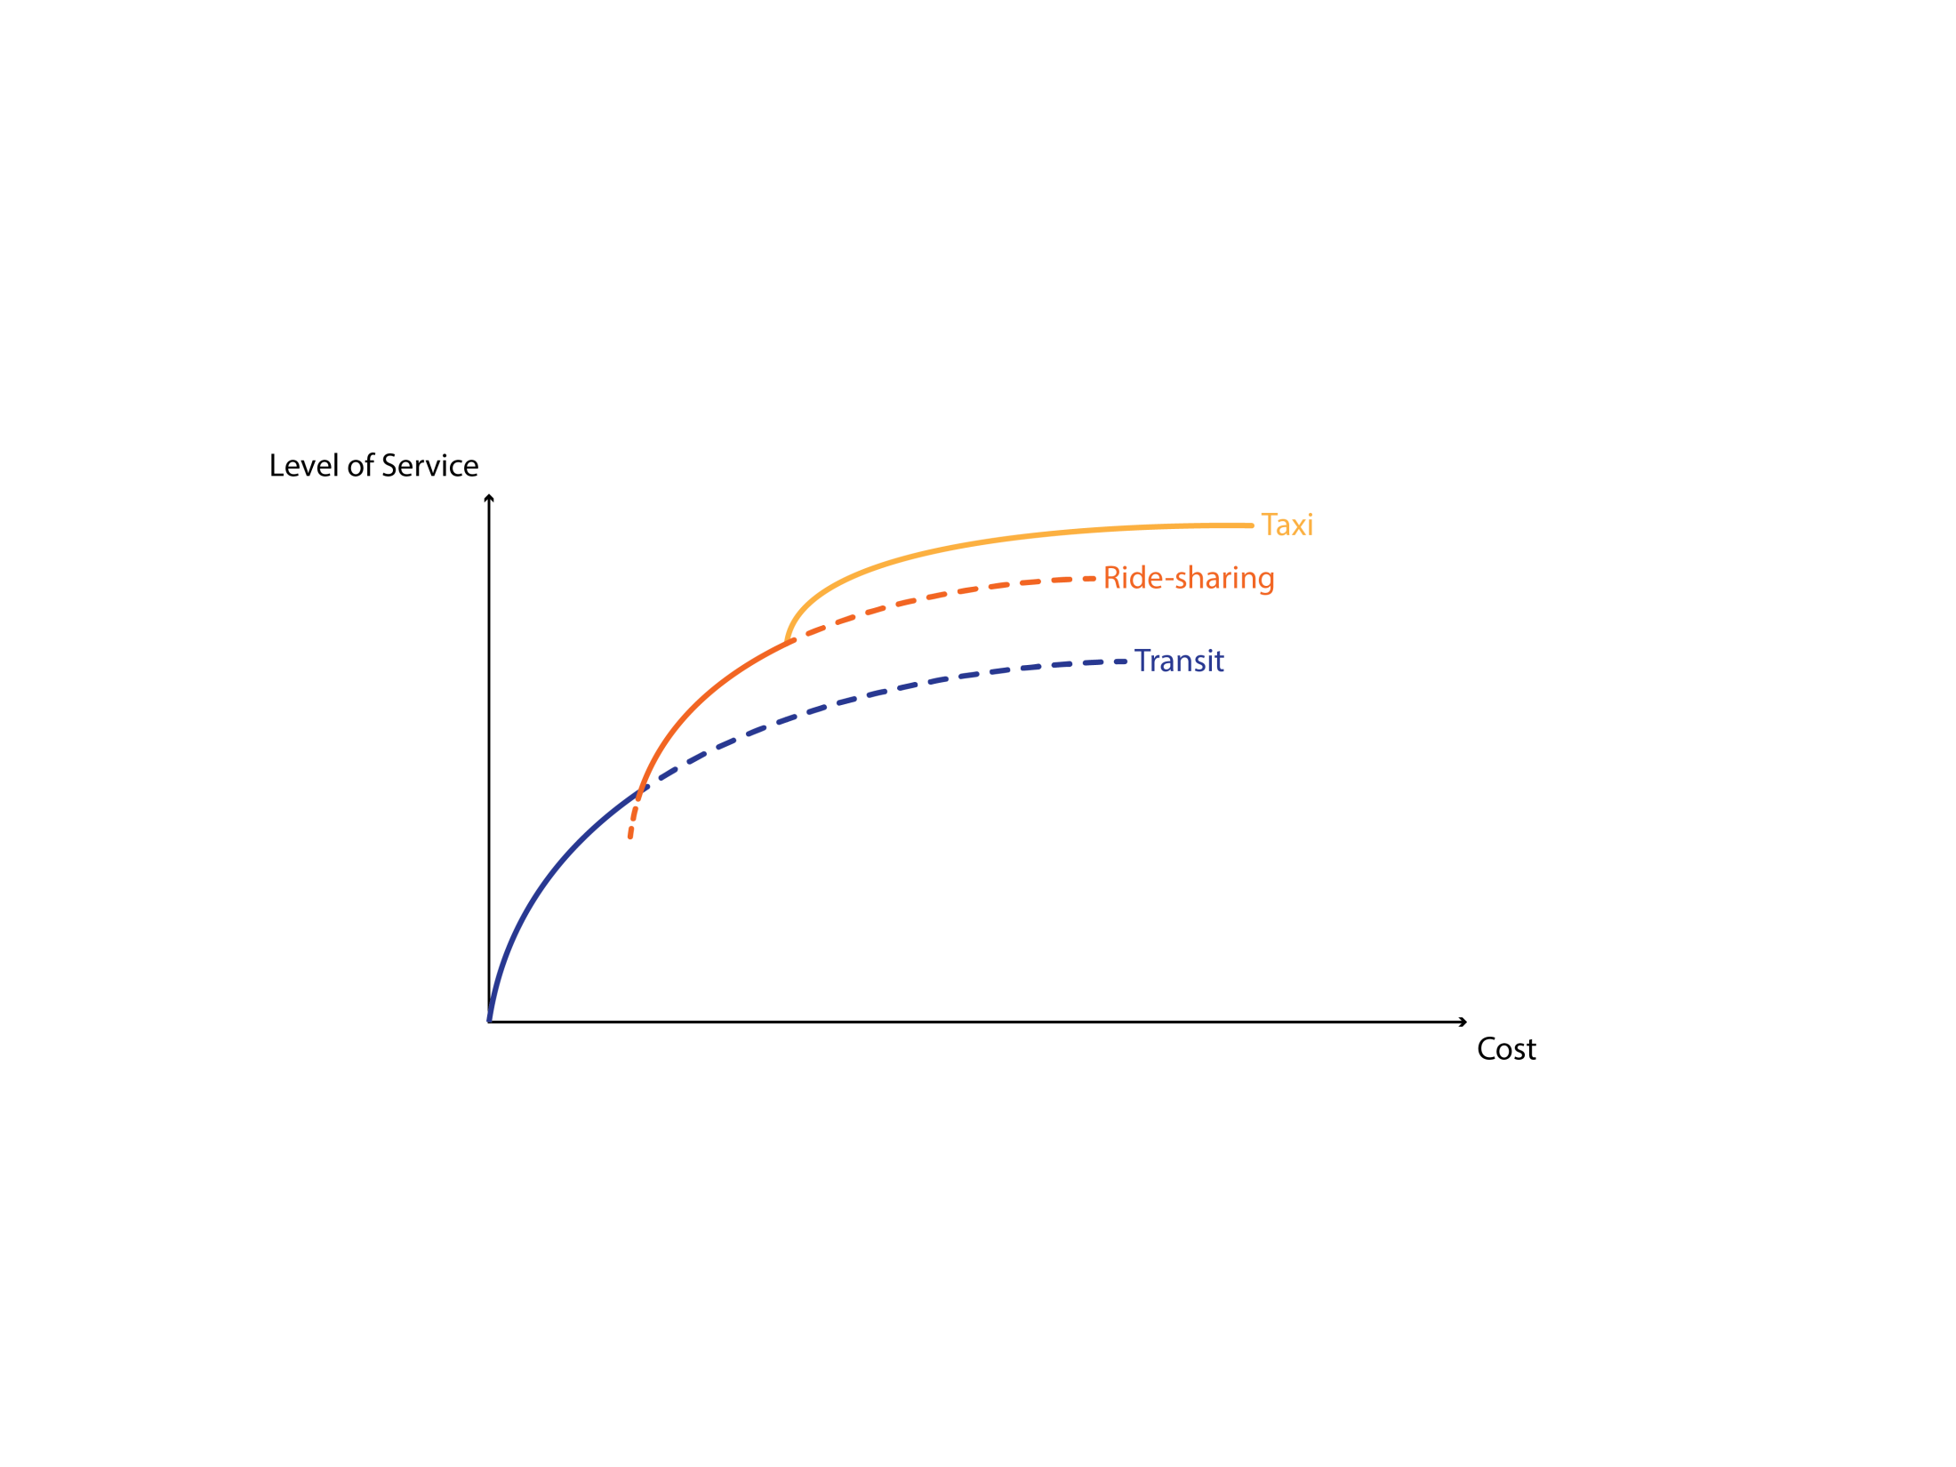
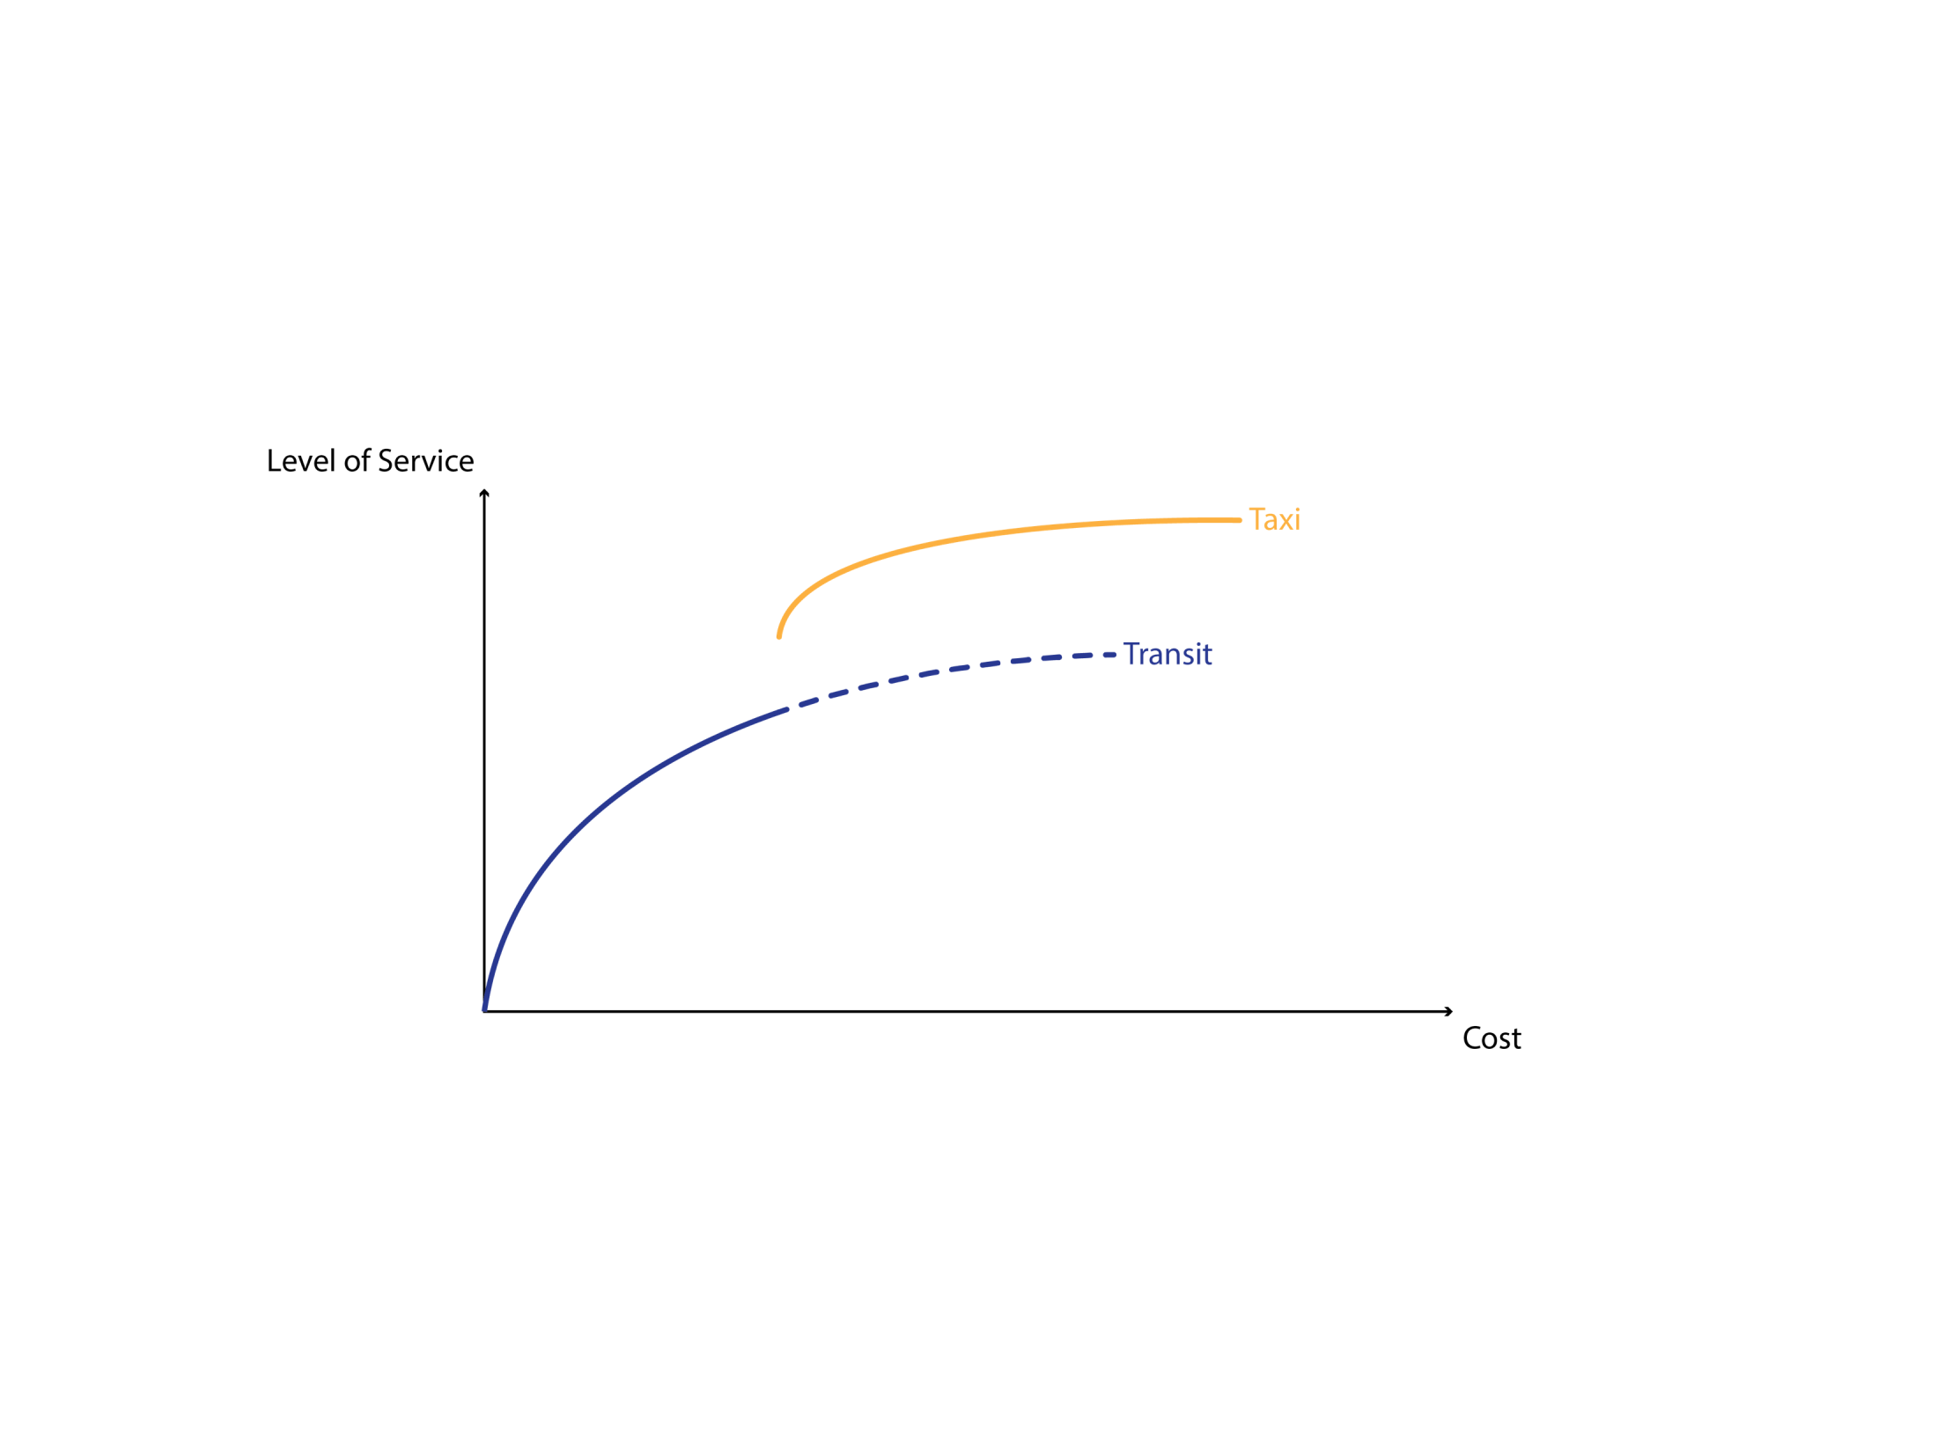

Results for Small Cities
Ride-sharing services complement other modes
S3: How should TNC’s be regulated?
Source: "A general model of ride sharing services” ArXiv:1807.01140v2, (2018).
Notes:
The reference on the bottom right contains the details. This chart shows how conventional taxi and mass transit service compare in a city of small bigness.
Each curve shows the level of service that can be achieved for a given cost by the mode in question, when used alone.
Three things should be noted from the pattern.
First that that the gold, solo-ride, taxi-curve is quite high, signifying that taxi can provide a higher level of service;
Second, that the dotted part of the blue transit curve should never be provided;
And third POP1 that there is a vertical gap between the solid lines.
This gap means that with our two modes citizens of small cities can only receive either very low level of service with transit, or very high with taxi. The intermediate levels spanned by the green arrow cannot be delivered.
So… enter ride-sharing POP2
Note how it neatly fills the gap.
This means that in small cities POP3 ride-sharing services complement the other modes.
Since this happens spontaneously, service providers don’t need to be regulated much.
But what about big cities?

Slide 20
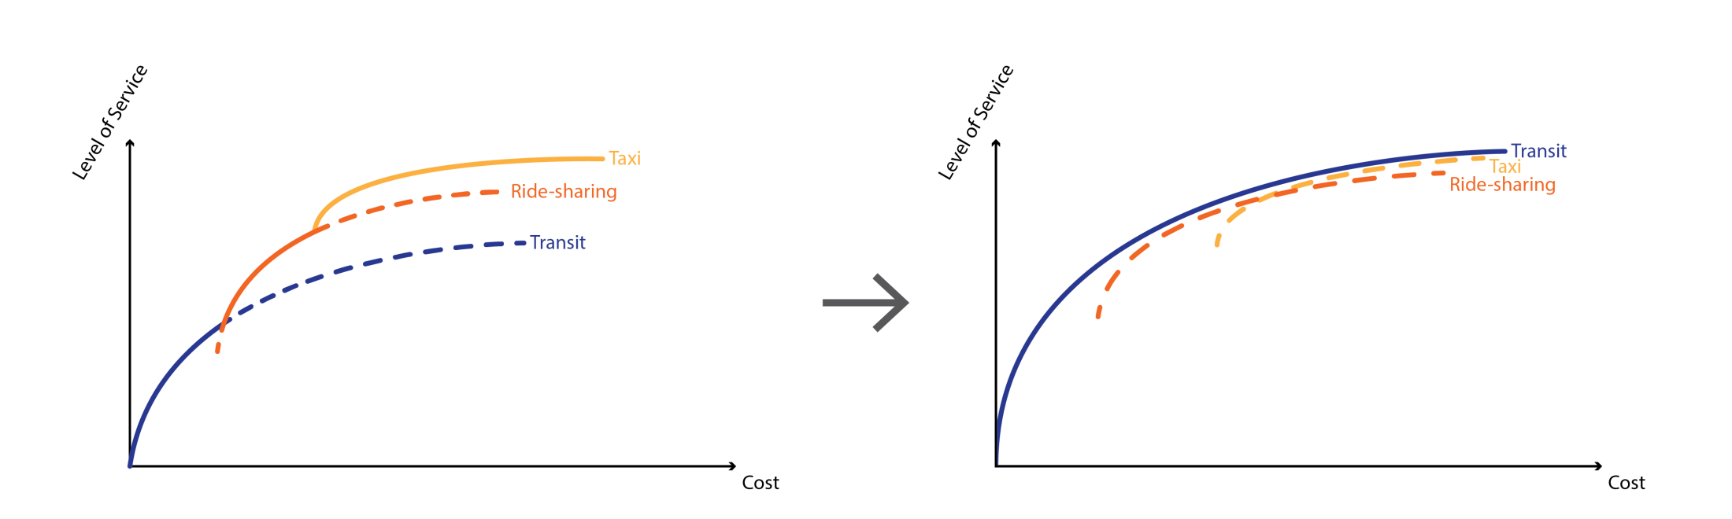
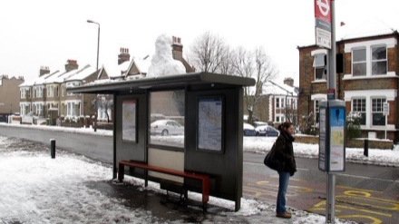
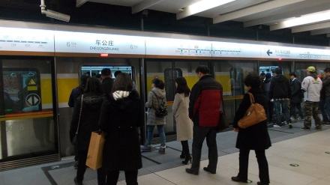
Big and Small Cities Compared
Small city
Big city
• Mass transit dominates both taxi services
• Big cities: Taxi companies should work together with mass transit
• Regulations tailored to each city type can be unveiled
S3: How should TNC’s be regulated?
Source: "A general model of ride sharing services” ArXiv:1807.01140v2, (2018).
Notes:
Here are the results for small and big cities side by side. Note from the picture on the right how the blue transit curve is now entirely above the other two curves. This means that in big cities a good mass transit system POP1 dominates both traditional taxi and the new ride-sharing services provided by tech companies.
This happens because in big cities a mass transit vehicle can collect many people at a time every time it stops. POP2.
As you can imagine this is very efficient. Unfortunately, in cities of small bigness the picture is different POP3 because in these cities the demand is too low.
Unfortunately, it is impossible for taxi companies (no matter how techy) to experience the efficiencies in the right pane because their vehicles are too small. This is why transit dominates taxi services in big cities.
Therefore, for big cities, taxi services of all types are most useful if, POP4 they work together with a good mass transit system, for example providing last-mile services rather than as a stand-alone solution that competes with mass transit. This suggests that regulating the new tech companies is desirable.
My team and I plan to use the imagination and analysis tools we used in developing these curves to unveil regulations POP 5 that are tailored to each city type.
This is very important both for China and the US because in both countries tech company services are rapidly proliferating, sometimes with undesirable side-effects.
This concludes my third story. The stories so far have discussed long term planning issues. My fourth and final story is about a more immediate problem.

Slide 21
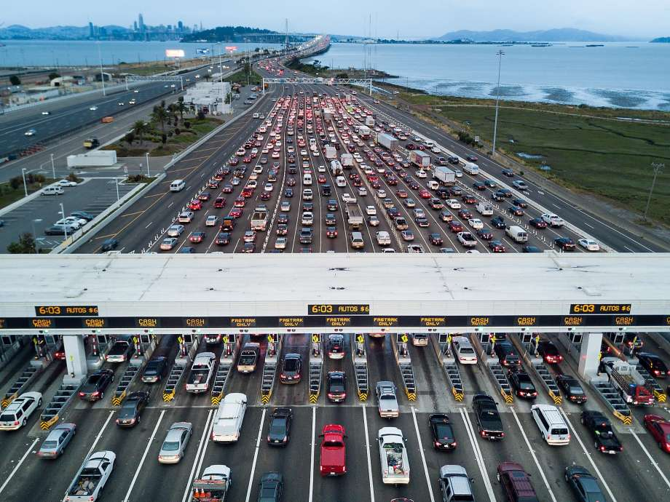
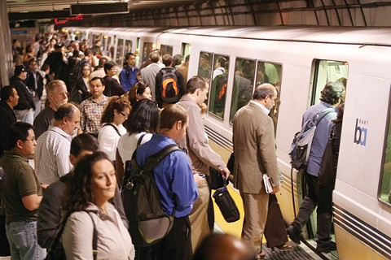
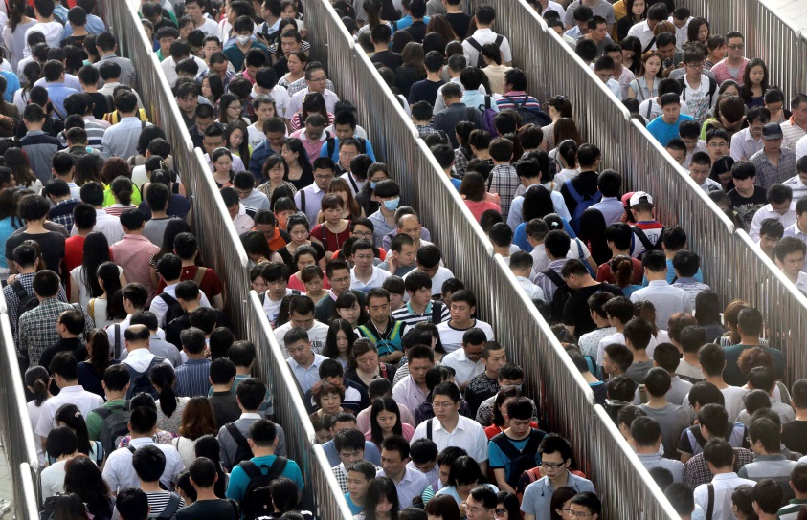
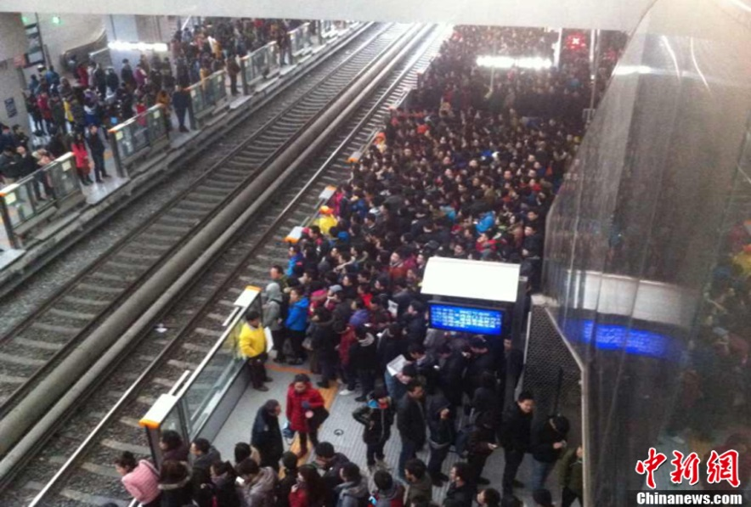
STORY 4: CAN A SUBWAY BE DECONGESTED
WITHOUT BUILDING ANYTHING?
Bay Bridge : 7,000 [Pax/h]
BART : 15,000 [Pax/h]
Access to Line 2
• 2 minute separation
Beijing Line 2 Subway: 60,000 [Pax/h]
S4: Can we expand subway capacity?
Notes:
It tells how a subway can be decongested without building anything. This is important in Beijing. It is also relevant locally, given BARTs increased usage.
Just to get some perspective on the issues in Beijing, let me use the Bay Area as a frame of reference. Consider this. POP1 Downtown San Francisco absorbs a maximum of about 7000 car passengers per hour from the East Bay at the peak of the morning commute.
This may seem like a lot given all the congestion that we see on the news, right?
Well, BART POP2 quietly delivers to the city about twice as many commuters in the same amount of time (about 15,000). And passengers already complain that BART is getting crowded…
Now, the most congested line in Beijing (of which there are several) POP3 carries about 60,000. This is almost three times as many as BART and the Bay Bridge combined….
Oh… And because the demand is even higher congestion is horrendous. POP4
Passengers of Line 2 often have to wait for 6 and 7 trains during the morning rush because trains arrive already full.
This happens even though trains are already as long as the station platforms allow, and scheduled POP5 at the minimum safe time separations of 2 minutes.
So, can something be done?

Slide 22
Proposed Solution: Time Lapse Representation of a Double Stop
• Intervals grow from 2min to 3min
• Capacity increases by only 33%
• Trains slowed
S4: Can we expand subway capacity?
Notes:
The solution I proposed uses the idea shown in this diagram… that although minimum safe train separations are two minutes long, zero-separations can also be achieved by POP1 physically attaching two trains together and making a convoy with twice the length.
Note, the train in front is labeled “L” for leader and the one in back “F” for follower.
These convoys would then make a double stop at each station as shown on the three snapshots of the slide…
The slide should be read from top to bottom as the convoy moves from left to right. On the top, the convoy approaches;
it then collects passengers with the lead train; POP2
and then with the following train. POP3
Using this strategy, convoys could collect twice the number of passengers at each station.
Unfortunately, because double stops would last about a minute longer, POP4 the minimum interval between consecutive convoys would grow from 2 minutes to 3.
As a result, POP5 the capacity to carry passengers would increase by only 33%.
A more serious drawback POP6 is that trains are slowed by the extra stops, so passengers would spend more time inside the trains.
The solution I proposed alleviates these problems by stopping the convoys in a different way that uses only single stops. Here is how it works.

Slide 23
The System’s Kinematics
|←⎯⎯ 2 min ⎯→|
Flow of trains doubled
Trains not slowed
Straitjacket considerations:
Train accelerations
Transfer stations
End-of-line turnarounds
Uneven system dimensions
Passenger information systems
Crowd management
Safety
• Twice the number of seats per passenger
• Uniform distribution of passengers
• Capacity increases to 120,000 pax/h
S4: Can we expand subway capacity?
Notes:
This is a time-space diagram showing in one picture the motion of four convoys as they traverse two stations. Because the convoys only make single stops trains are not slowed POP1 and can still arrive every two minutes POP2.
And because each convoy consists of two trains POP3 the flow of trains past any station is doubled.
To make the scheme work, the stations along the route are labeled as odd or even POP4 and convoys are consecutively designed as being of type A or B POP5.
Type-A convoys align the lead train with the odd stations for boarding, POP6 and the following train with the even. POP7
Type B convoys do the reverse. POP8
Why is this useful? A symmetry argument reveals why.
Since the flow of trains is doubled, the flow of seats is doubled. So, if the flow of passengers stays the same, then POP9 there must be twice the number of seats available per passenger.
And since the strategy is symmetric in the sense that all the trains, stations and convoys are treated exactly the same, it follows POP10 that the distribution of passengers across the available seats must be uniform.
Thus, seats can be fully used and therefore POP11 the capacity would increase from 60,000 to 120,000 passengers per hour.
This is an optimistic guess, of course, because there are real-world complications that muddy the picture. Here are some: POP12
Realistic simulations that account for all the complications are now being conducted by my Chinese colleagues. I am not sure what the outcome will be, but I am hopeful…
And this concludes the last story.
I hope these stories have given you an idea of how scientific imagination constrained by the laws of physics can help diagnose and solve transportation problems.
I will now close by discussing how the stories fit with where I see our field going.

Slide 24
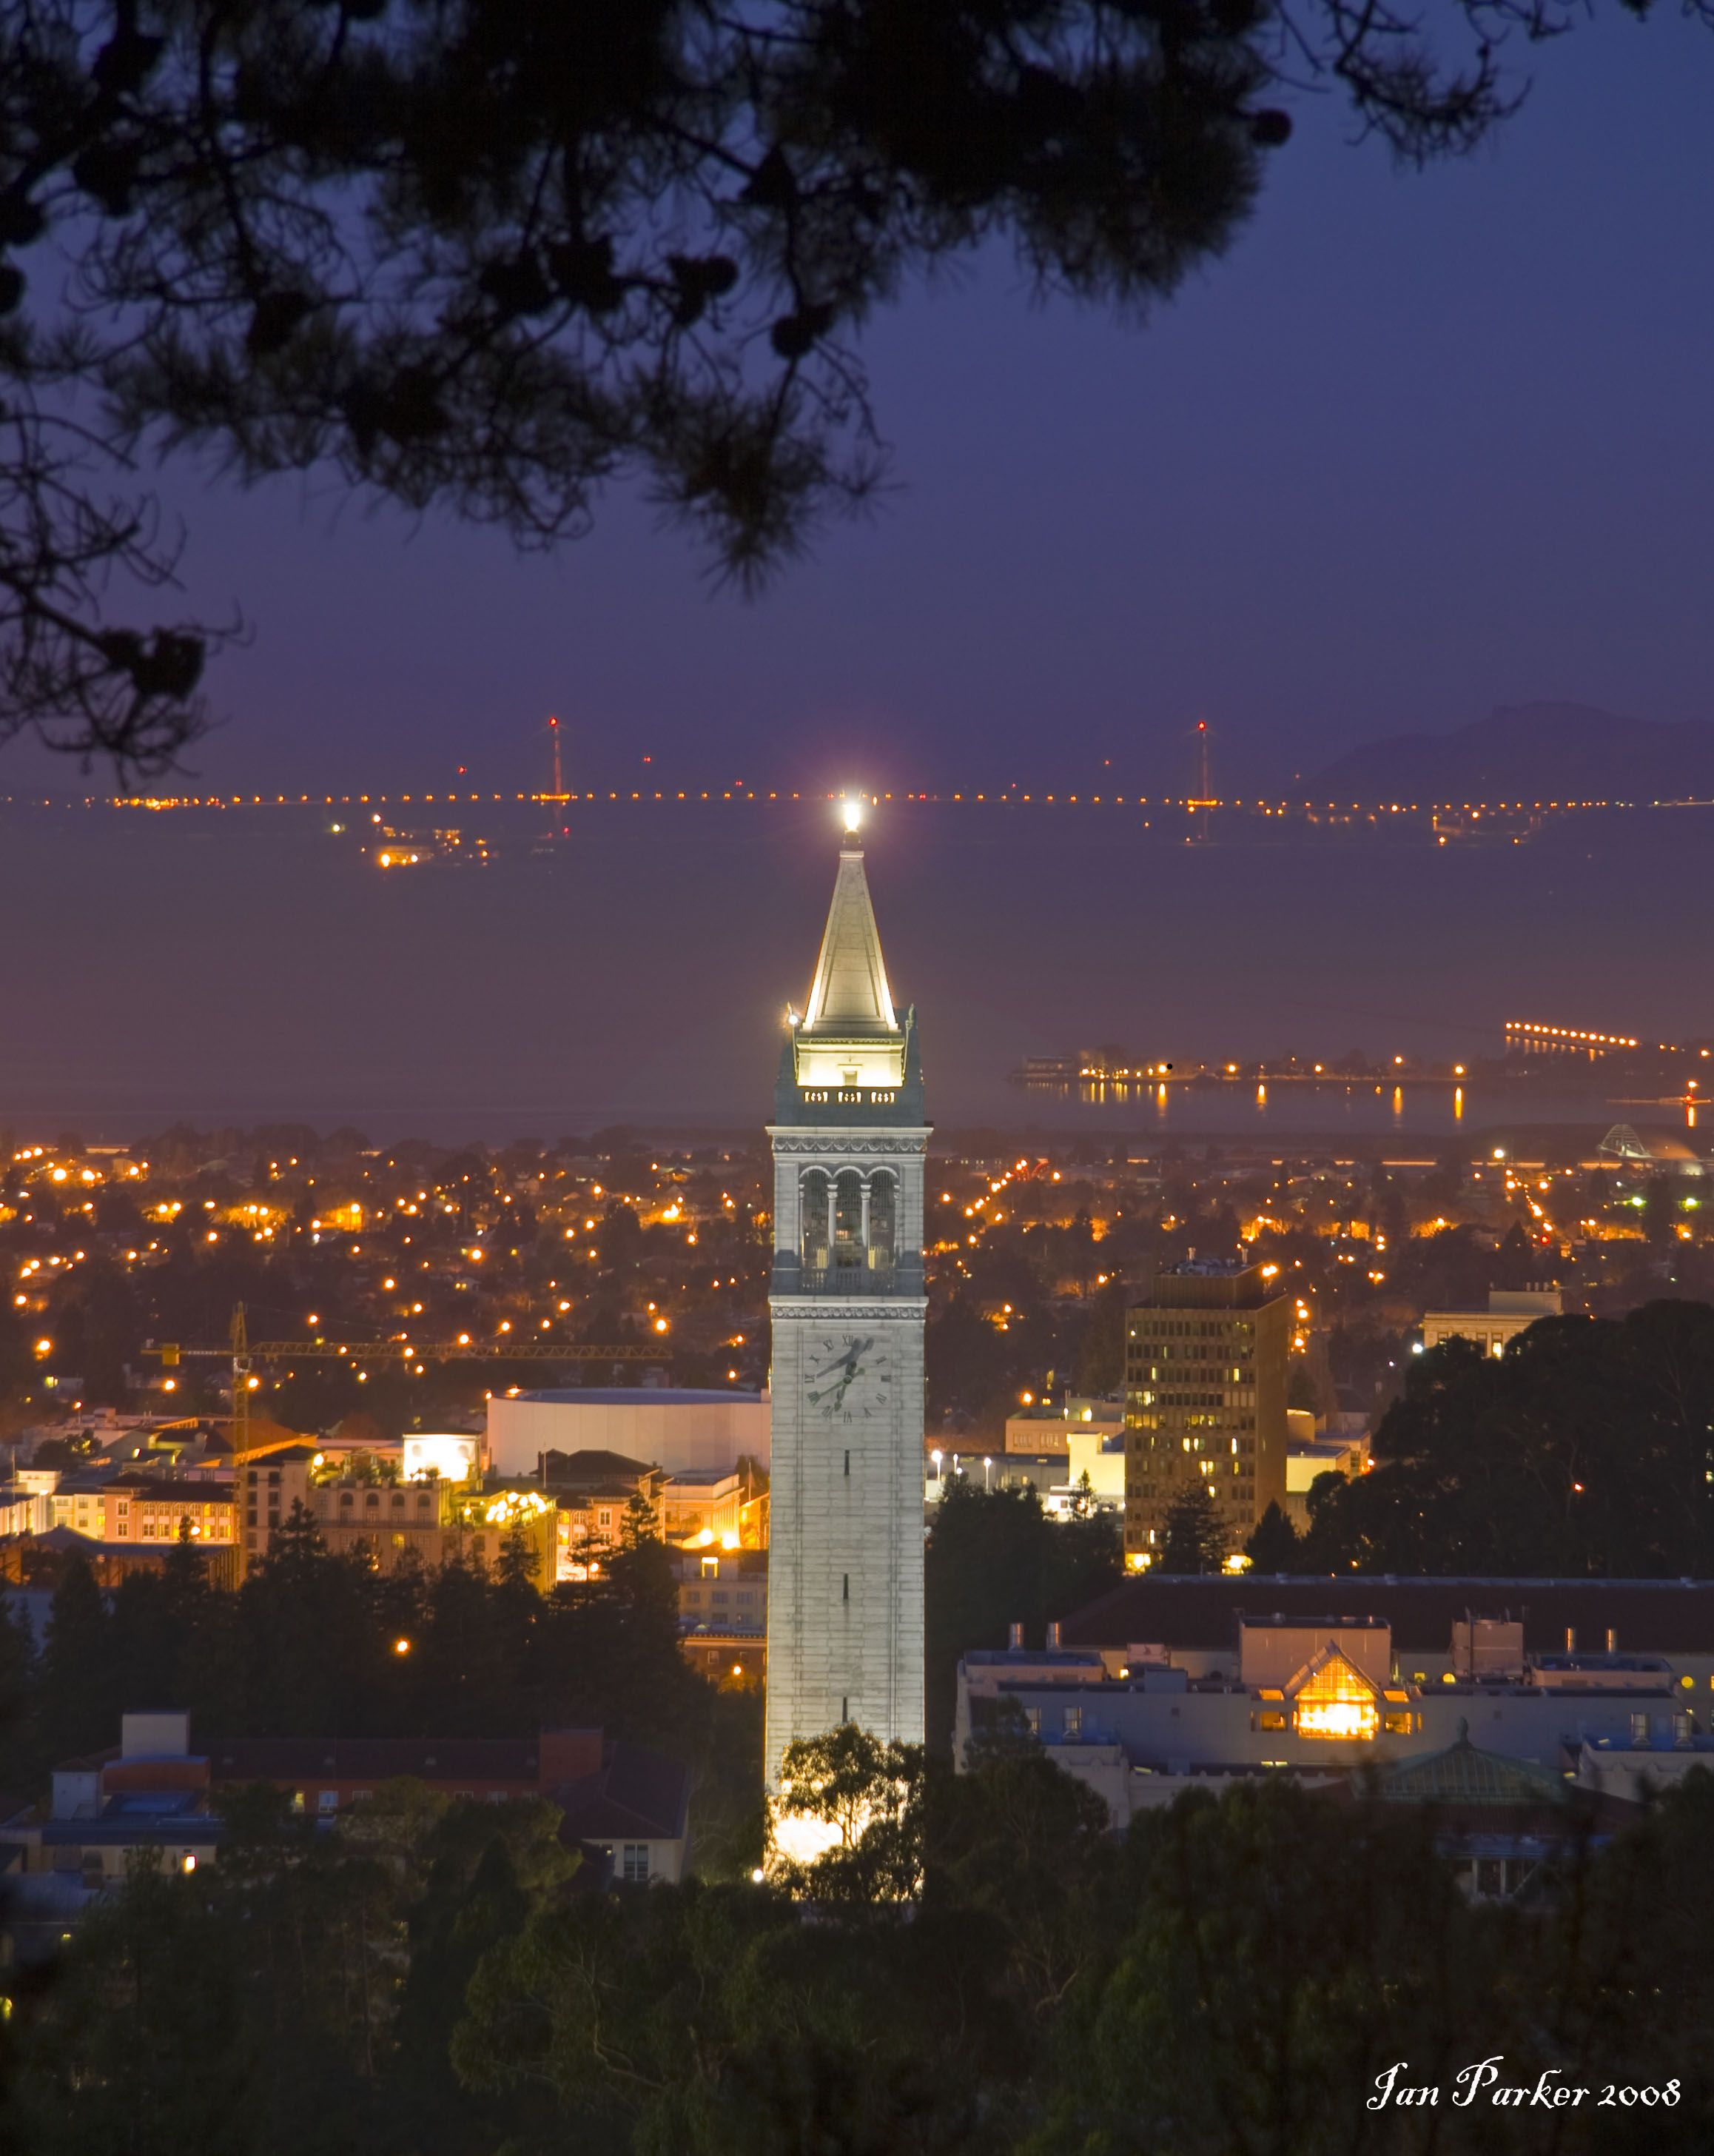


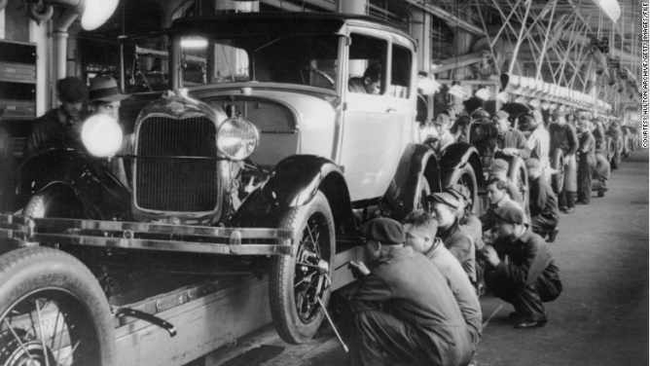
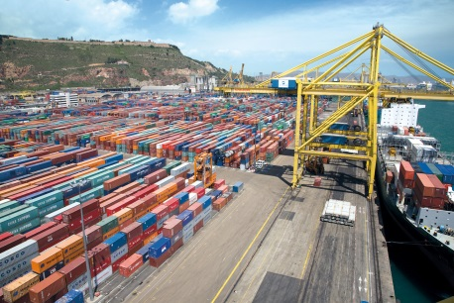




IMAGINATION AND THE EVOLUTION OF TRANSPORTATION SCIENCE
“Imagination is more important than knowledge”
Computer science tools put knowledge to use.
Transportation physics laws not fully known.
Notes:
I’ll be provocative and say that my field’s current direction is missing something. Today there is much emphasis in government funding agencies and academia on computer science tools such as “big data” and “machine learning”. I myself cofounded a company that uses these tools to improve transit service. I saw first-hand that, although useful, all these tools did for me was putting knowledge and data I already had to good use. POP1
I think this is true in general; and that the tools alone are not enough. To address the really difficult transportation problems (or other civil engineering problems), knowledge-based tools should come second to scientific imagination and an intimate knowledge of the straitjacket of how things work. My four stories attempted to illustrate this point.
The most notable engineering achievements always have included a strong dose of imagination. Think of the first arch dam (built by the romans in France) POP2 (picture), the assembly line POP3 (picture), the Ferris wheel at the Chicago fair POP4 (picture), the invention of the hub by Federal Express that revolutionized package delivery POP5 (picture), the introduction of containers, POP6 (picture) the ideas behind Uber and Lyft POP7 (picture), or almost any invention.
In fact, I believe that any engineering problem that involves lasting decisions requires a strong dose of imagination and knowledge of how things work. Only by combining these two assets, we can ensure that our solutions will work as anticipated.
The field of transportation is particularly exciting today because its fundamental laws are not completely known. POP8 (bullet). Some have been recently been discovered and other discoveries loom on the horizon.
Better solutions to most of society’s mobility problems demand both, that we improve our understanding of the fundamental laws and that we use imagination to enrich the standard ways in which the laws we know are being applied today.
Throughout my career, I have learned that the biggest improvements to transportation systems come from shining the light on simple ideas that are outside the box but within the straitjacket.
Keep shining the light my friends! POP9.

Slide 25

Dispersed Destinations
Concentrated Destinations
Dispersed
Destinations
S1: Why are big cities so congested?
Notes:
To see why let us look at an extreme case with destinations uniformly dispersed all over the city. POP This is shown on the right pane of this picture. The tips of the arrows, representing the destinations, are now contained in a much bigger area. I have colored it blue rather than pink to remind ourselves that the scenario is different and very favorable.

Slide 26


The Conundrum of Scale Revisited
Supply: Number of trips that fit in a city is proportional to its area.
Demand: Number of trips that need to coexist
Mass Conservation
Rate × Duration
(area)
(diameter)
S1: Why are big cities so congested?
Notes:
So let us see what happens now.
It should be obvious POP1 that the number of trips that can simultaneously fit in a city is directly proportional to the surface of all its streets combined, which is itself proportional to the city’s area. Therefore the number of trips that fit must be proportional to the city’s area. This is what the city can supply.
Note that POP2 this supply quadruples if the city’s linear dimension doubles.
Now, contrast this with the demand; POP3 that is with number of trips that would need to coexist during the middle of the rush if people could travel when they want.
To get at this number we use another physics principle called “Mass Conservation”. POP4
It says that the number of trips that would coexist if everyone were to travel when they want is the product of POP4 the rate at which trips start, and the duration of a typical trip.
Now, since the rate at which trips start is proportional to the population (that is, to the city’s area) POP5 and the duration of a trip is proportional to the city’s diameter POP6,
we see that the number of trips in the scenario of the figure would increase by a factor of 8. POP7
This means that even when destinations are dispersed, POP8
the demand grows more rapidly than the supply. Therefore, as in the case of concentrated demand the conundrum persists--- there must be a maximum diameter beyond which all the desired travel is impossible.

Slide 27
Results: Dispersed Destinations
Without subway
(d < 7 km)
With subway
(d < 20 km)
Concentrated Destinations
Lausanne
Athens
Dispersed Destinations
Without subway
(d < 25 km)
With subway
(d < 75 km)
Madrid
Beijing
S1: Why are big cities so congested?
Notes:
To quantify the changes I repeated the calculations of the case with concentrated destinations.
For a dispersed city without a subway POP1 the diameter limit is now about 25 km instead of 7; or about the size of Madrid (Spain).
And for a city with an extensive subway network POP2 the limit is now about 75 km.
This larger number may come as a relief since it is slightly larger than the diameter the world’s largest cities. But remember, the number is based on favorable assumptions.
This result shows that for a megacity to be workable, subways have to be extensively developed. And driving must be restricted so buses can function well. Since this is hard to do, congestion is often the result. This is the curse of bigness.

Slide 28






WHERE DO WE GO FROM HERE?
Beijing:
Existing streets
Existing subway
Xiong’an:
Goals
90% green
80% Public transportation
Notes:
Regarding practice, the mayor of Beijing wants to build on the ideas to improve his city. POP1 (Beijing)
He has asked me to identify and help solve Beijing’s many transportation problems… and to direct the creation of a master transportation plan. I found this to be a humongous but interesting mountain, so decided that to honor my Chinese name, I would approach it.
The mountain seems tall to me not just because of the size of the city, but because POP2 (Two maps) of the extensive pre-existing physical infrastructure that constrains what can be done — I think this is a very restrictive straitjacket. POP3 (Strait jacket 1)
Also regarding practice, I don’t know if you have heard of the new initiative of China’s president Xi to make cities greener. A centerpiece of this initiative is a new satellite city 100 km away from Beijing. POP4 (Xiong’an) It is called the Xiong’an New Area. You may have read about it in the Economist or Wikipedia. This is how it looks now. POP5 (Xiong’an picture). There is not much there.
I have also been asked to conceive of a transportation system for this city. The goal is to house a population of 2 to 5 million people, plus all the tech industry from Beijing. The city is supposed to be POP6 (percentages) 90% green and 80% served by public transit.
I think the initiative is on the right track because it is consistent with the moral of my first story: that one should decentralize; reduce demand and reduce the size of cities. I also think that it is realistic because as my stories have shown, well organized public transportation can serve all the demand, even in large cities. But for the experiment to succeed the city needs to be properly designed with full consideration of the strait jacket. POP7 (straightjacket).
The problem may be even more challenging than Beijing’s because the slate is completely clean and the questions seem unending: How many centers should the city have? How big its blocks? How wide the streets? and on an on...
Clearly, this is another Everest…. Curious fool that I am, I want to see what’s on the other side of the mountain. So… I am now debating whether I should approach both the Beijing and Xiong’an mountains together. The peaks seem tall. POP8 (two mountains).
Needless to say I am a little nervous about this. If you have any ideas, I’m all ears. Maybe we can brainstorm over wine.
But before we get to the drinks, I would like to return just very briefly to the quotes of the two smart guys at the start of my talk and comment on my field’s evolution. This will be my last slide. I promise.

