Slide 1
The Generalised Network Fundamental Diagram
An easy description of the traffic state
Victor L. Knoop

Slide 2
Topics
Fundamental diagram
Macroscopic Fundamental Diagram
Your desktop
Inhomogeneity of densities
Network Dynamics

Slide 3
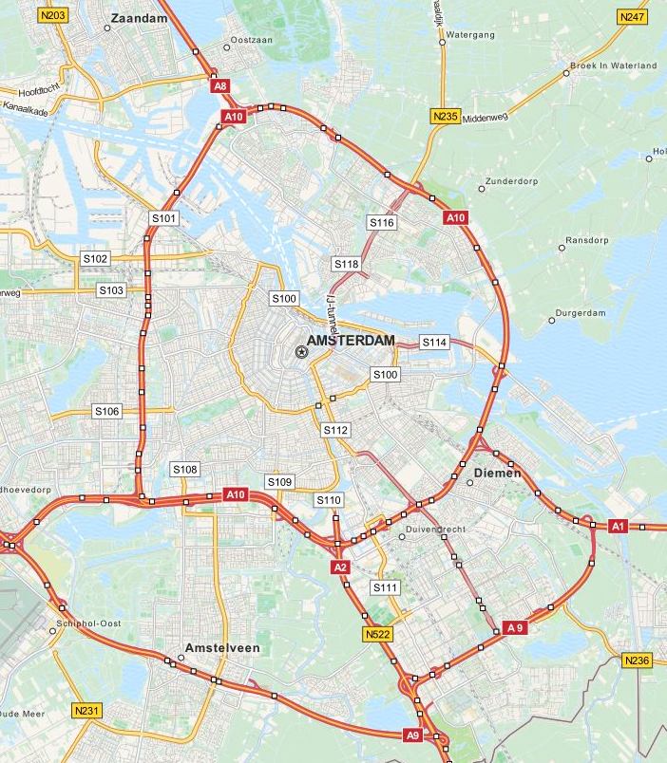
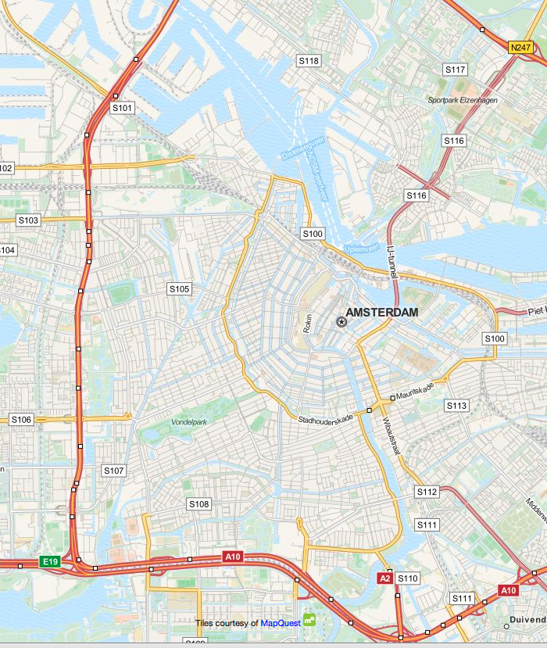
Goal
Describe traffic states and future traffic states
An easy description of traffic allows for large scale control
Idea: describe the flow (speed) as function of nr of vehicles
Use for routing or perimeter control

Slide 4
Traffic flow fundamentals
Flow q (veh/h)
Density k (veh/km)

Slide 5
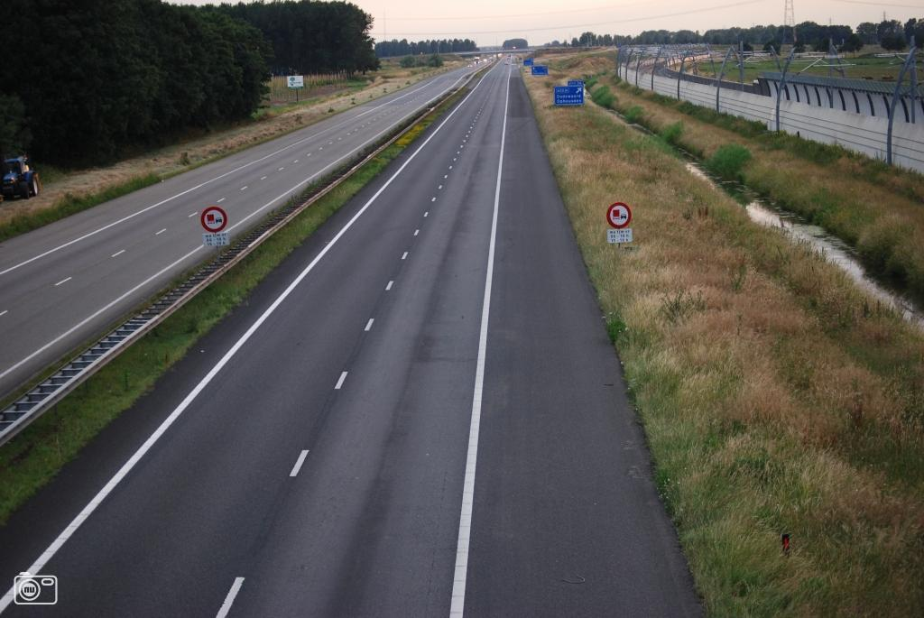

Slide 6
Traffic flow fundamentals
Flow q (veh/h)
Density k (veh/km)

Slide 7
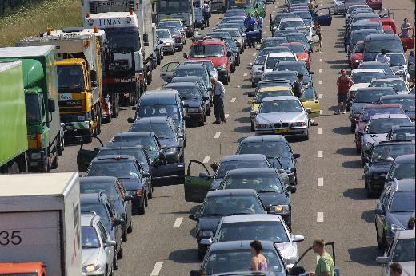

Slide 8
Fundamental diagram
Flow q (veh/h)
Density k (veh/km)

Slide 9
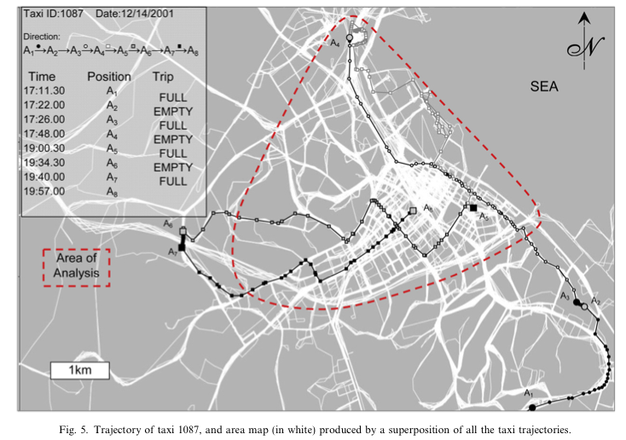
Macroscopic Fundamental Diagram
Average flow
and density in area
Requires
homogeneity
Introduced by
Geroliminis and Daganzo
(2008)

Slide 10
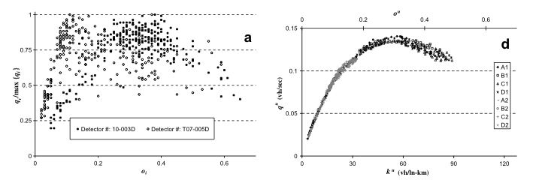
Apparently quite good, but only with homogeneous networks
What would be the effect of inhomogeneity?

Slide 11
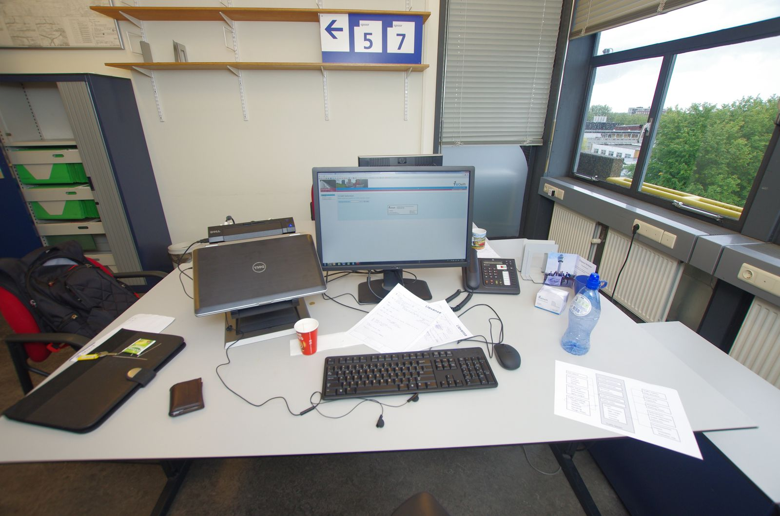
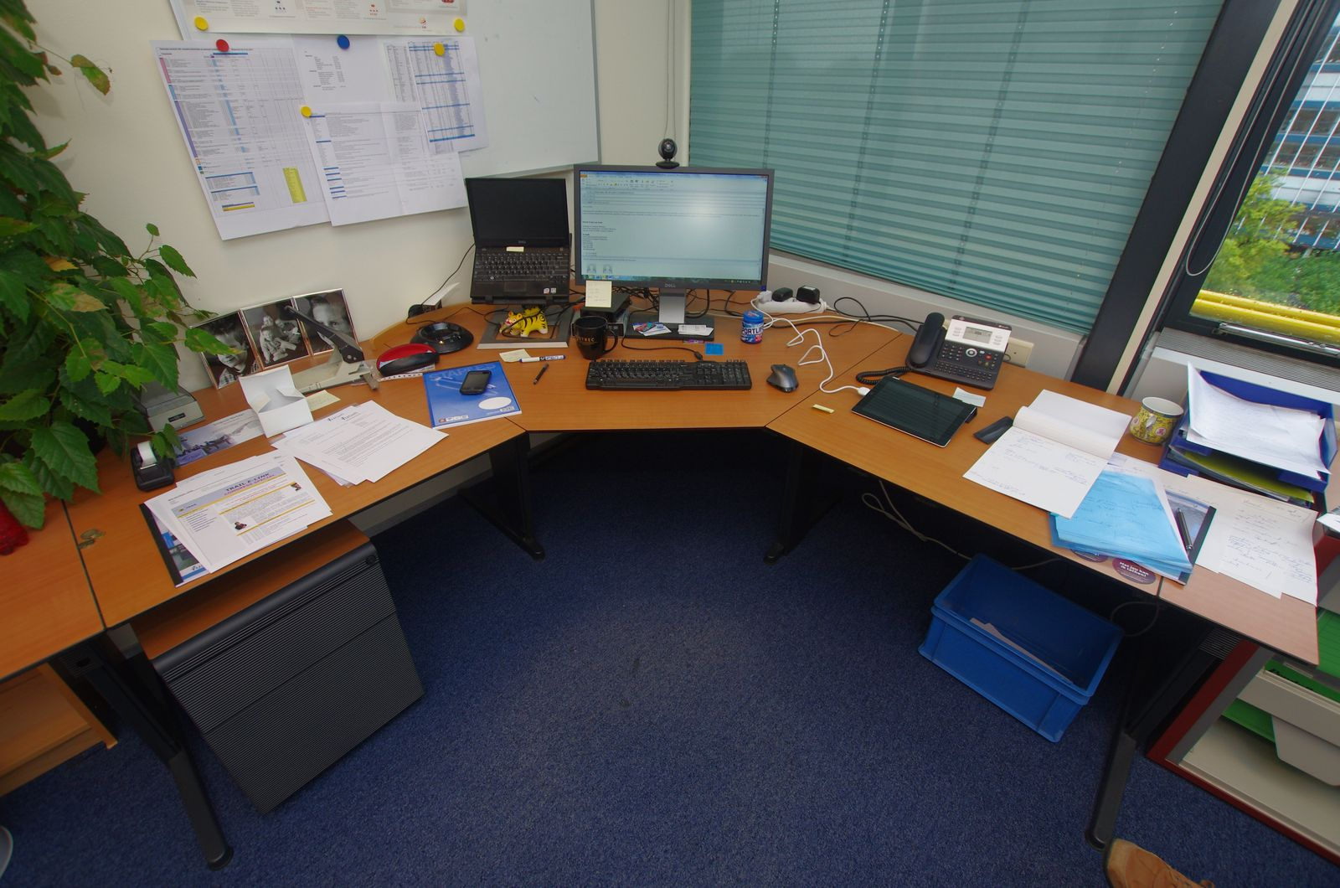
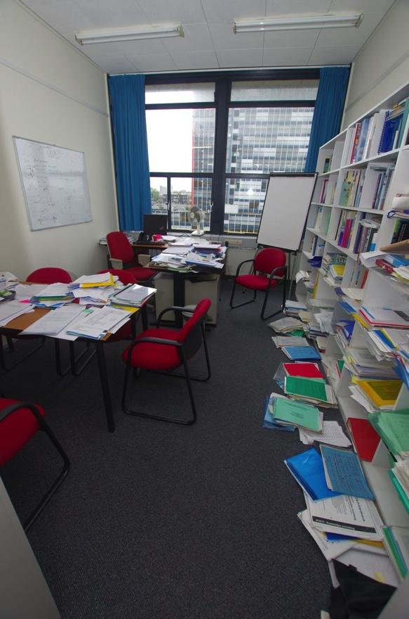
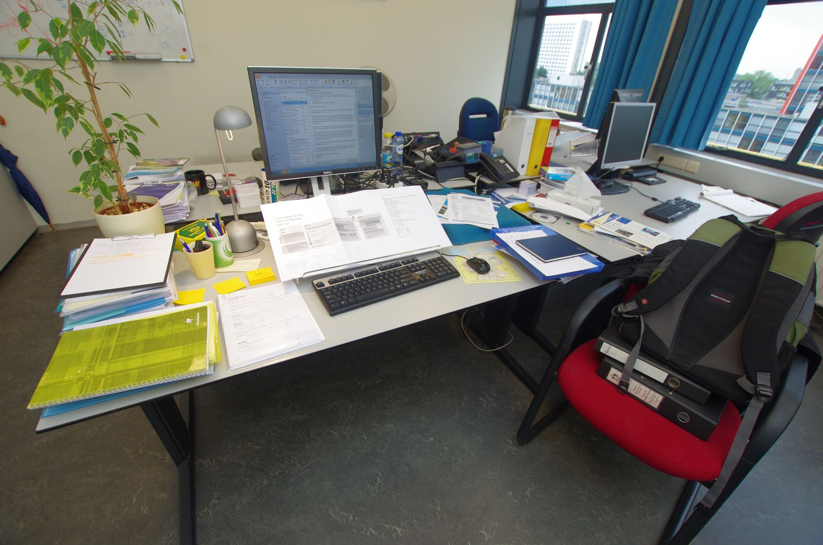
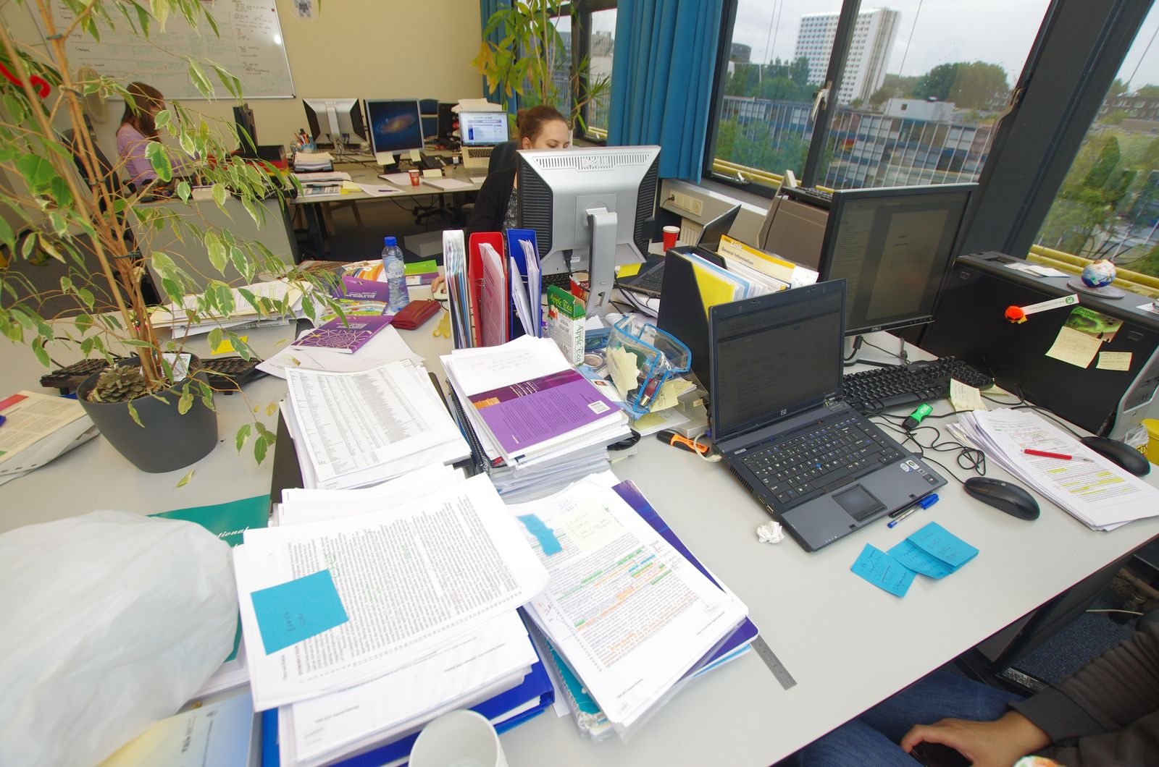
Your desktop

Slide 12
In traffic
Constant nr of vehicles
Dynamics: congestion attracts congestion
“nucleation effect”
Performance decreseas with inhomogeneity

Slide 13
Empirical evidence
A10 motorway

Slide 14
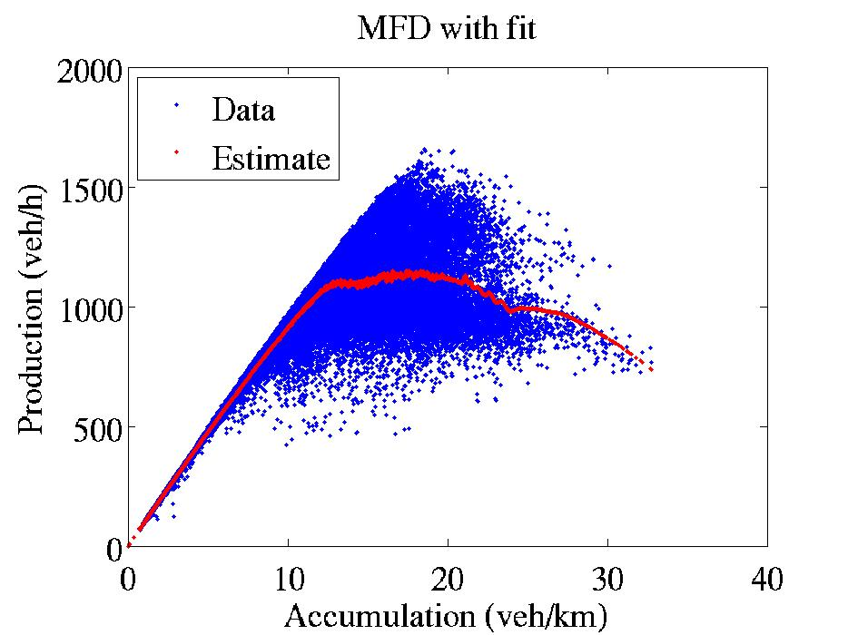
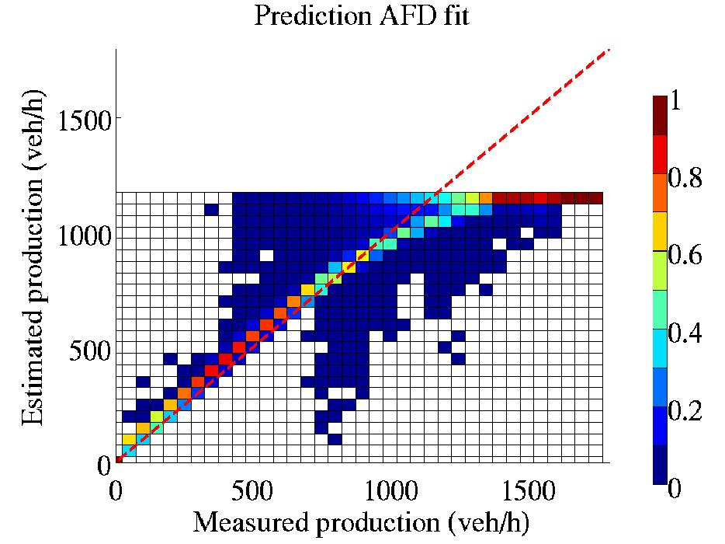
Fit and predictive power
Severe underestimation
of production near capacity

Slide 15
Including inhomogeneity
P(A)=A*(c₁+c₂A+c₃A²)-c₄σ
Production
Production
Accumulation
Accumulation
Homogeneous traffic situation
Inhomogeneous traffic situation

Slide 16
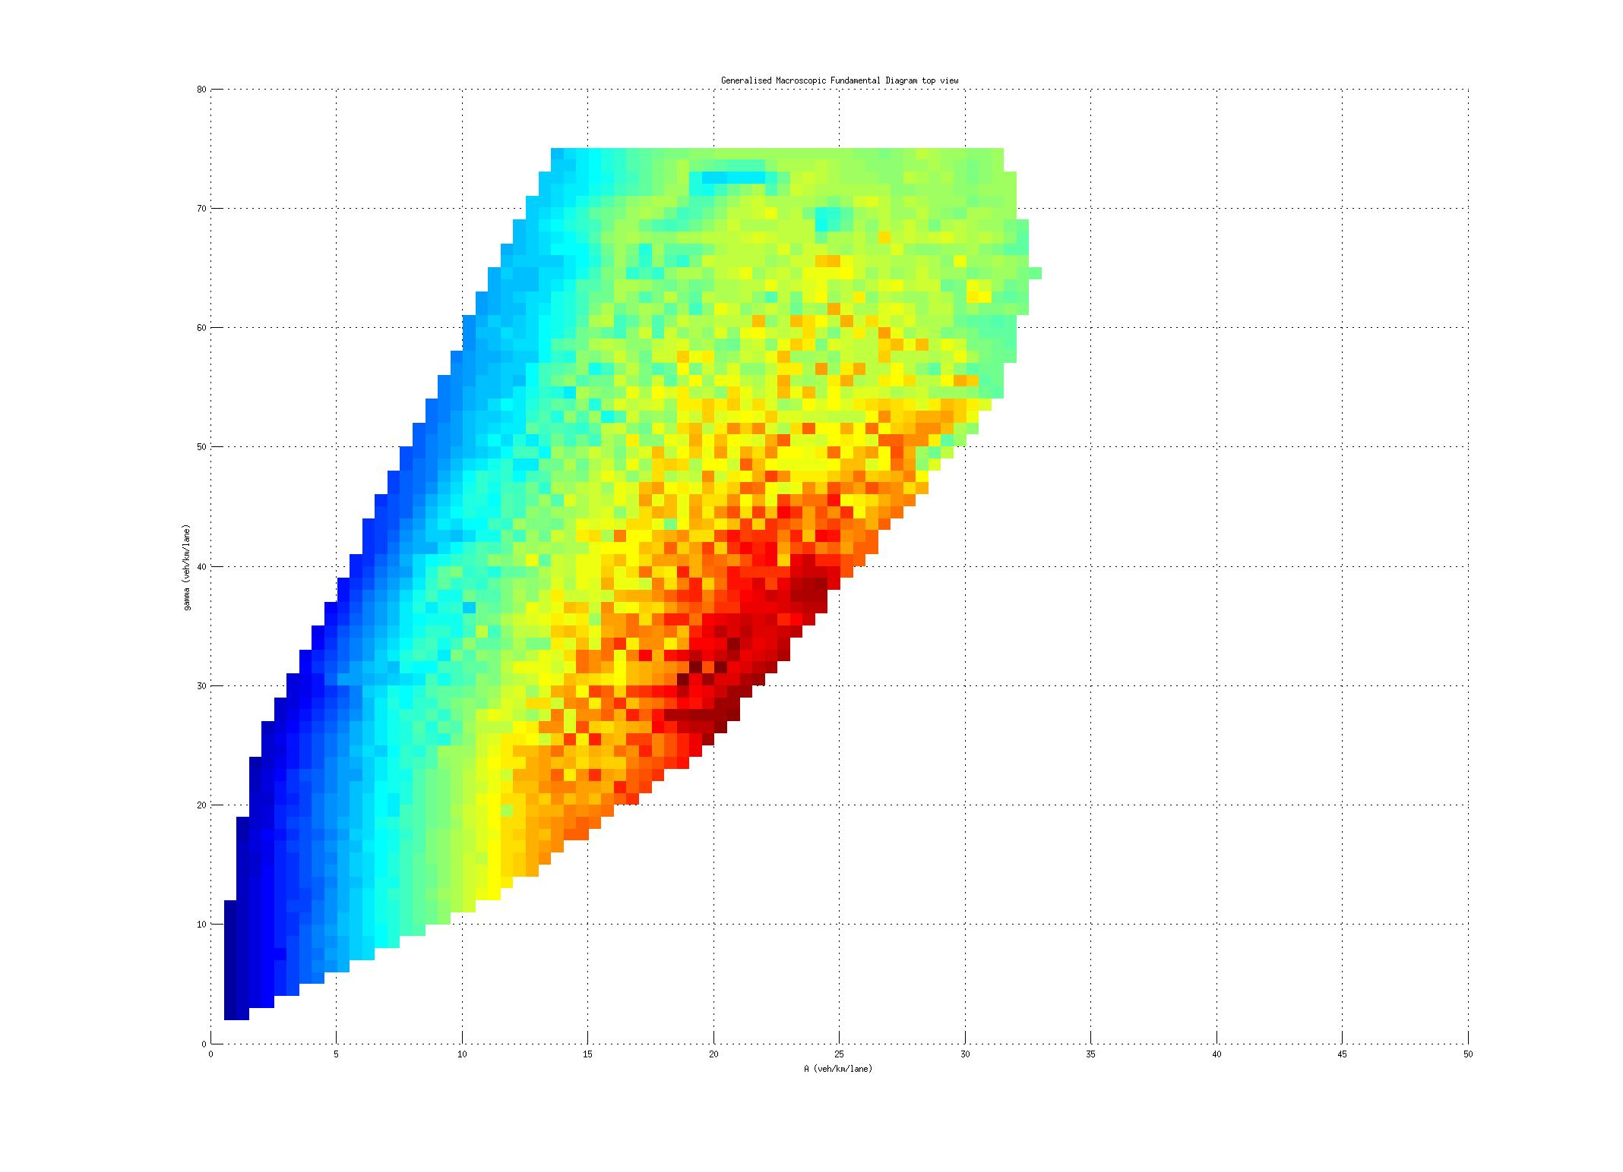
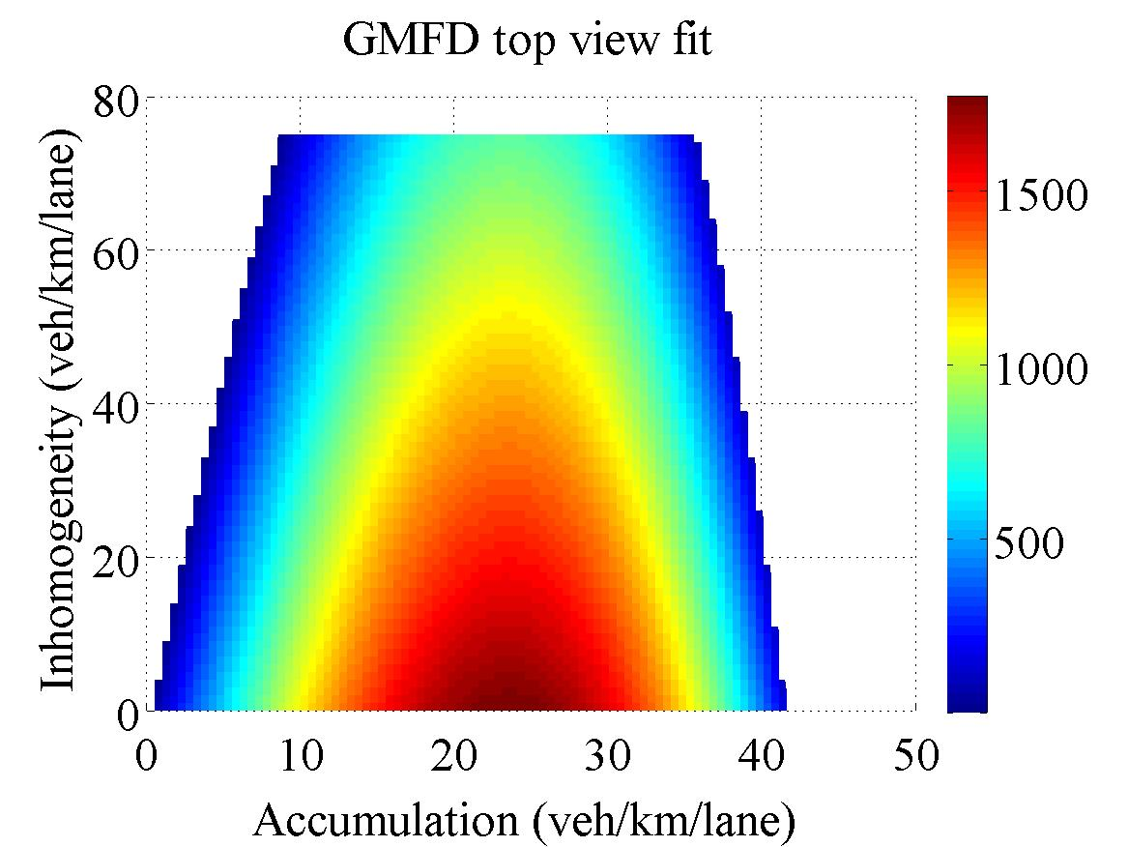
Empirical evidence
Inhomogeneity =>
Accumulation =>

Slide 17
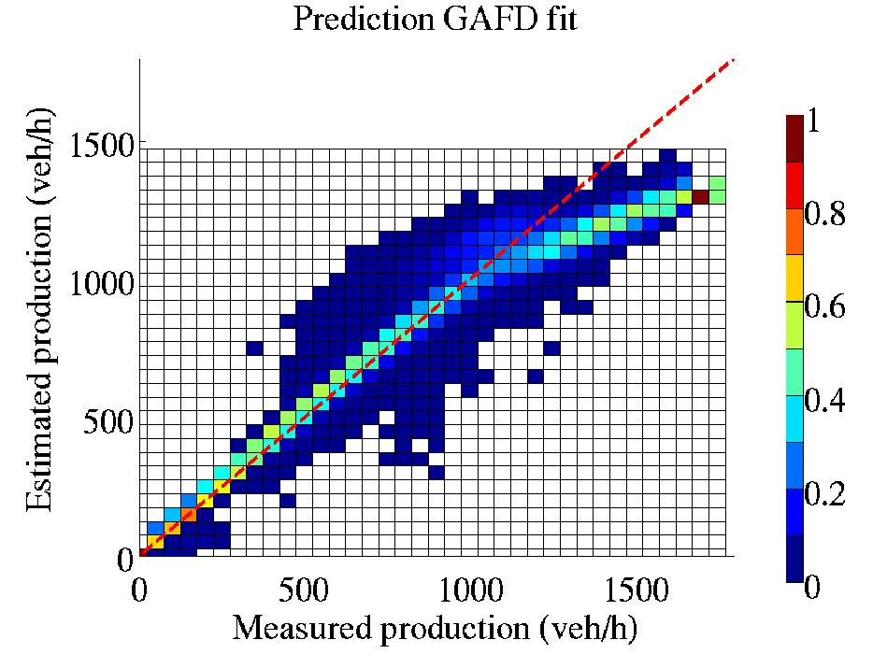
Fit and predictive power (2)
Fit much better
Bias much smaller

Slide 18
Use in traffic optimization
Buffer traffic to ensure maximum outflow to motorway
Hold traffic further upstream, e.g.
Production
Orange
Production
Red
Green
Orange
Red
Black
Green
Black
.5 A_{c}
A_{c}
(Ac+A_{max})/2
A_{max}
A_{c}
A_{max}
.5 A_{c}
(Ac+A_{max})/2
Accumulation
Accumulation

Slide 19
Conclusions
Traffic flow can be descibed at a high (area-wide) level
Explanatory variables: accumulation & inhomogeneity
Traffic congestion starts in
one point and attacts more congestion: nucleation

Slide 20
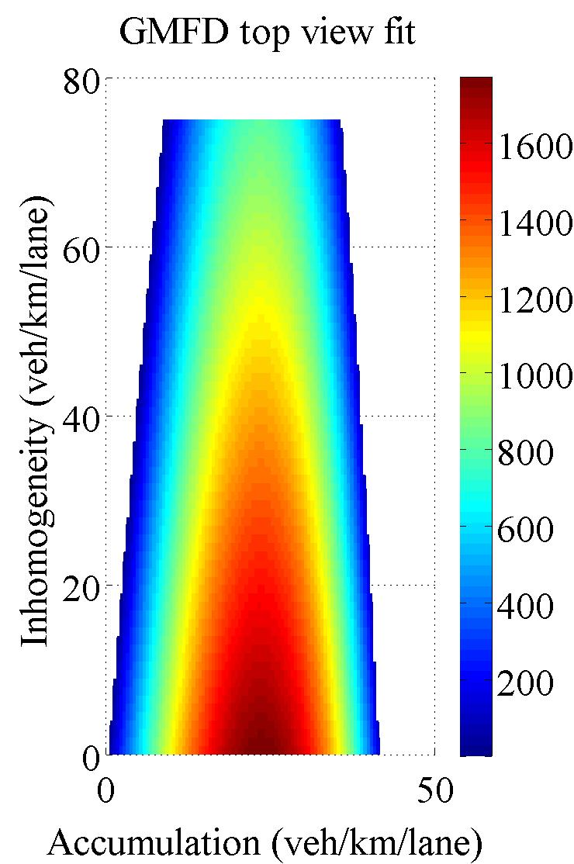
Use for your desktop
✗
1
4
2
3
5

