Slide 1
Traffic Network Guidance using Area Accumulation and Spatial Variation in Density
Victor L. Knoop, Hans van Lint, Serge P. Hoogendoorn
Sponsors: Foundation Next Generation Infrastructures
IIP-CC subsidy by ICTregie/NWO

Slide 2
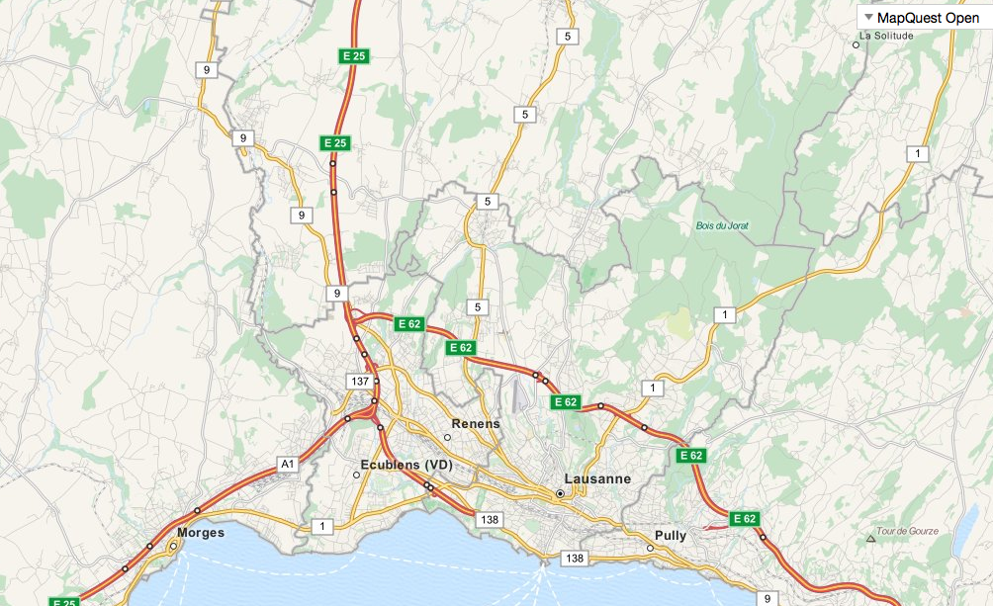
Contribution
Network fundamental diagram studied and empirically checked
Earlier: route guidance by accumulation
Now: improvement by adding spatial inhomogeneity?
Use: Less data Less computation time Less parameters => simple and reliable!
Improvement: Almost as good as speed data

Slide 3
Data increase with scale
Data requirement increases with scale
Time horizon increases with scale
Solution space increases with scale
Amount of data =>
Simple relationships are needed
Size of area =>

Slide 4
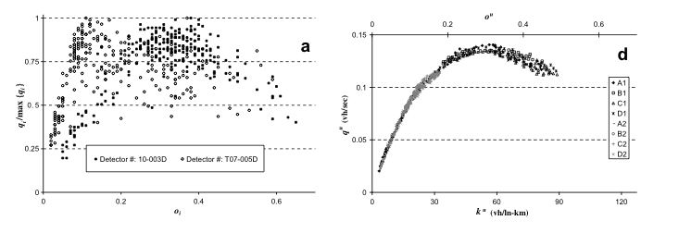
Stochasticity in local data
Macroscopic fundamental diagram
“Average” fundamental diagram for an area
(Avg.) Flow =>
Density Average density
Fig: (Geroliminis and Daganzo)

Slide 5
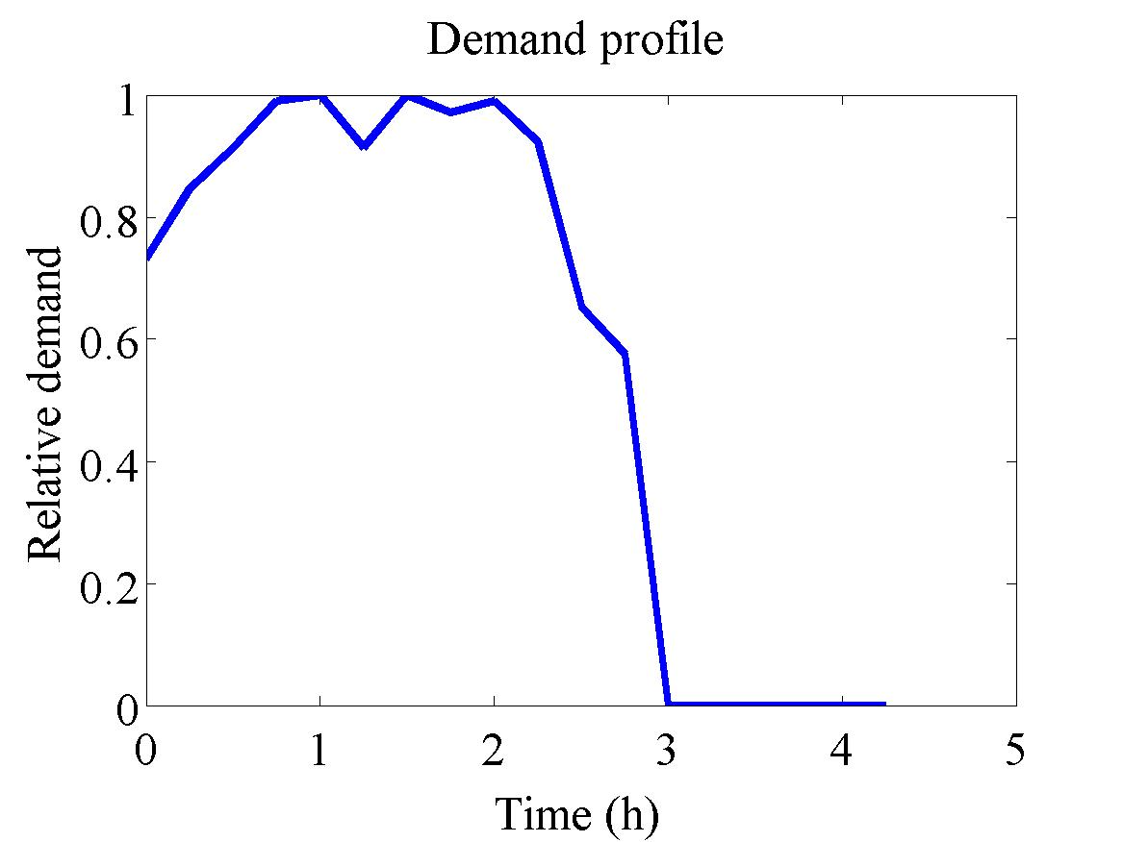
Network with periodic boundary

Slide 6
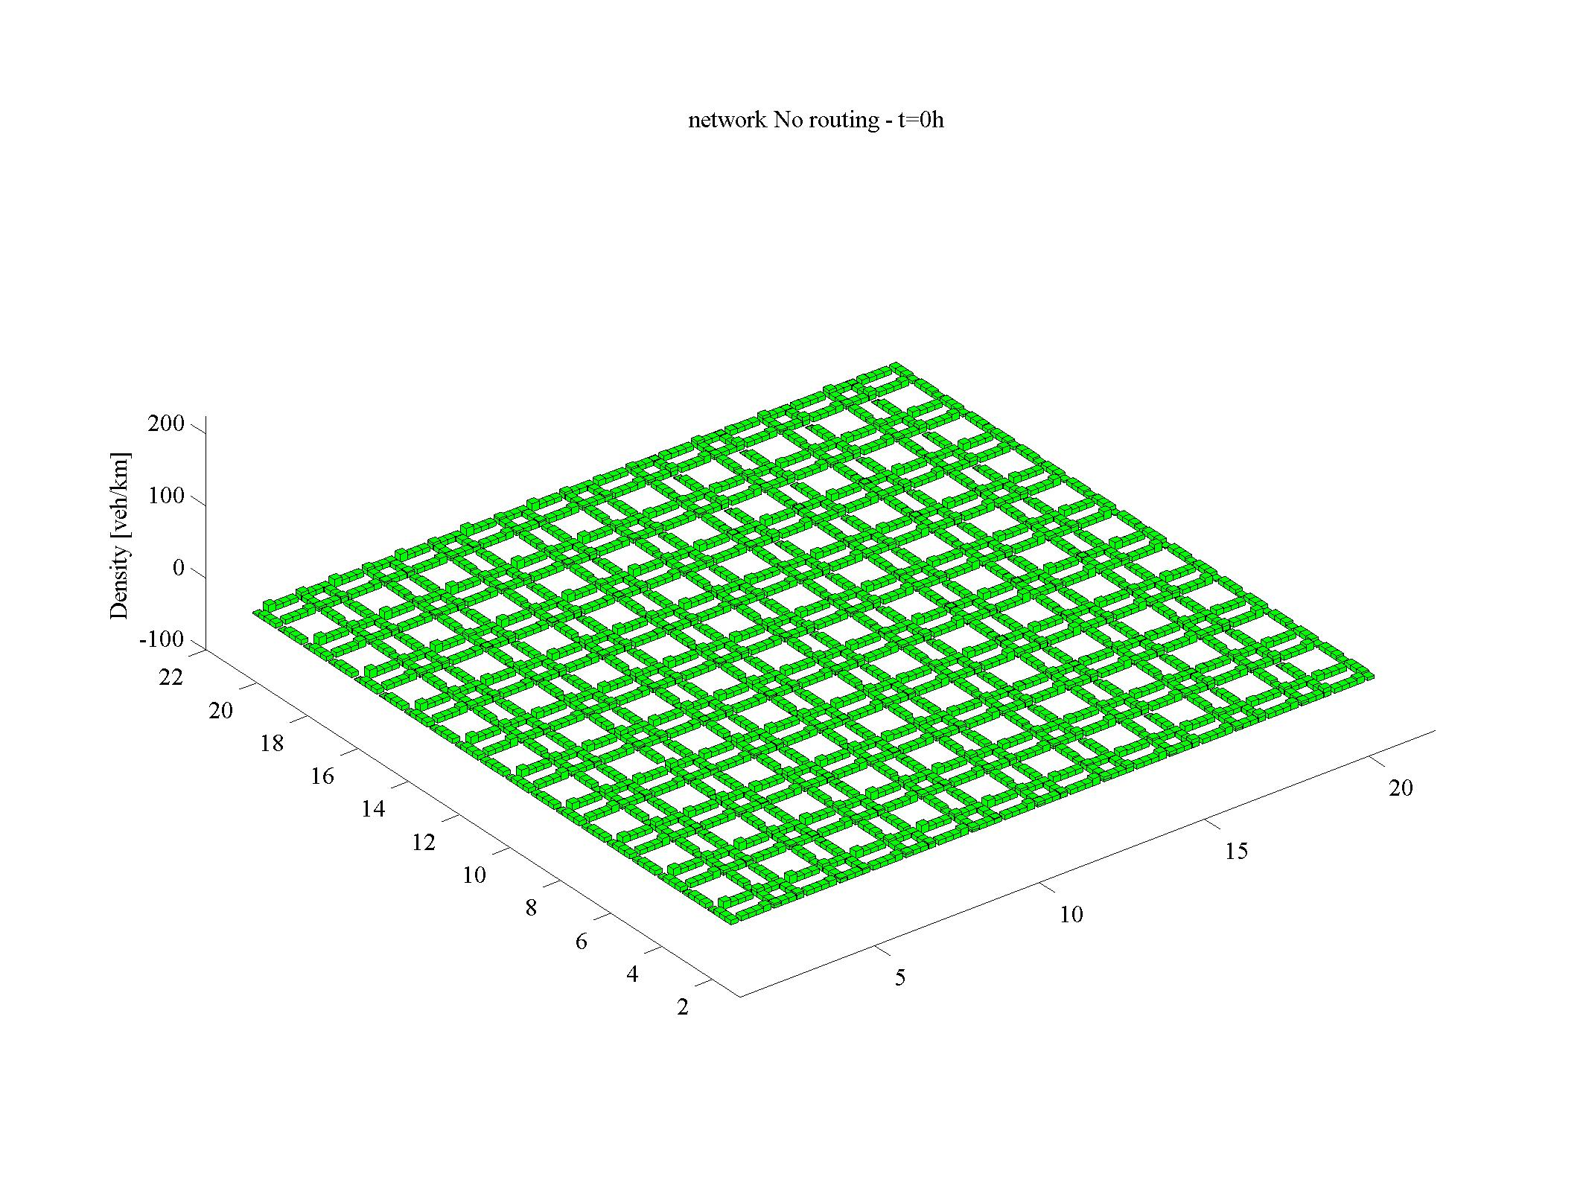
Build up of congestion

Slide 7
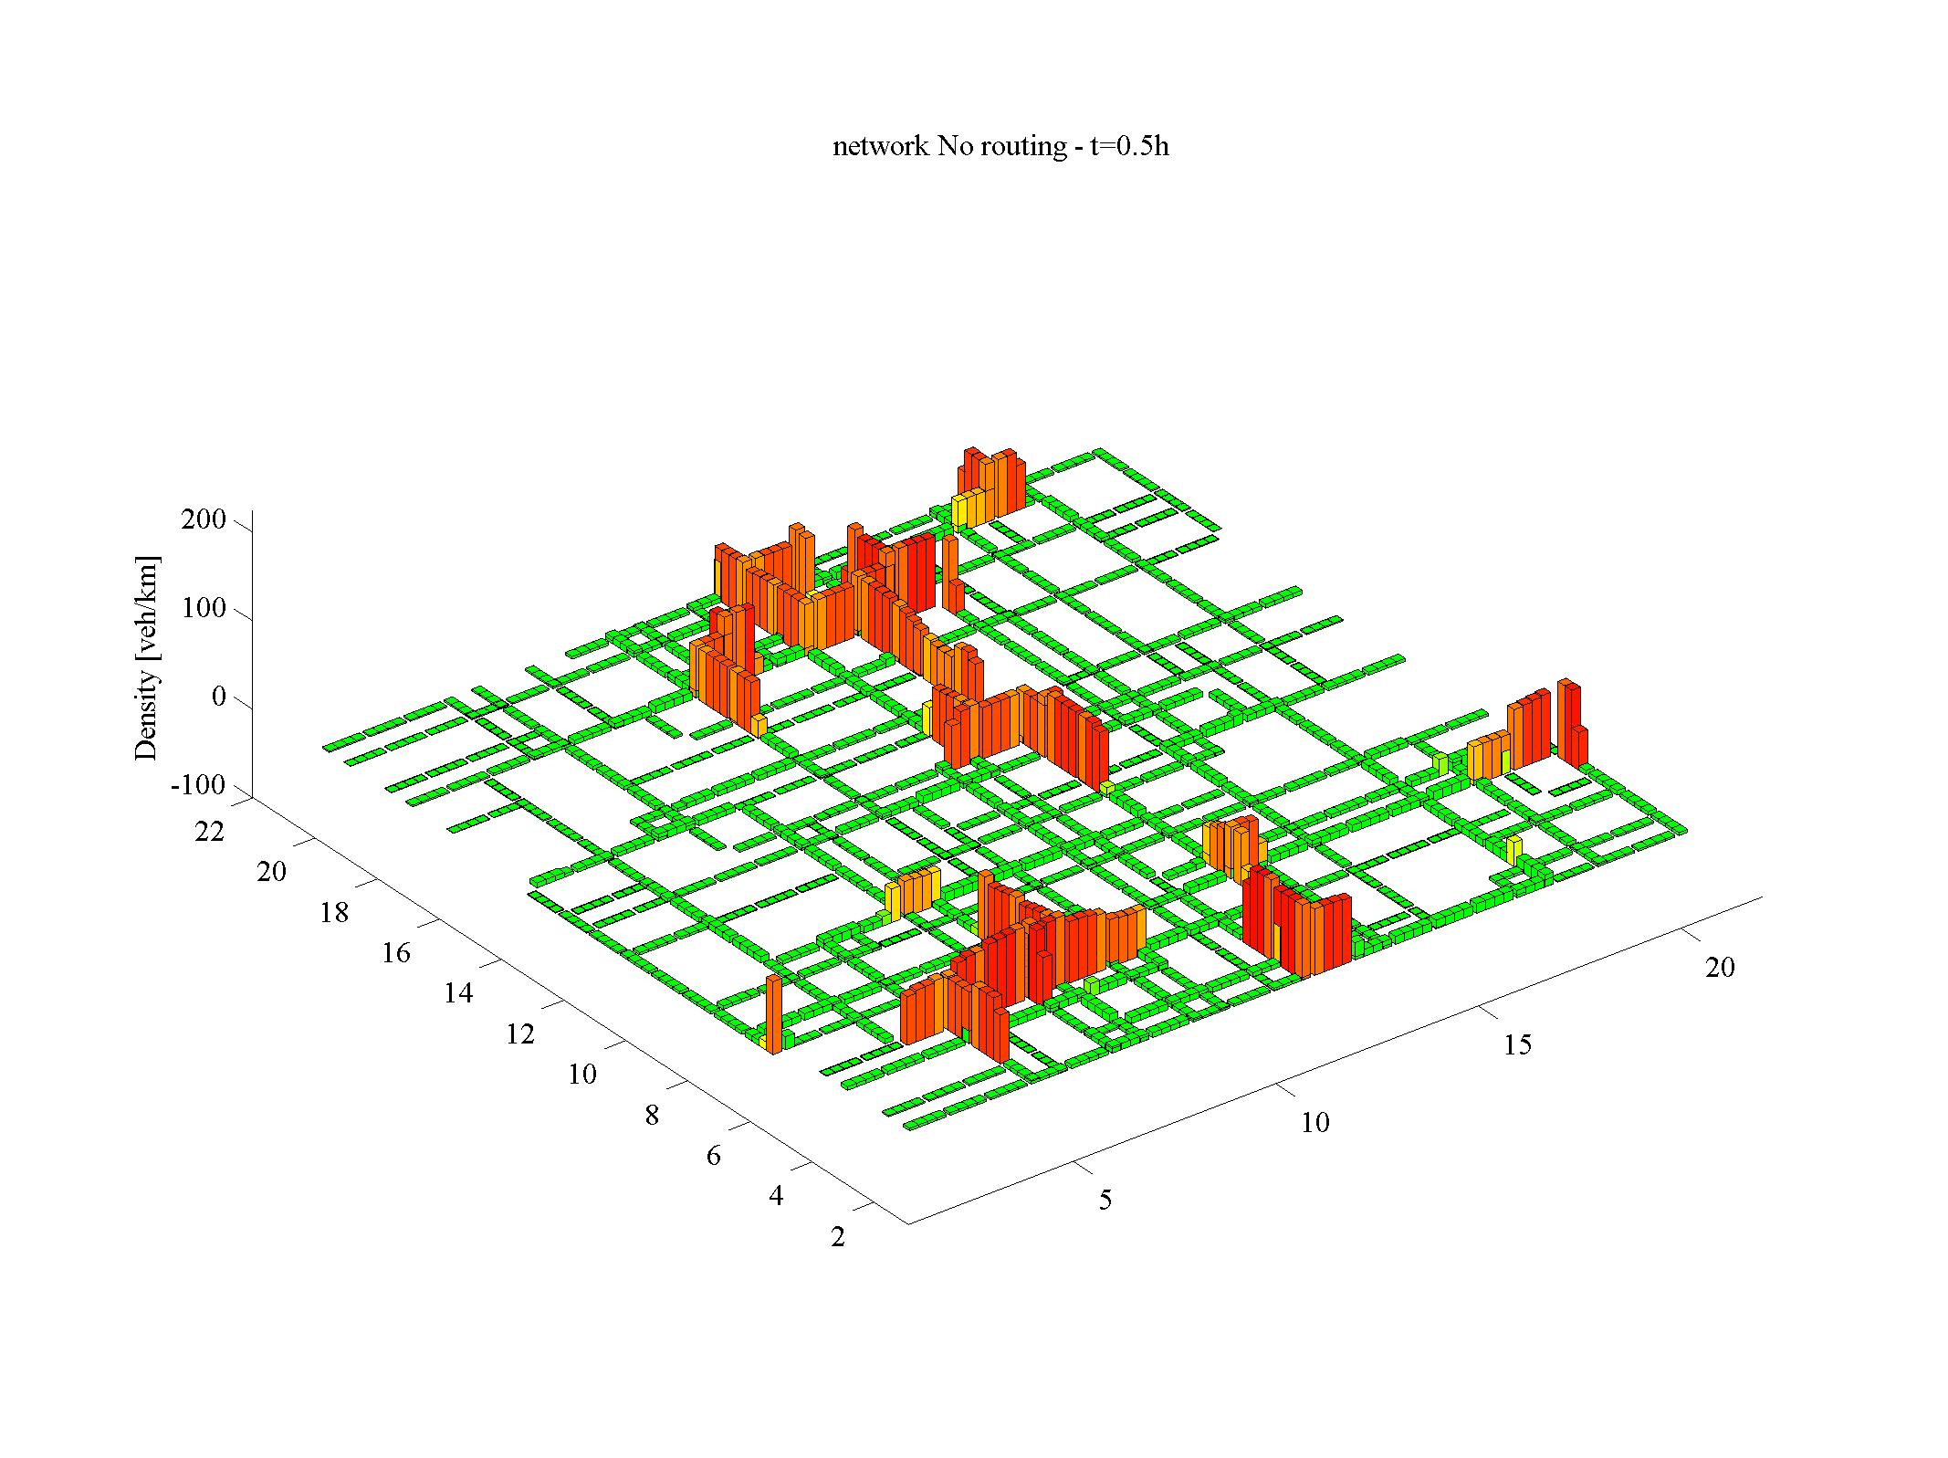

Slide 8
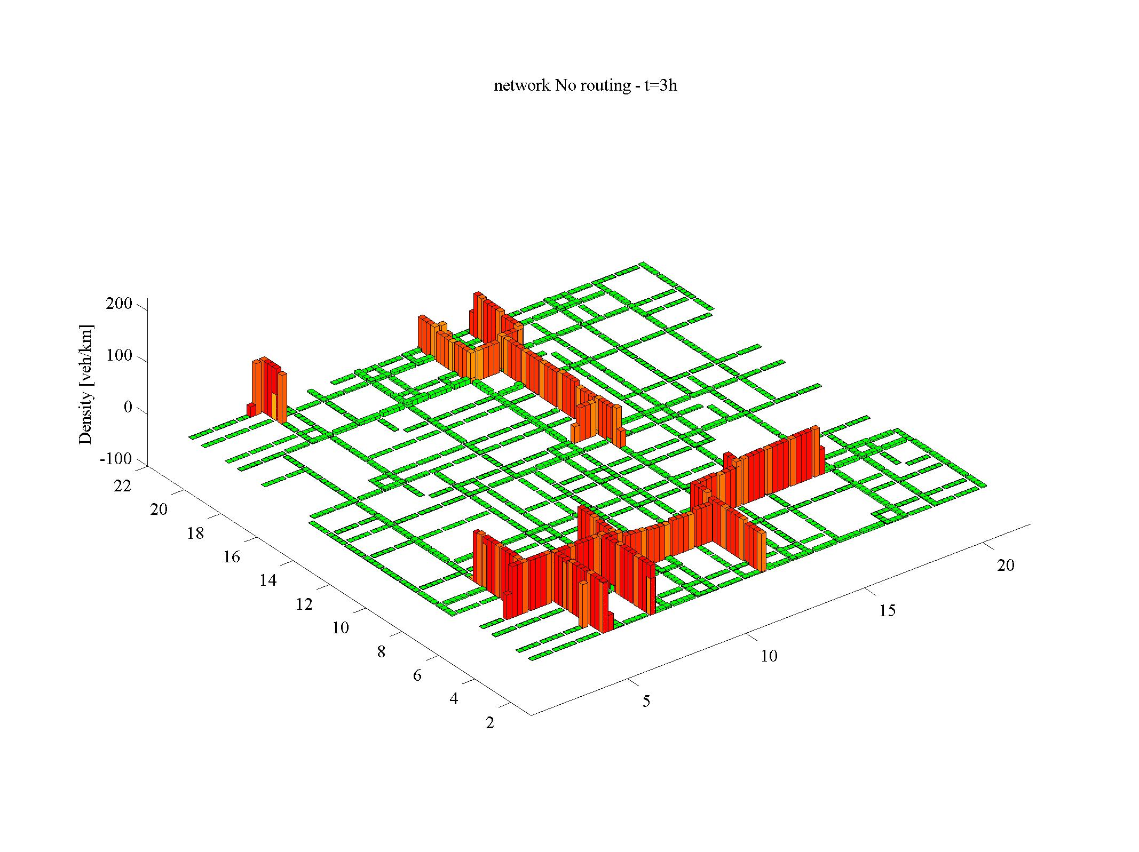

Slide 9
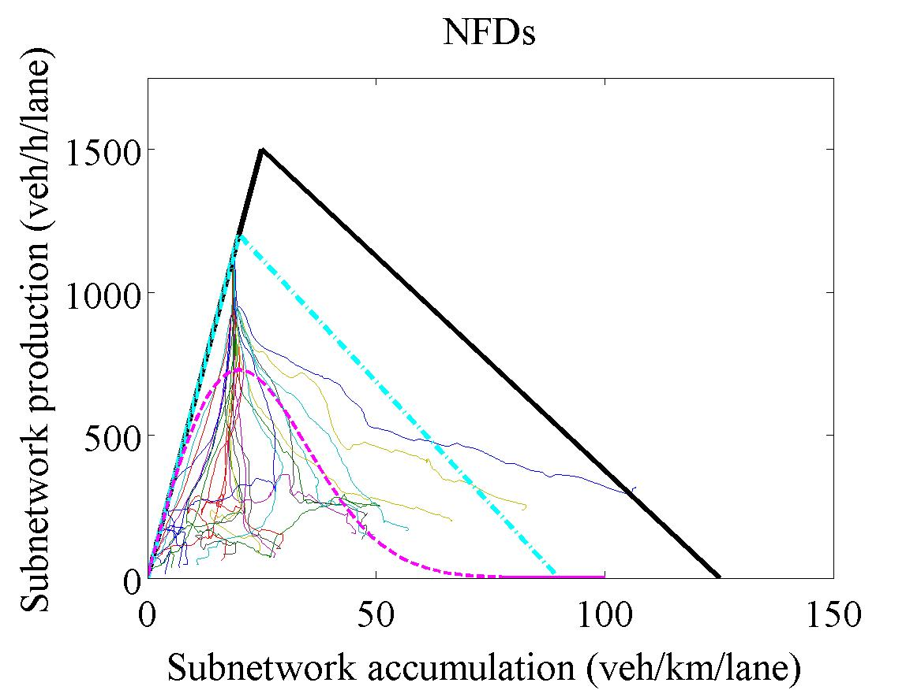
Resulting NFDs?
Still scattered
hysteresis?
2nd expanatory variable: stdev of density
Generalised Network Fundamental Diagram

Slide 10
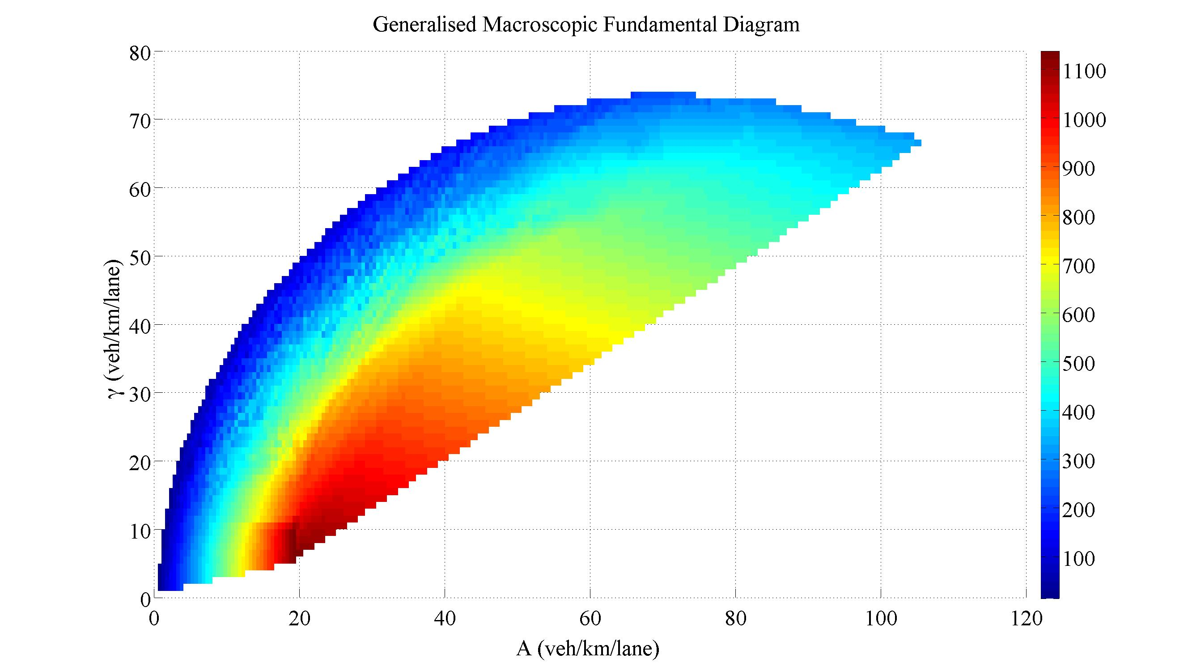
Improvement: Generalised NFD
Std of density=>
Accumulation =>

Slide 11
Methodology
Test different routing strategies
In a macroscopic simulation program
Routing in a grid network
Shortest path (distance)
Shortest path (time)
Area-based
Average speed
Network Fundamental Diagram
Generalised Network Fundamental Diagram
Reference

Slide 12

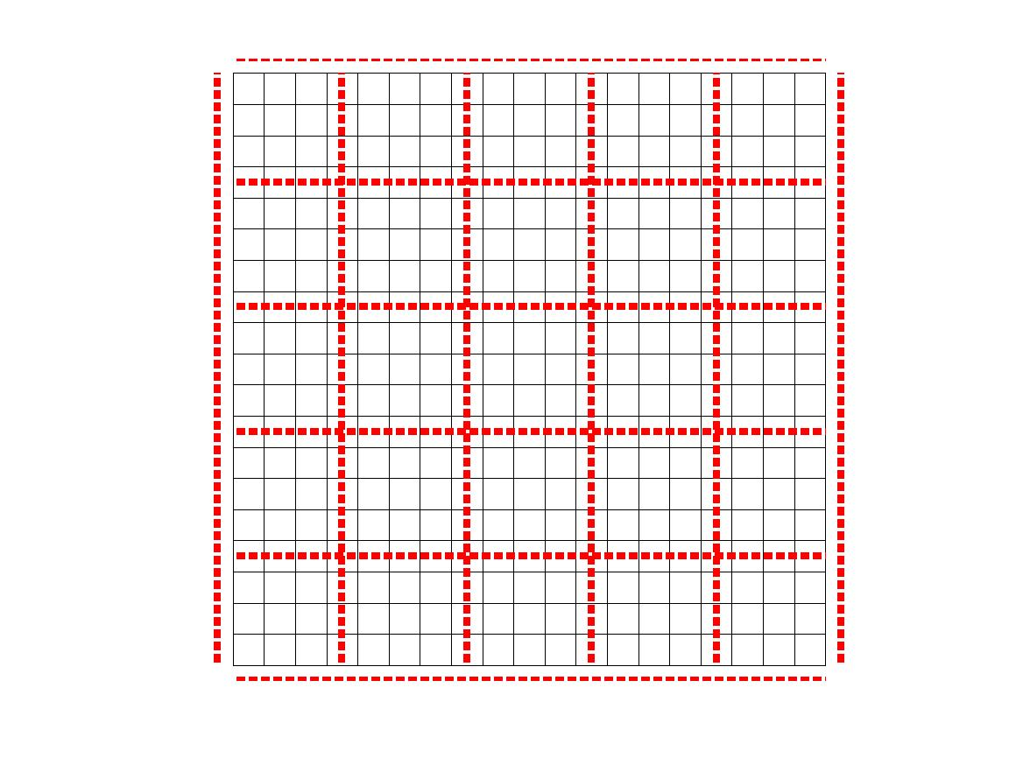
Create subnetworks

Slide 13
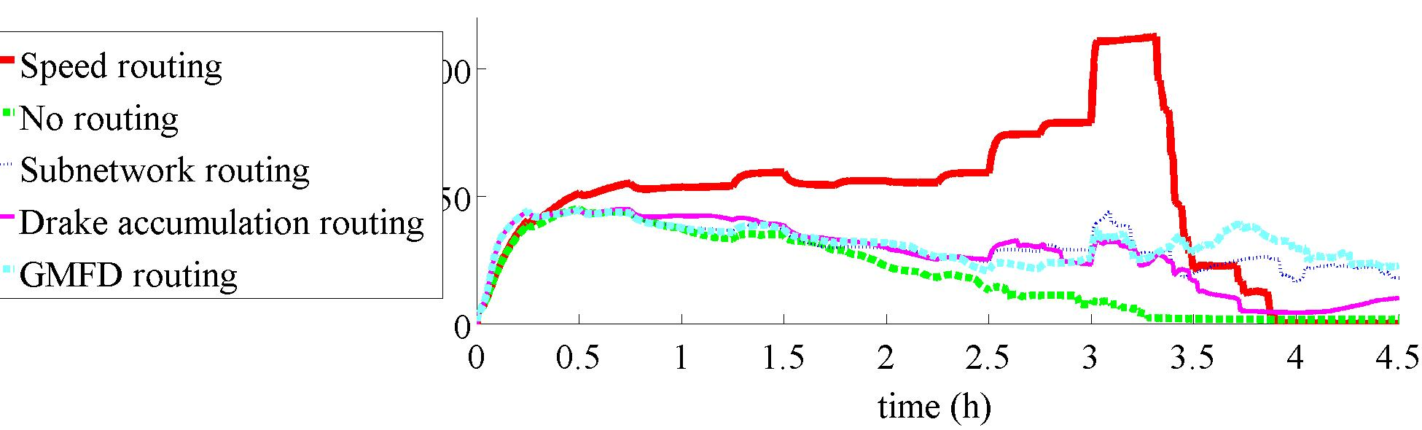
Good network performance
Less than with “full routing”
Factor 100 less data / computations needed

Slide 14
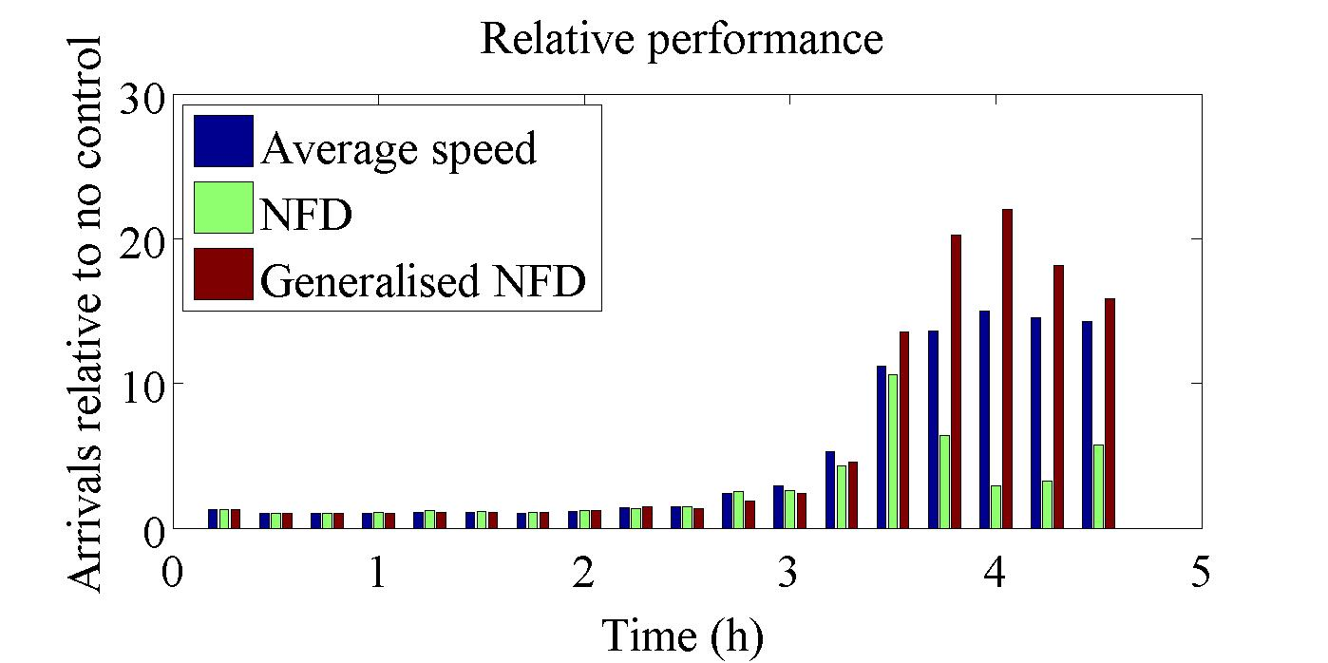
Good network performance (2)
Relative to no routing
NFD relatively poor
GNFD on par with full speed (and sometimes better!)

Slide 15
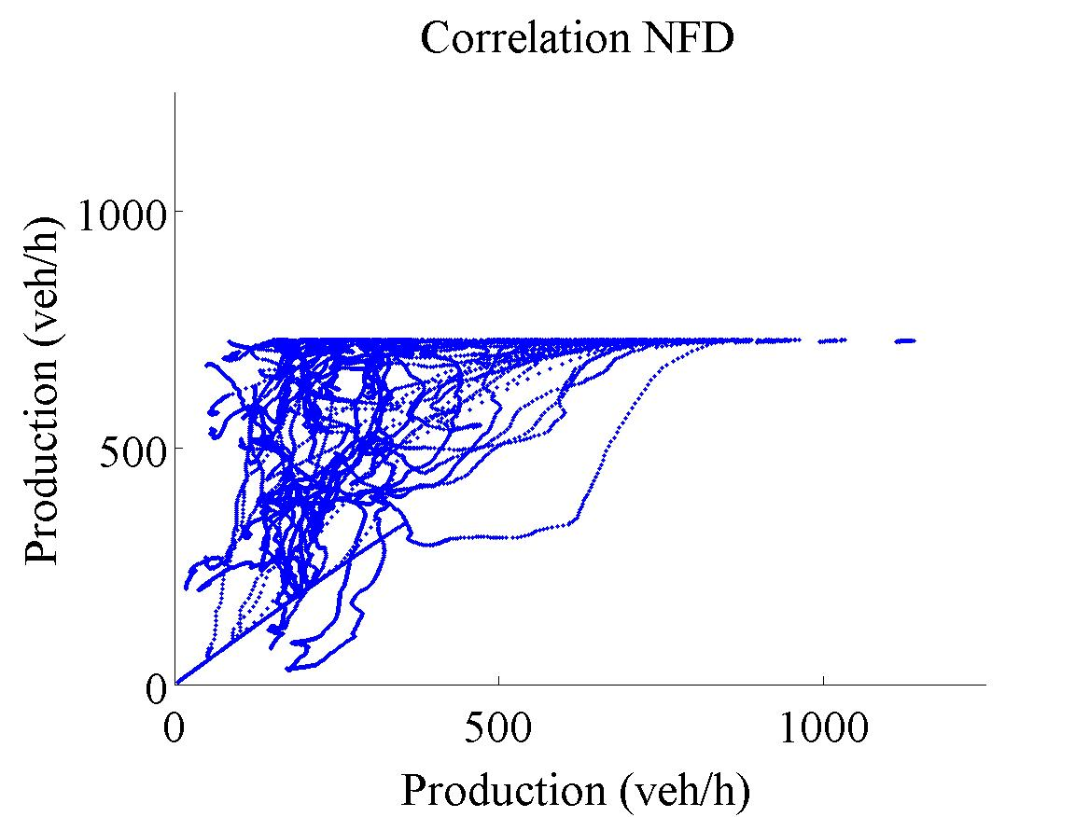
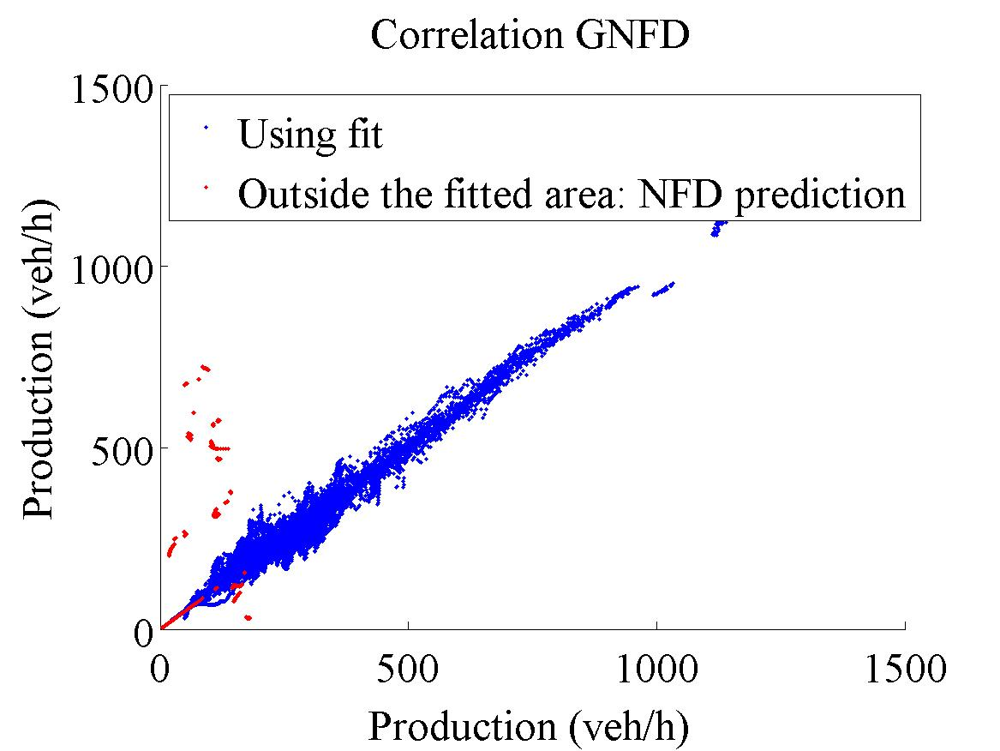
Performance similar to mean speed – but why?
Similar arrivals due to perfect speed prediction
Best Network Fundamental Diagram
Generalised Network Fundamental Diagram
R²=0.42
R²=0.98

Slide 16
Conclusions
Traffic control using the Generalised NFD is possible
Performance lower than detailed routing because
Less routing possibilities
Aggregation effects
…and NOT because of a bad speed prediction
Speed prediction is excellent
Future work:
Predict future speeds (model predictive control)

Slide 17
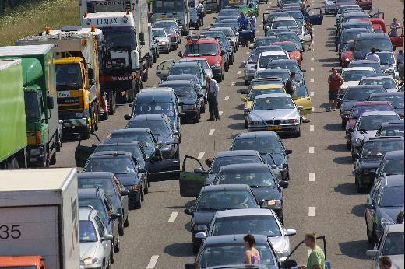
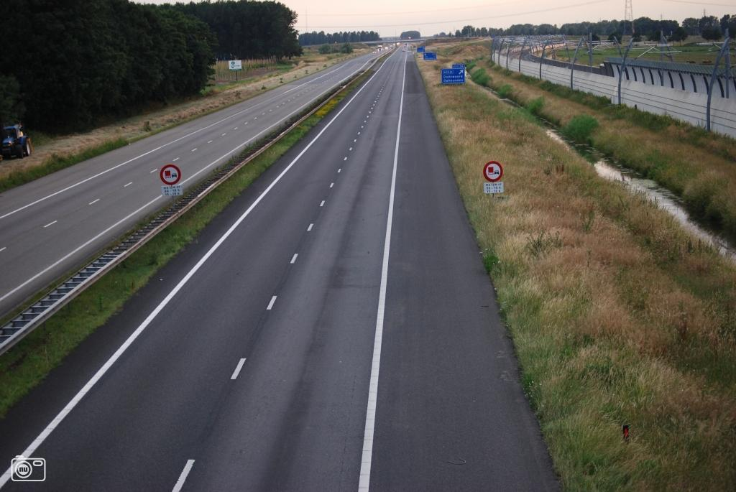
Traffic flow characteristics - links
1 veh / 1.5 s
Flow q (veh/h)
85 km/h
150 veh/km/lane
Density k (veh/km)

Slide 18
Control?
Routing through subnetworks

Slide 19
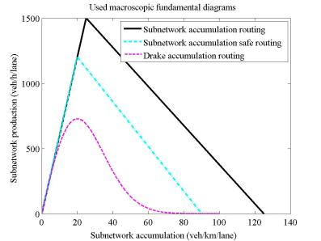
Assume subnetwork speeds
Shortest path (distance)
Shortest path (time)
Area-based
Average speed
Macroscopic Fundamental Diagram approaches
Same as links
Lower in flow
With tail

Slide 20
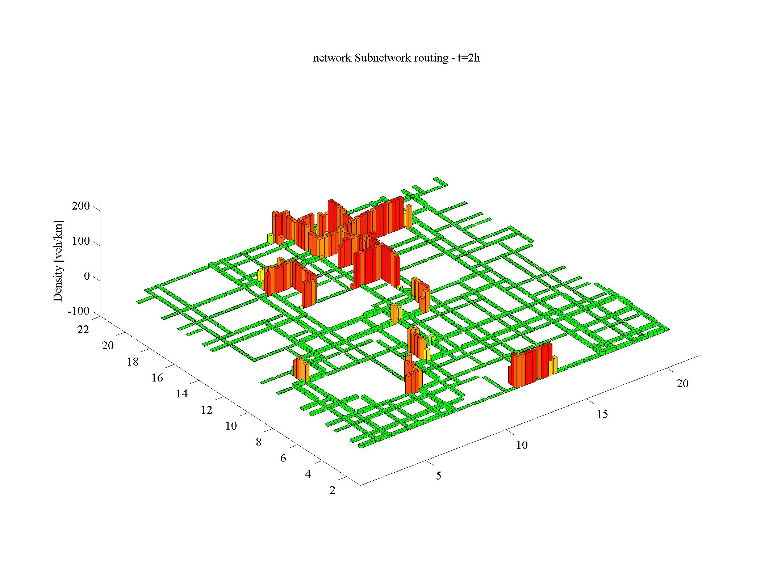
Build up of congestion

Slide 21
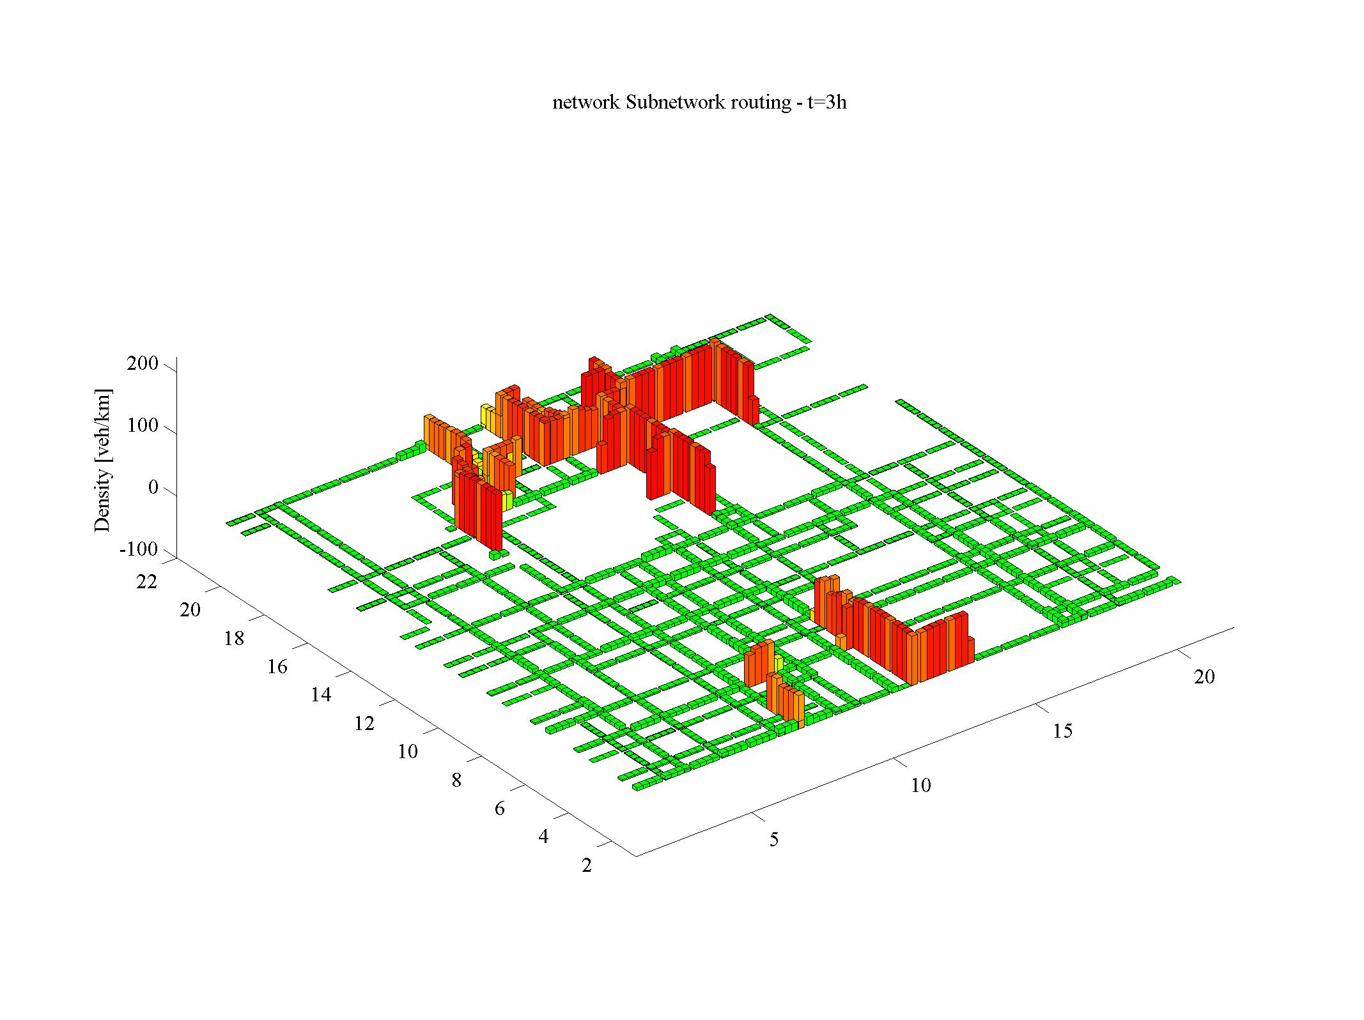
Build up of congestion

Slide 22
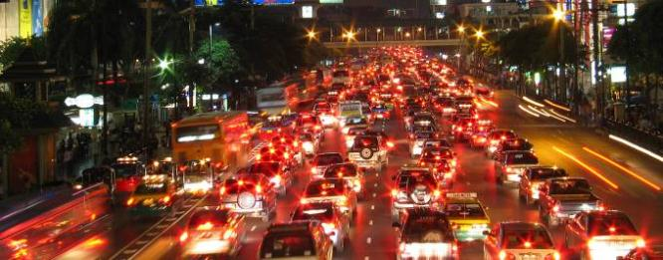
Conclusions en future research
Performance reduces with clustering of congestion
Route advise based on subnetwork variables works
MFD with “tail” works good
Does a real network show the same relationship?
How about traffic prediction?

Slide 23

Q&A

