Slide 1
Empirics of a Generalized Macroscopic Fundamental Diagram for Urban Freeways
Victor L. Knoop, Serge P. Hoogendoorn

Slide 2
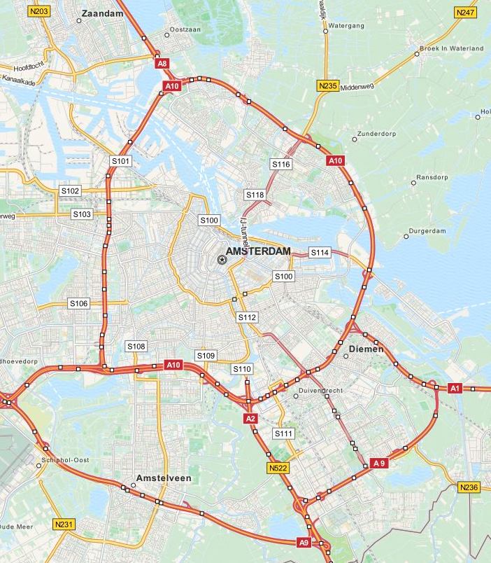
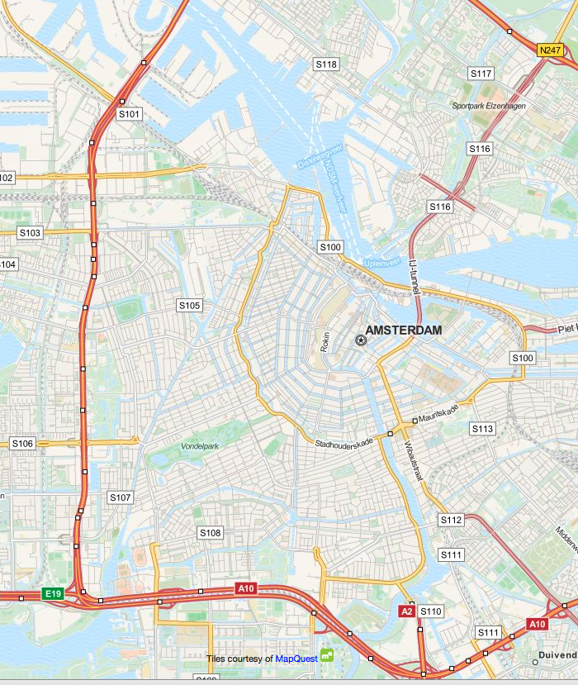
Goal
Describe traffic states and future traffic states
An easy description of traffic allows for large scale control
MFD: describe the flow (speed) as function of nr of vehicles
Use for control: routing, perimeter control

Slide 3
Macroscopic Fundamental Diagram
Apparently quite good, but only with homogeneous networks
Main questions
1) Can produciton for inhomogeneous traffic conditions be described by an MFD?
2) How to quantify the effect of inhomogeneity
=> Emperical observations

Slide 4
Empirical study – site
A10 freeway
21 km
10 months, daytime
Mostly 3 lanes
80-100 km/h speed limit
Dual loop detectors
<500 meter sections
Speed, density => accumulation & production

Slide 5
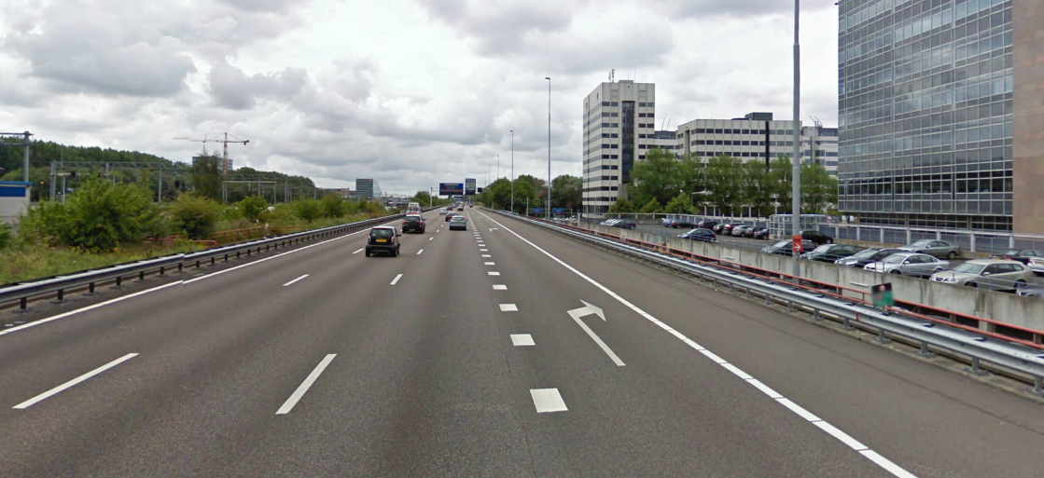
Road impression

Slide 6
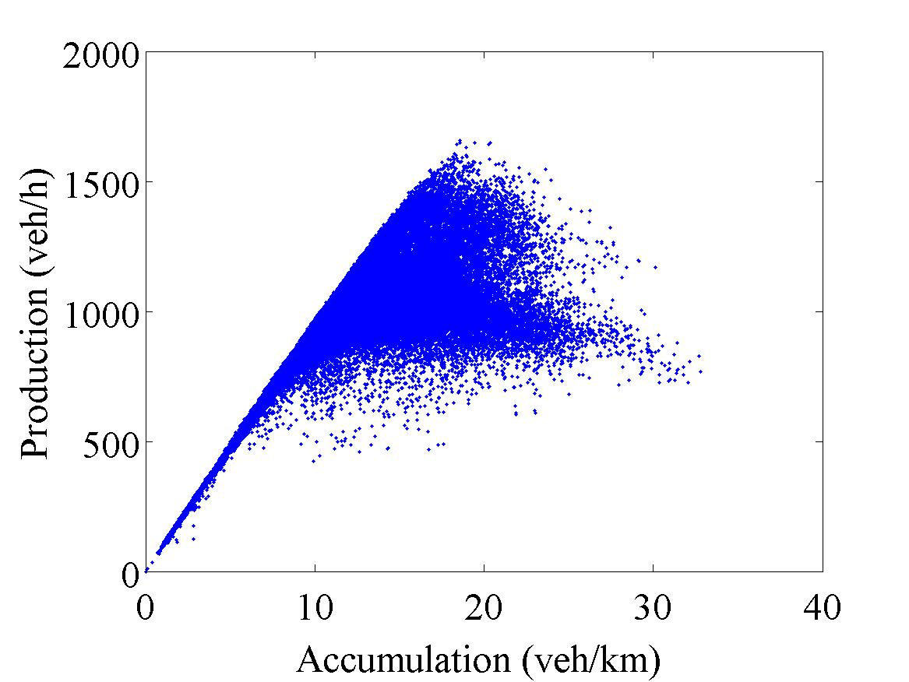
Predicting production: methodology
Split data set (calibration/validation)
Create MFD
For validation set: predict production based on accumulation using MFD

Slide 7
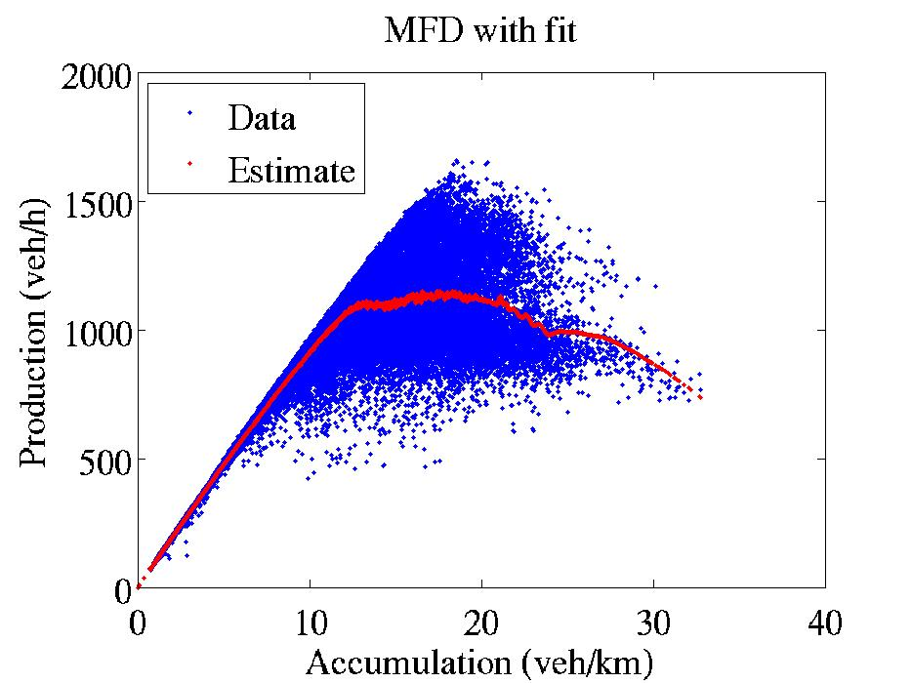
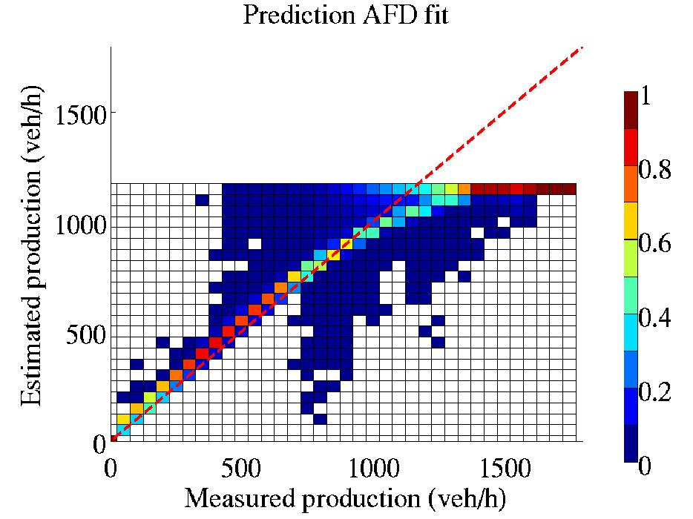
Fit and predictive power
Moving average
Severe errors in estimation of production near capacity

Slide 8
Generalized MFD
Production as function of accumulation and inhomogeneity
Inhomogeneity expressed as stdev of density
Production =>
Inhomogeneity =>
Accumulation =>

Slide 9
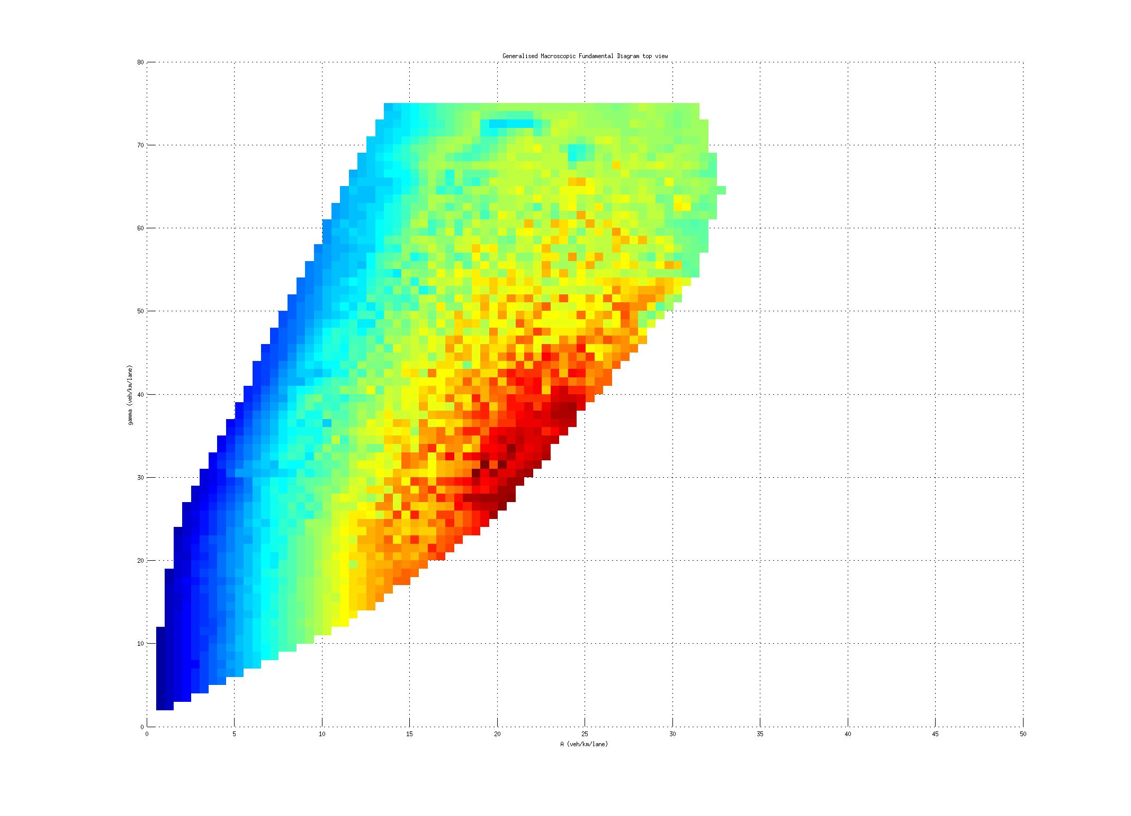
Generalized MFD
Color = production
Interpolation as predictor
Measure accumulation & inhomogeneity => predict production
Inhomogeneity =>
Accumulation =>

Slide 10
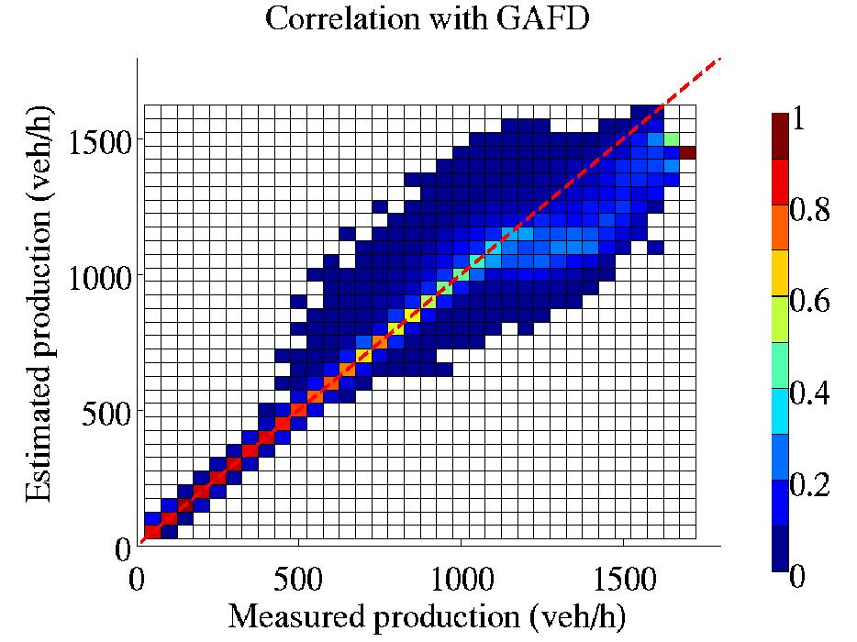
Quality of prediction
Predicted by interpolation

Slide 11
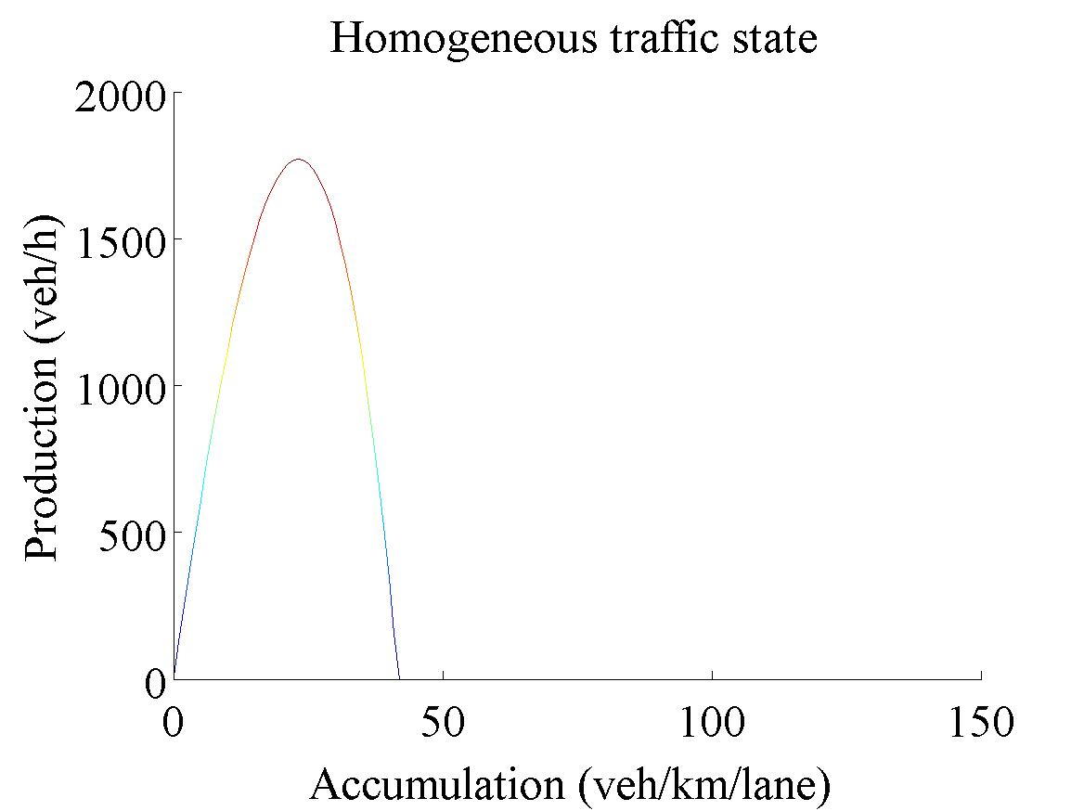
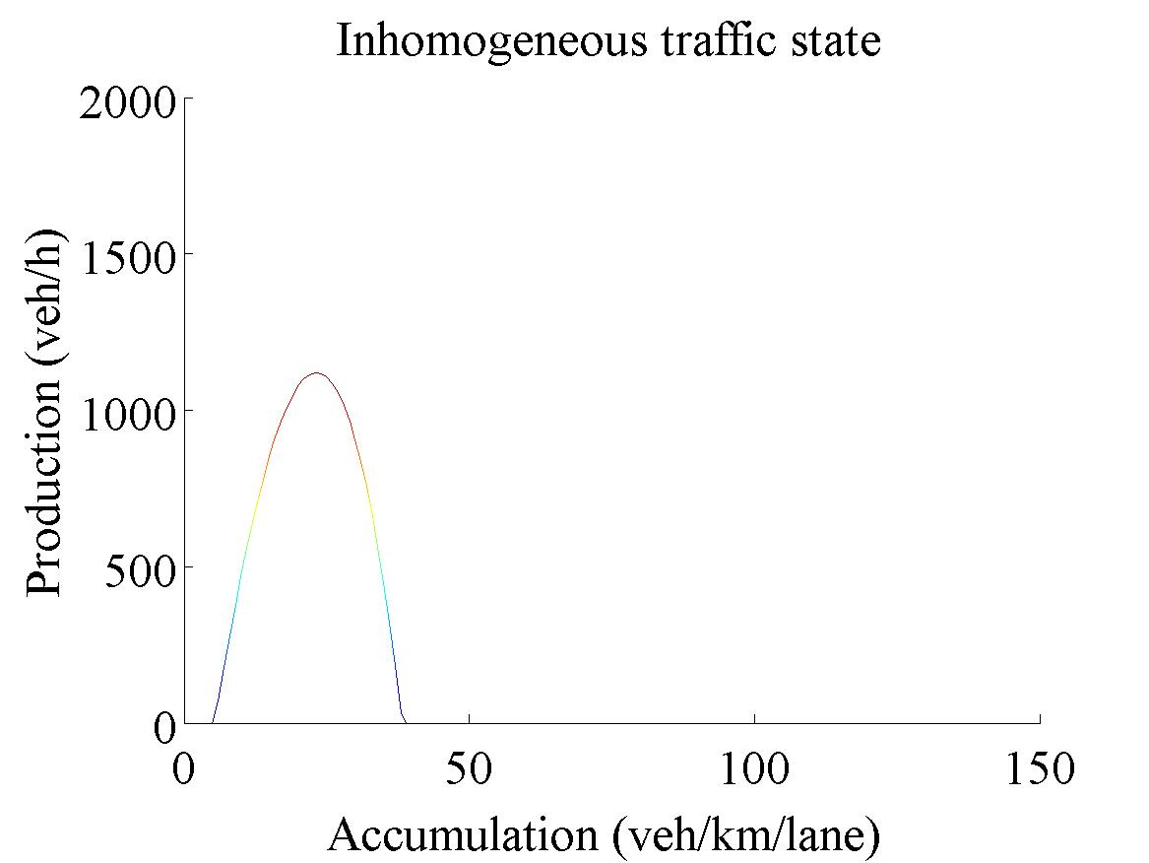
Fitting a functional form
P(A)=A*(c₁+c₂A+c₃A²)-c₄σ
Homogeneous traffic situation
Inhomogeneous traffic situation

Slide 12
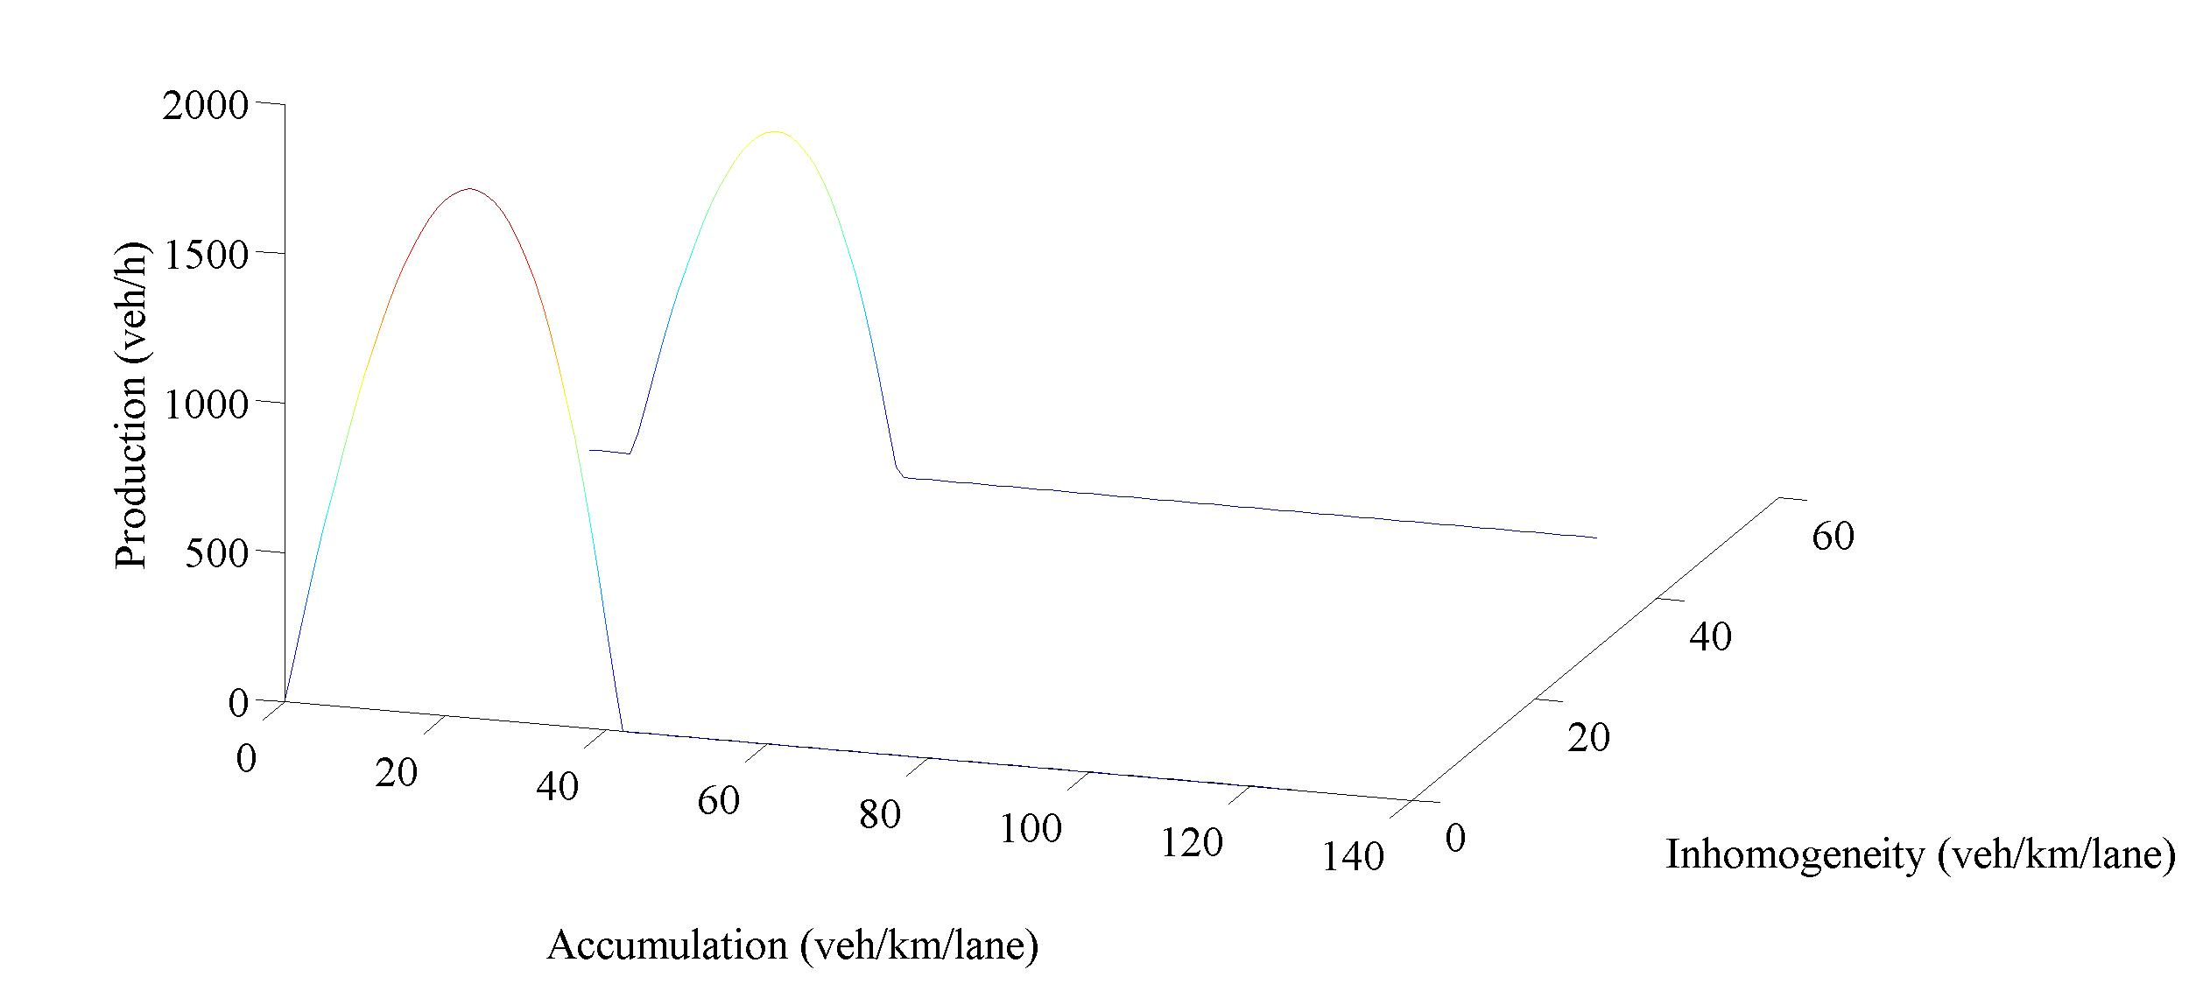
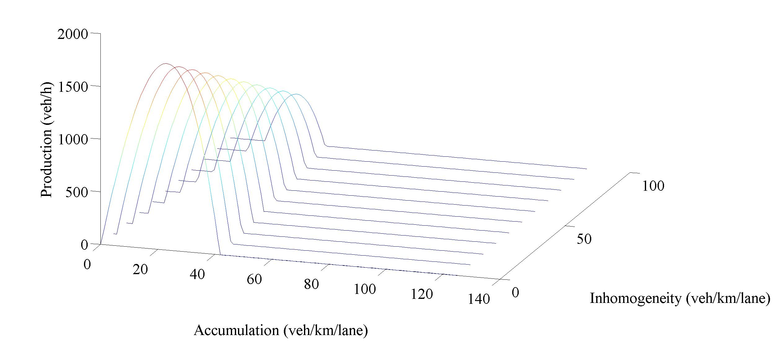
Fitting a functional form
P(A)=A*(c₁+c₂A+c₃A²)-c₄σ

Slide 13
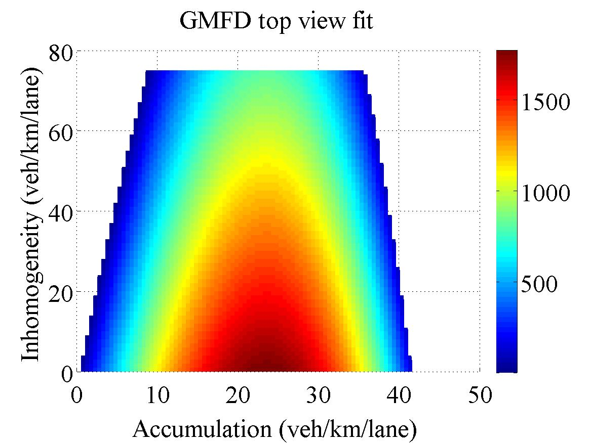
Empirical evidence
Inhomogeneity =>
Accumulation =>

Slide 14
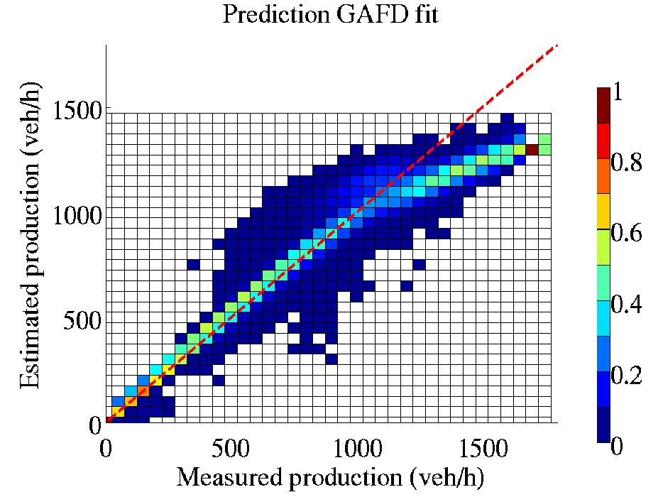
Fit and predictive power (2)
Similar to interpolation
Easier to quantify
Interpretation of variables

Slide 15
Quality of fit
R² | MFD | GMFD
Quality of fit | 0.85 | 0.86
A>18 veh/km | 0.0016 | 0.39

Slide 16
Use in practise
Buffer traffic to ensure maximum outflow to motorway
Hold traffic further upstream, e.g.
LOS B
LOS C
Production
Production
LOS A
LOS D
LOS C
LOS B
LOS A
LOS D
.5 A_{c}
A_{c}
(Ac+A_{max})/2
A_{max}
A_{c}
A_{max}
.5 A_{c}
(Ac+A_{max})/2
Accumulation
Accumulation

Slide 17
Conclusions
Traffic flow can be descibed at a high (area-wide) level
Two explanatory variables: accumulation & inhomogeneity
Predictive power much increased by adding inhomogeneity

