Slide 1
Single Frequency Precise Point Positioning:
obtaining a map accurate to lane-level
Victor L. Knoop, Peter de Bakker, Christian Tiberius, and Bart van Arem
NWO – There is plenty of lane in the other lane

Slide 2
Contribution
New technique for dm-accurate gps position
Cost: ~ 100 USD
Easy to set up
More accurate than a lane width
Automatically create maps with lane positions: field test

Slide 3
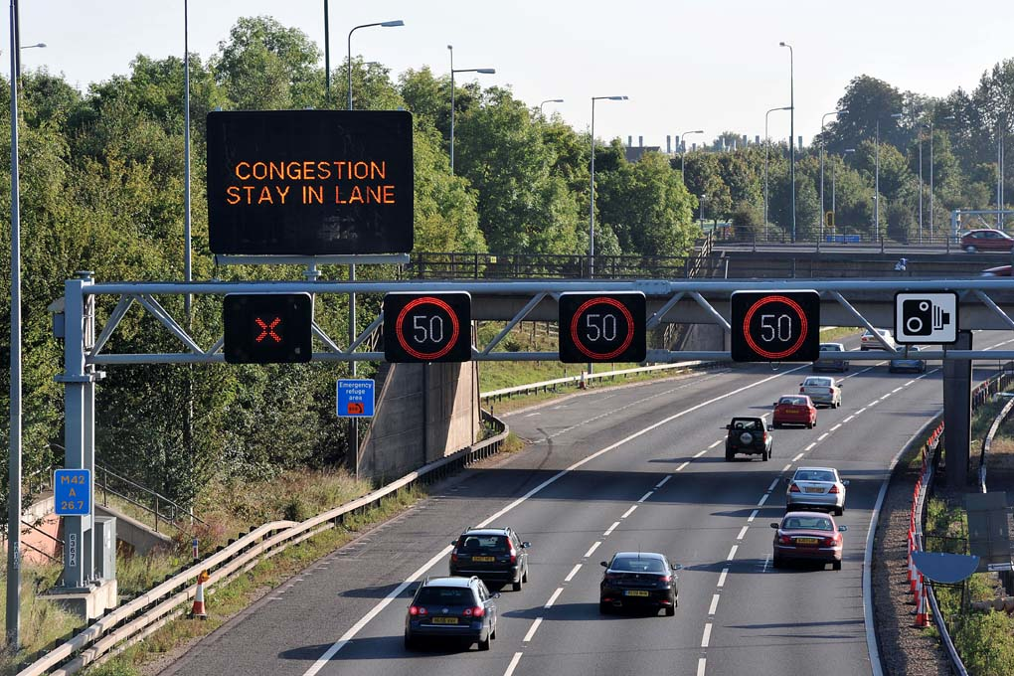
Motivation
Large focus on lateral management (cooperative active cruise control)
Lane-specific freeway advice can improve flow
Next step towards automated vehicles
2 steps: 1) find lane positions 2) determine lane of veh

Slide 4


Regular GPS
Three dimensions => 4 satellites
Resulting accuracy:
~5-10 meters horizontally
10-20 meters vertically

Slide 5

Differential GPS
Resulting accuracy:
< 1cm
High cost

Slide 6

Precise Point Positioning
Hundreds of base stations
Sharing measured GPS signals
Accurate satellite trajectories (+atmospheric distortions) calculated and published
=> used to correct GPS measurement
Accuracy: ~1-2 dm
Cost: regular GPS (~100 USD)

Slide 7
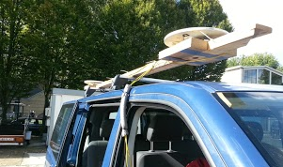
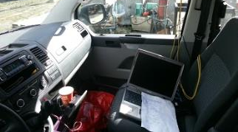
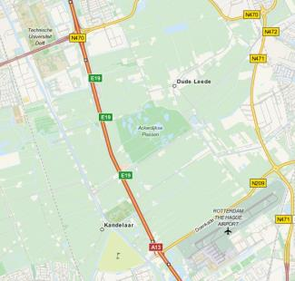
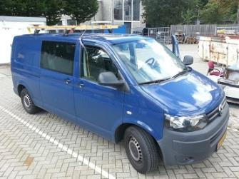


Field test set up
100 rounds of 2 X 5km freeway stretch
PPP and D-GPS (reference)

Slide 8
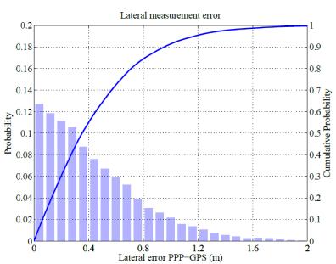
Accurary
Not bias free (due to construction on roof?): 20 cm off
Typical error: 20 cm

Slide 9
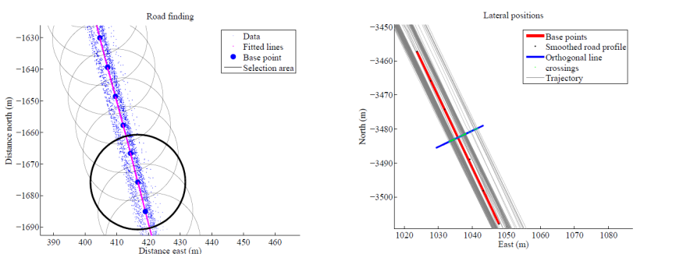

Slide 10
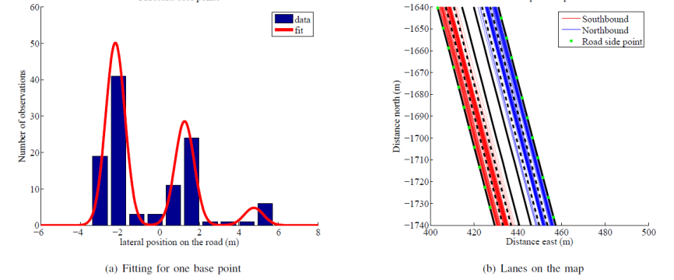
Fits
Fit the frequency of passing at a lateral position
Combined normal distributions

Slide 11

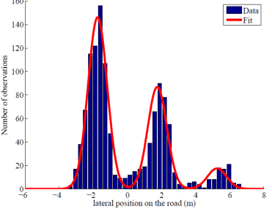
Combine 10 cross sections
Increase data sample
Only works for the same road layout (laterally)

Slide 12
(Practical) conclusions & future work
~100 USD receiver detecting at ~dm accuracy
Easy implementation in-car (mobile phone a bit more difficult)
Lane mapping is possible
100 vehicles passing => Collect trajectories (openstreetmap, TomTom)
New possiblities for management and intelligent vehicles
Field operational test shows feasibility
Next:
integration in commercial devices
More challanging conditions

