Slide 1
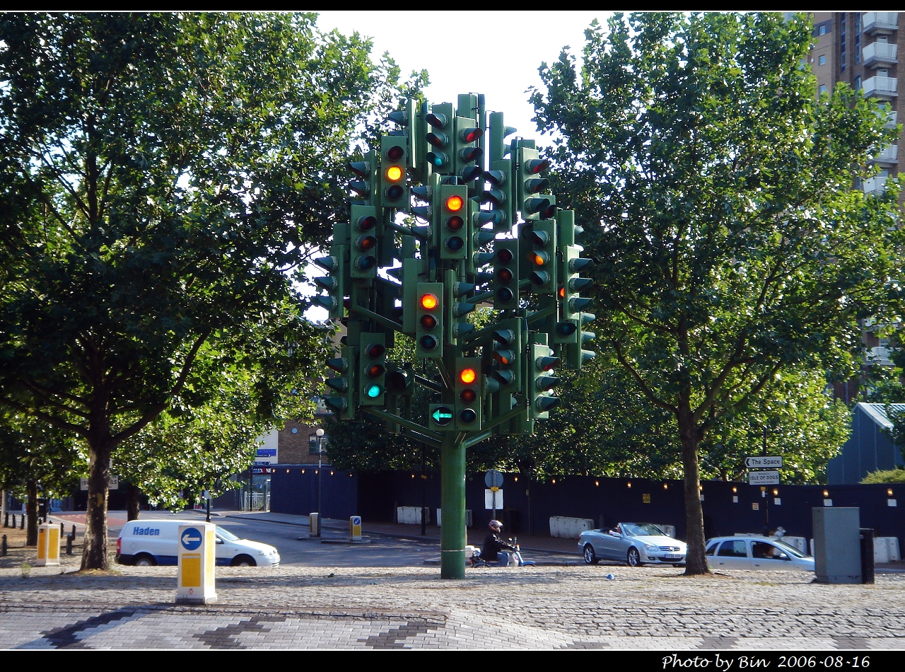
de Jong, Knoop, Hoogendoorn
The Effect of Signal Settings on the Macroscopic Fundamental Diagram and its Applicability in Traffic Signal Driven Perimeter Control Strategies
IEEE-ITCS 2013
Session TuA8
8 October 2013, 09:18 – 09:36

Slide 2
Overview
Introduction
Research scope
Methodology
Results
Discussion
Conclusion

Slide 3
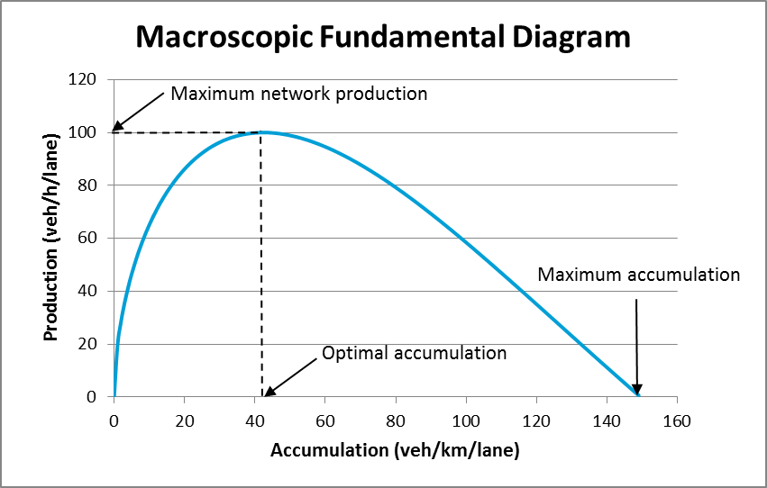

Introduction
MFD
Relates accumulation to
production
  Accumulation: average
  weighted density $A=\frac{\sum{k_{i}l_{i}}}{\sum{l_{i}}}$
  Production: average
  weighted flow $P=\frac{\sum{q_{i}l_{i}}}{\sum{l_{i}}}$
  Maximum production and optimal/critical accumulation are parameters of interest
Notes:
Production and accumulation are network characteristics and are not related to the traffic within that network!

Slide 4
Introduction
MFD can be used in perimeter control strategies
Perimeter control aims to hold back traffic in certain areas, in order to maximize production in another area
One method to achieve this is by changing signal timings
Research has found that changing signal timings changes the shape of the MFD
Studies aiming to implement perimeter control, have not taken this effect into account yet

Slide 5
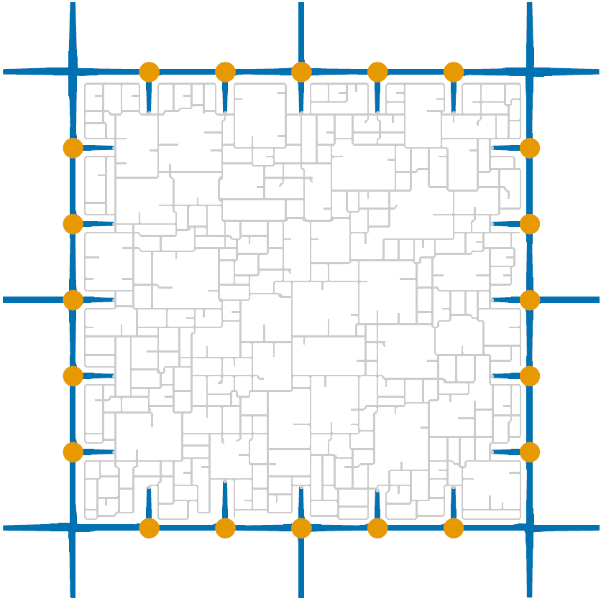
Research scope
In what way do changes in traffic light settings at the arterial around a subnetwork, influence the shape of the MFD of the subnetwork and the arterial itself

Slide 6
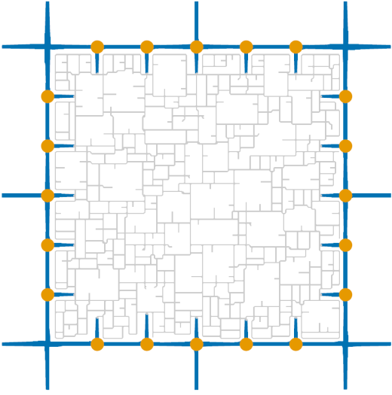
Methodology
Simulation setup
Simulation model (VISSIM):
  Detailed node model
  Individual signal timings for each intersection (static)
  Rerouting possible
Network and OD-matrix (Matlab):
  Randomly generated street pattern and OD matrix in 3x3 km network
  Network layout and signal timings are tuned to demand
Simulations:
  First simulations are run in order to construct a ‘basic’ MFD
  Next simulations are run using different signal timings

Slide 7
Methodology
Inflow and outflow control
Inflow control: Signal timings for flow from arterial to subnetwork are fixed to accommodate specific number of vehicles (100, 200, 300, 400, 500)
Outflow control: Signal timings for
flow from subnetwork to arterial
are fixed
Aterial
Subnetwork

Slide 8
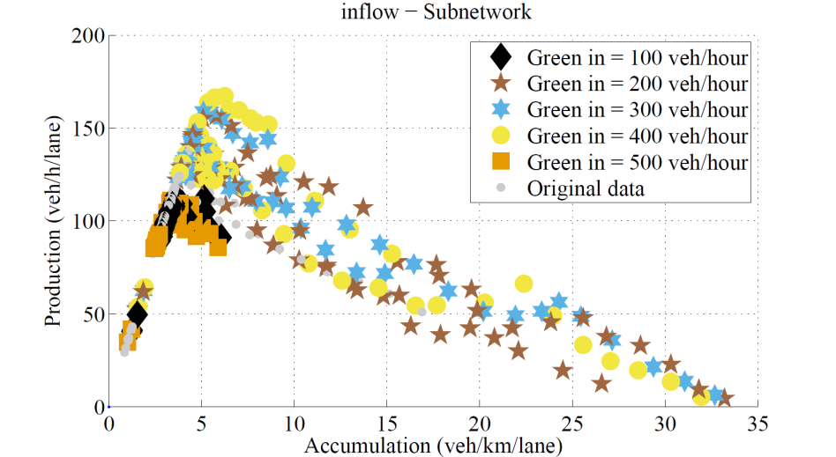
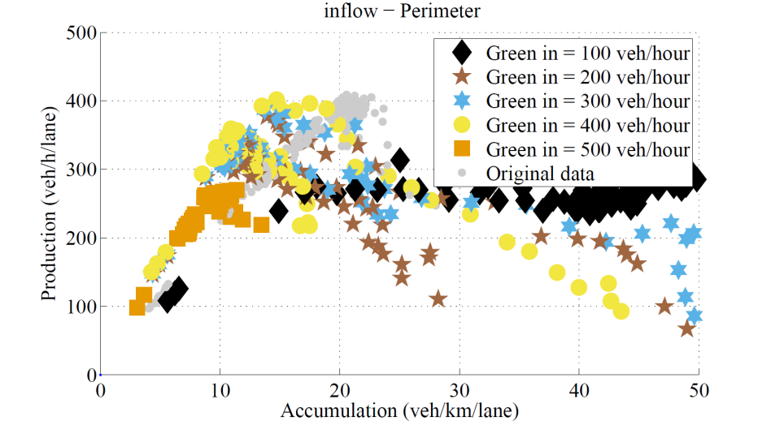
Results
Controlling subnetwork inflow
Different signal timings result in
differently shaped MFDs
Improvement in production for
subnetwork found at 200-400 veh/h
Certain productions can be
sustained over a large
accumulation range
30.000 vehicles completing trip at
100 veh/h, in other cases
15.000 - 20.000

Slide 9
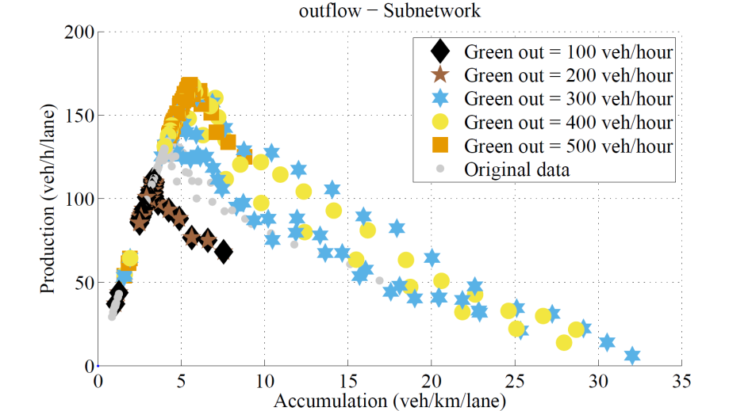
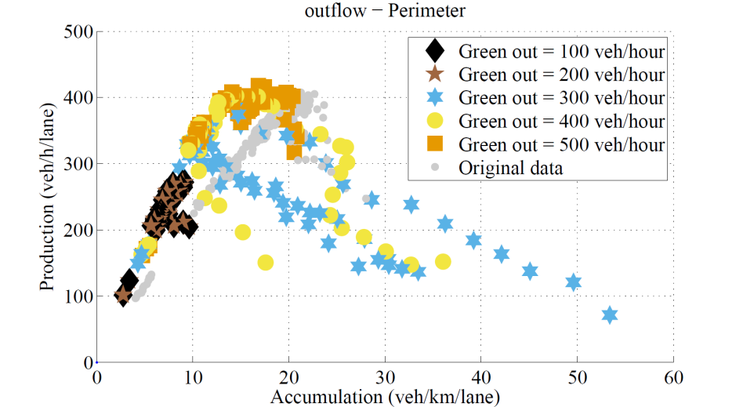
Results
Controlling subnetwork outflow
Roughly same results as for
controlling inflow
Timings at which highest
production is achieved (300-500),
differs from inflow (200-400)
32.000-35.000 vehicles completing
trip at 400-500, in other cases
25.000

Slide 10
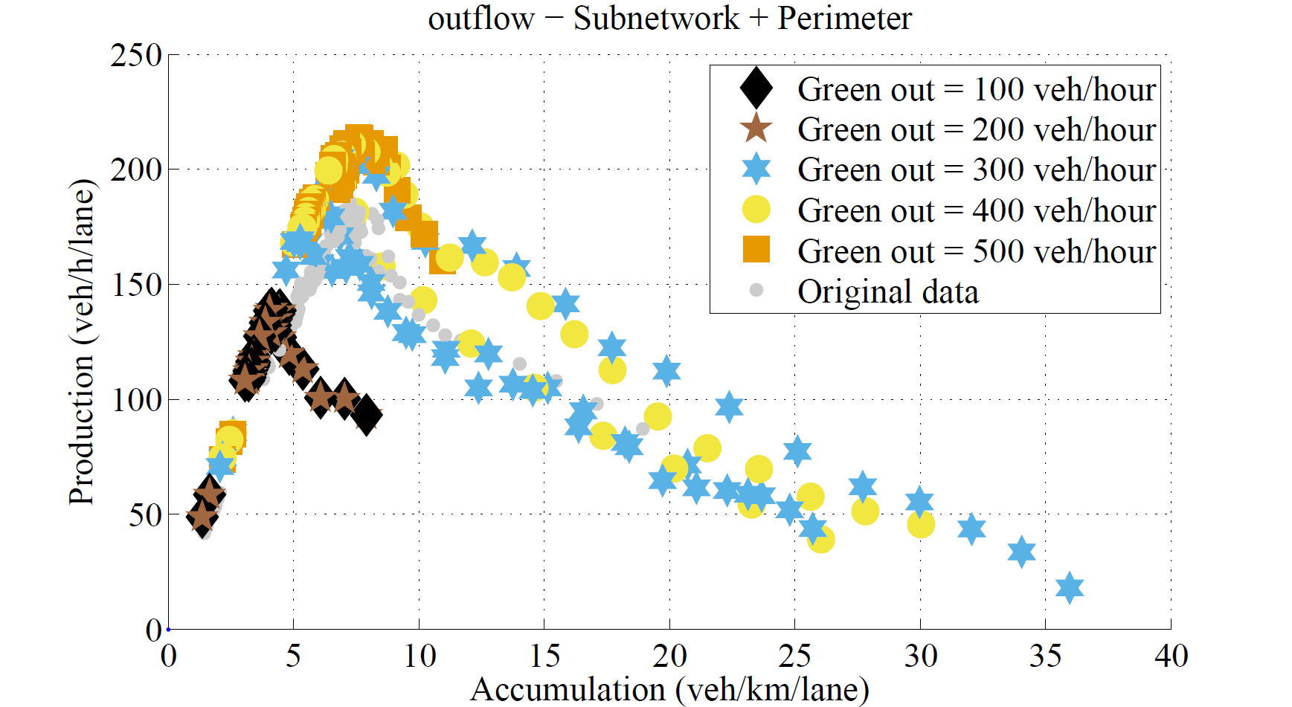
Discussion
Improvements in traffic flow
Improvements can be achieved over locally optimized signals
Highest production does not always result in highest output
Production of perimeter is higher than subnetwork
For both control strategies output is maximized if as many vehicles as possible are kept within the perimeter
  The perimeter is better capable in processing traffic and preventing gridlock
  Formation of ‘gridblocks’ in subnetwork easier

Slide 11
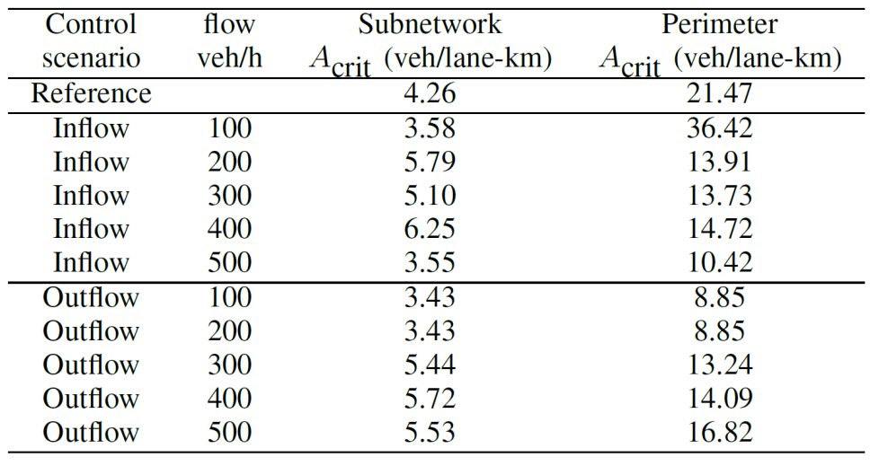
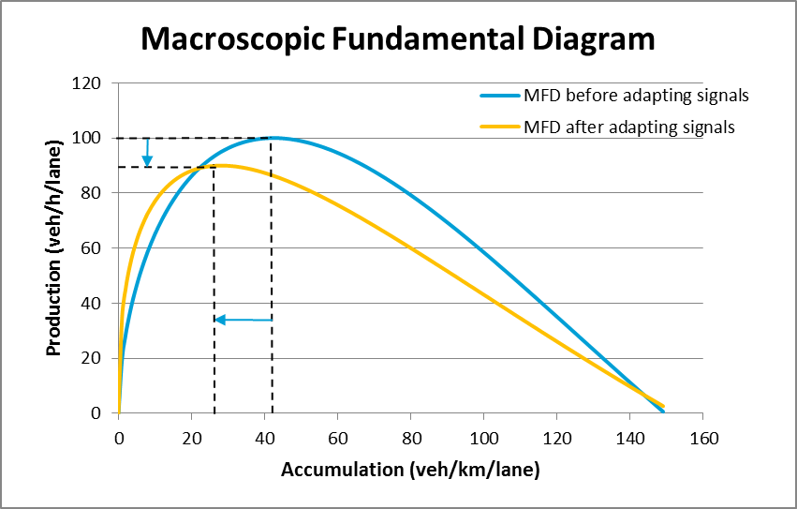
Discussion
Critical accumulation
Accumulation at which production
is maximized differs, given
different signal timings
Using critical accumulation of the
original MFD as a control target
results in a different (possibly
lower) critical accumulation,
resulting in even more congestion
A-priori construction of MFDs for different
signal timings needed

Slide 12
Conclusion
For two control types tested, no substantial differences in maximum production are found. However, higher outputs achieved with outflow control
Keeping the perimeter at maximum production and keeping amount of traffic in subnetwork low generates best results
Production can improve by changing signal timings
Different signal timings can have a strong effect on the shape of the MFD, i.e. the maximum production and critical accumulation
As critical accumulation differs for different signal timings, it cannot be directly utilized input for control strategies
A-priori construction of MFD for different signal timings needed for (perimeter) control strategies

Slide 13
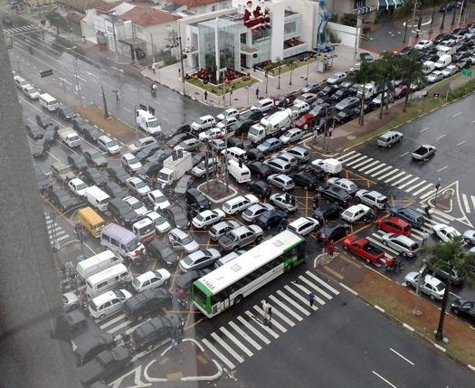
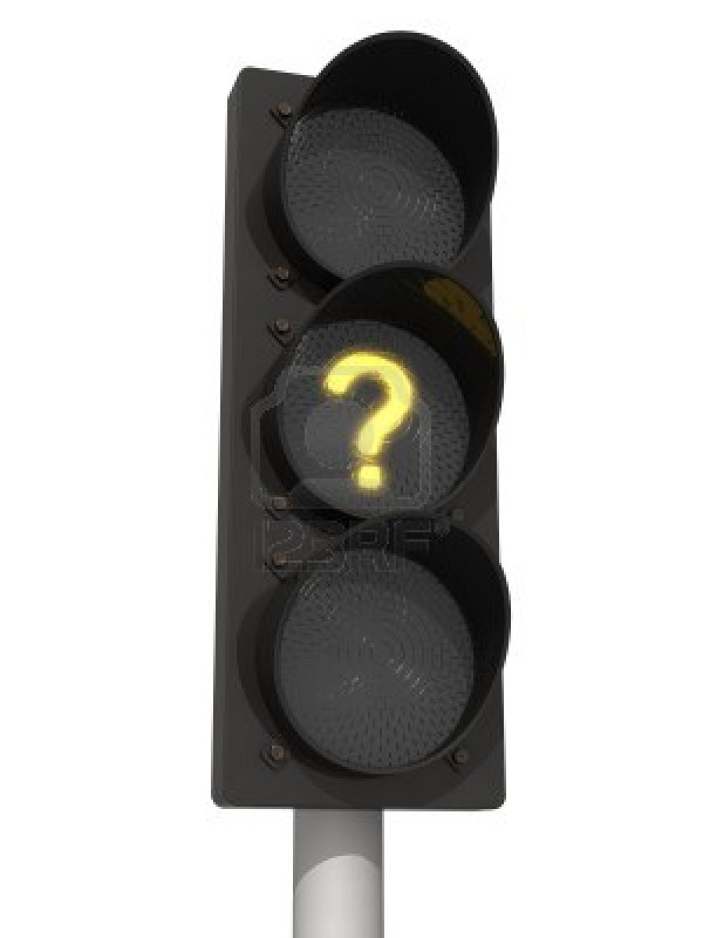
  Questions?

