Slide 1
Automated lane identification using Precise Point Positioning An affordable and accurate GPS technique
Victor L. Knoop, Christian Tiberius, Peter Buist and Bart van Arem
Sponsors: Foundation Next Generation Infrastructures
IIP-CC subsidy by ICTregie/NWO

Slide 2
Contribution
New technique for dm-accurate gps position
  Cost: ~ 100 USD
  Easy to set up
More accurate than a lane width
Automatically create maps with lane positions:
proof of concept

Slide 3
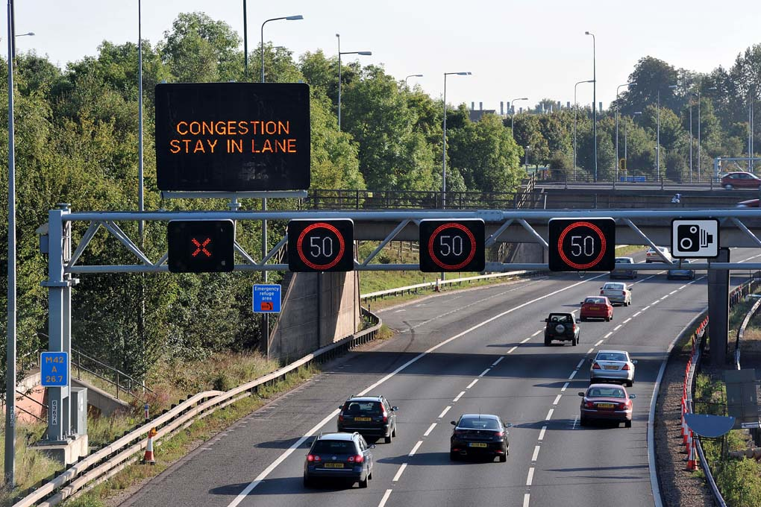
Motivation
Large focus on lateral management
(cooperative active cruise control)
Lane-specific freeway
advice can improve flow
Next step towards
automated vehicles
2 steps:
1) find lane positions
2) determine lane of veh

Slide 4


Regular GPS
Three dimensions => 4 satellites

Slide 5
Errors in positions
Souces:
  (Predicted) trajectories of satellite
  US airforce provided
  Atmosphere
Resulting accuracy:
  ~5-10 meters horizontally
  10-20 meters vertically

Slide 6

Differential GPS

Slide 7

Precise Point Positioning
Hundreds of base stations
Sharing measured GPS signals
Accurate satellite trajectories
(+atmospheric distortions)
calculated and published
=> used to correct GPS measurement

Slide 8
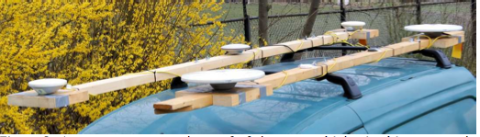
Testing
Set-up on a (small European) van
Real-life freeway test
Compare with ground truth (D-GPS)
4 sessions of each 5 runs

Slide 9
Accuracy
Systematic for a time of day: ~50 cm off
Random: ~35 cm off
Accurate enough to identify the lane,
if lane positions are known..

Slide 10
Mapping lanes
Systematic error Normal(0;50cm)
Random error Normal(0;35 cm)
Position in vehicle Uniform(1.8m)
Vehicle position in lane Normal(0;20cm)
Lane changing 10% of the vehicles
position during LC uniform over lane width
Simulation of passings

Slide 11
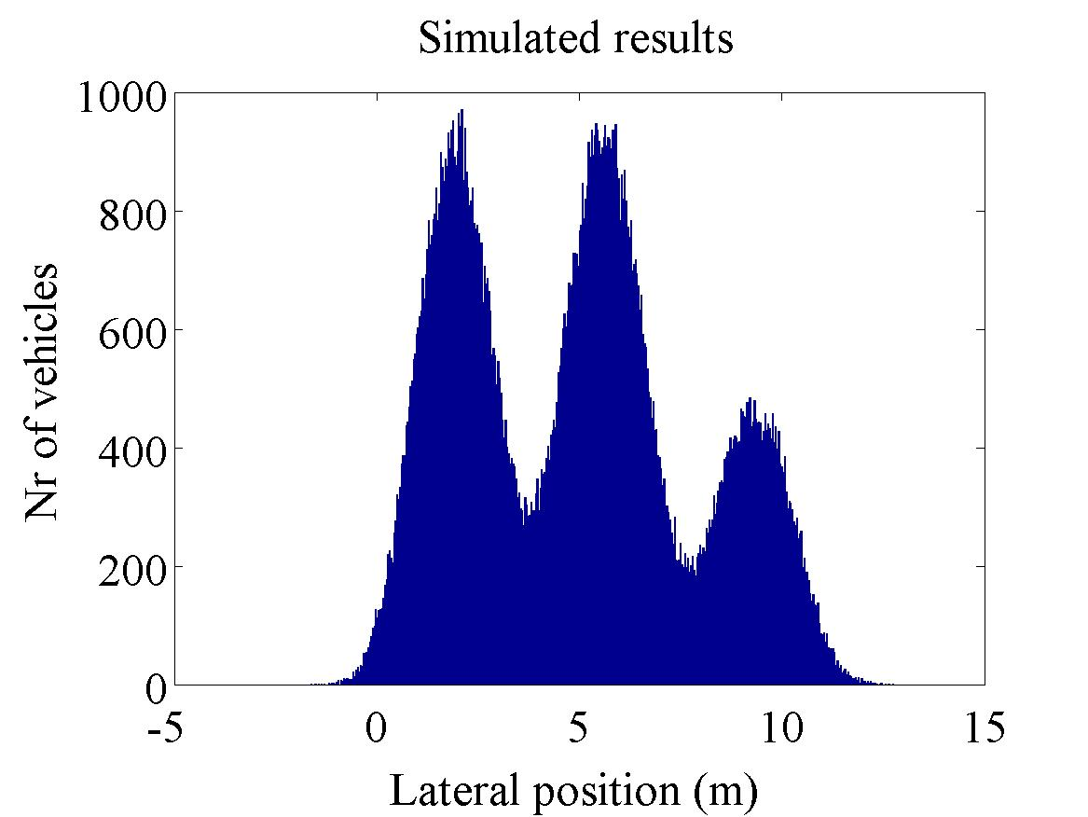
Simulation results

Slide 12
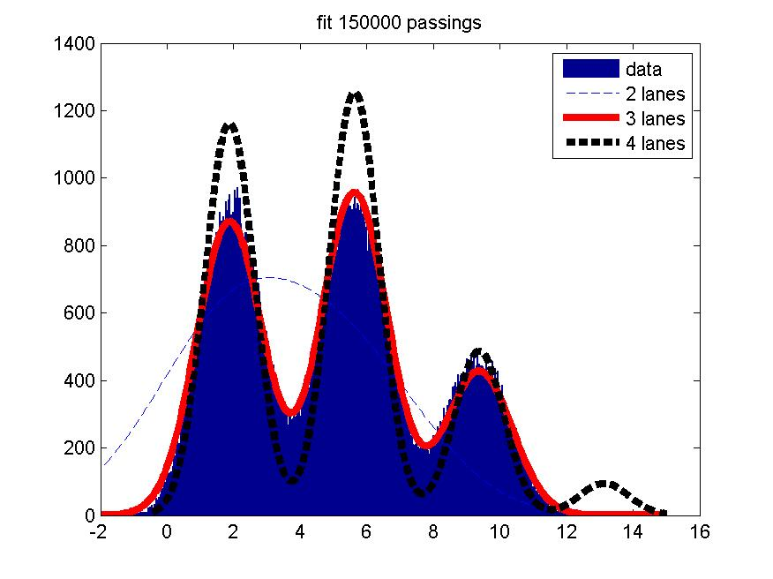
Fits of results
Estimated combined normal
  Offset (20±12cm)
  One standard deviation
  Lane distribution
  For 3-7 lanes:
  3 lanes fit best

Slide 13
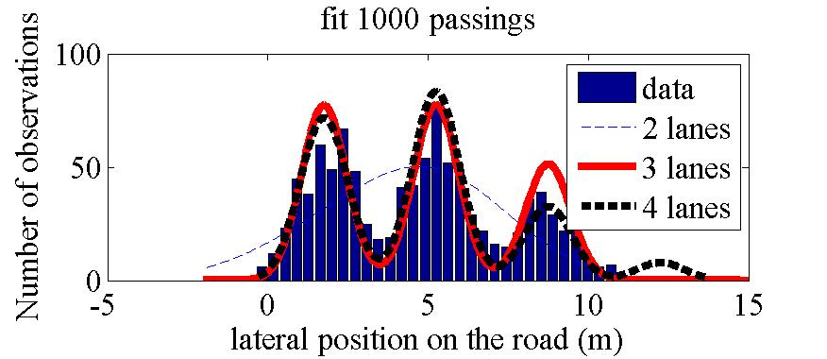
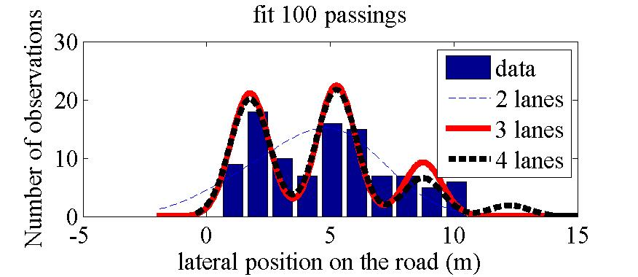
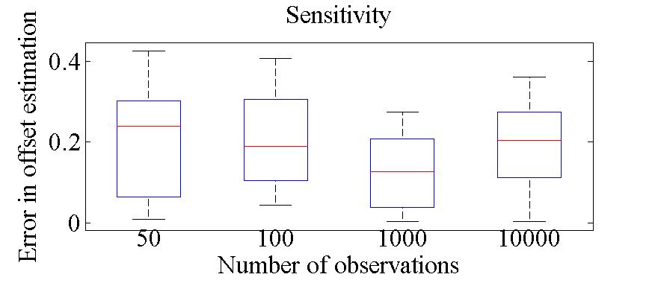
Sensitivity with fewer observations
useful estimation if
>100 vehicles

Slide 14
(Practical) conclusions & future work
~100 USD receiver detecting at ~dm accuracy
Easy implementation in-car
(mobile phone a bit more difficult)
Lane mapping is possible
  Many vehicles passing =>
  Collect trajectories (openstreetmap, TomTom)
New possiblities for management and intelligent vehicles
Proof of concept shows feasibility
Now: field test for ~100 vehicles

Slide 15
Regular GPS
One dimension => 2 satellites

