Slide 1


ISTTT, 07/18/2013
Rationing and Pricing Strategies for Congestion Mitigation: Behavioral Theory, Econometric Model, and Application in Beijing
Shanjiang Zhu, Ph.D., Assistant Professor¹
Longyuan Du, Research Assistant, University of Maryland
Lei Zhang, Ph.D. Associate Professor, University of Maryland
Dept. of Civil, Environmental and Infrastructure Engineering
George Mason University

Slide 2
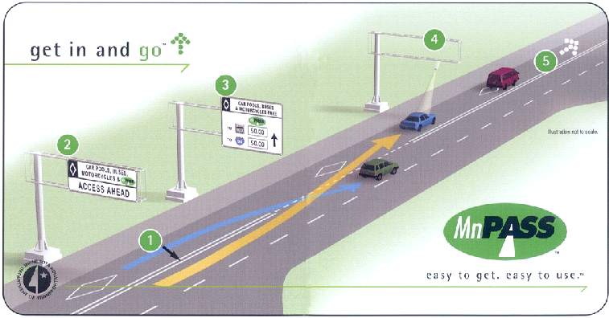
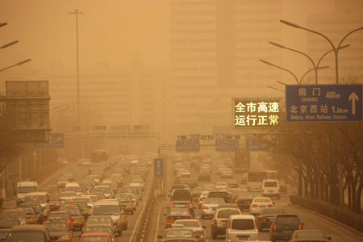
Fighting Growing Congestion
Concerns about pricing
Similar to tax
Hefty transaction cost
Distributional effects
Privacy concerns
…
Source: wantchinatimes.com
Source: MnDOT
Road Pricing
Rationing policy could be useful when
dealing with basic life necessities (e.g. water in Renwick and Archibald (1998))
dealing with inelastic demands (Guesnerie and Roberts, 1984)

Slide 3
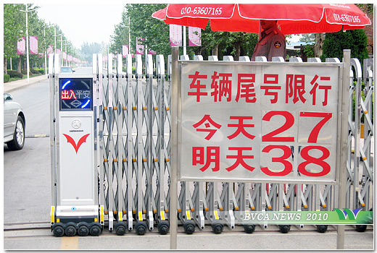
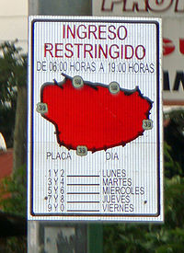

Examples of Usage Restriction
Driving Restriction Based on License Plate Number
Today, 2 and 7
Tomorrow, 3 and 8
Beijing, China
San José, Costa Rica
Source: BVCA News
Source: Wikipedia

Slide 4
A Growing List …
Rome, 45 B.C.
Athens, Greece, 1982
Santiago, Chile, 1986
Mexico City, Mexico, 1989
São Paulo, Brazil, 1996
Bogotá, Colombia, 1998
La Paz, Bolivia, 2003
San José, Costa Rica, 2005
Beijing, China, 2008
...

Slide 5
Examples of Ownership Quota
Singapore, Vehicle Quota System(VQS), 1990
Shanghai, License Plate Auction, 2001
Beijing, Vehicle Lottery, 2010
Guangzhou, 50% Lottery 50% Auction, 2012
…

Slide 6
Literature
Empirical studies:
“Day without a Car” policy in Mexico City did not achieve the policy objective. (Eskeland and Feyzioglu, 1997)
Vehicle usage restriction periods in Bogotá, Columbia keep on expanding. (Davis, 2008)
Singapore experience exhibits mixed results. (Smith and Chin, 1997)
…
Modeling:
Hybrid strategy of rationing and pricing (Daganzo, 1995)
Field experiment in Bay Bridge area, California (Nakamura and Kockelman, 2002)
A framework to deal with both short-term and long-term responses to vehicle usage rationing policies. (Wang, Yang, and Han, 2010)
…

Slide 7
Objectives
Develops a welfare analysis framework for rationing policies
Compares welfare effects of the two different rationing policies, and that of the more popular pricing policy.
Explores how to implement models on real networks.

Slide 8
Framework
Demand Models
Ownership
VMT
Supply Models
BPR Model
Vickery’s Model
Stylized Network
Equilibrium
Policies
Ownership rationing
Usage rationing
Pricing
Compensation Variation
Welfare Changes

Slide 9

Model Setup
Indirect Utility Function
Demand Function
Roy’s Identify
Dubin and McFadden (1984)
Mannering and Winston (1985)
De Jong (1990)
Goldberg (1998)
…

Slide 10
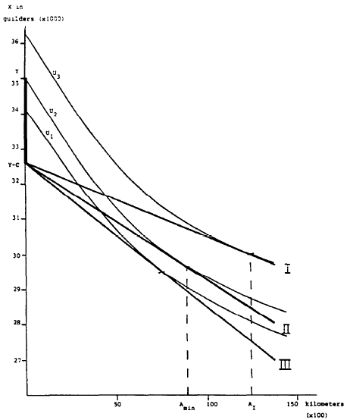


Ownership Decision
Other Expenses
Y
Y-C
Amin
Source: de Jong 1990
VMT

Slide 11

Model Setup
Supply Function

Slide 12
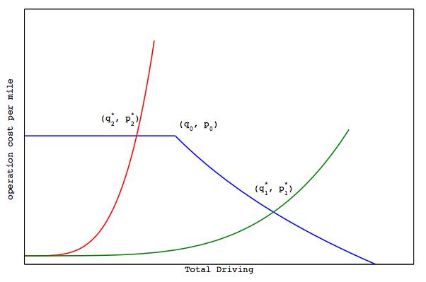
Network Equilibrium
More congestible network
Less congestible network
P

Slide 13
Welfare Analysis Methods
Consumer Surplus (CS)
Difference between what I want to pay and what I actually paid for a good or service
Compensating Variation (CV)
After the policy change, how much do I need to be compensated to stay at the same utility level
Equivalent Variation (EV)
Before the policy change, how much do I want to pay to avoid the policy change

Slide 14
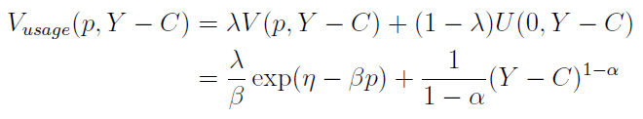

Vehicle Usage Rationing
Assuming drivers can not drive on $1−λ$ of days
New indirect utility function:
VMT choice:

Slide 15
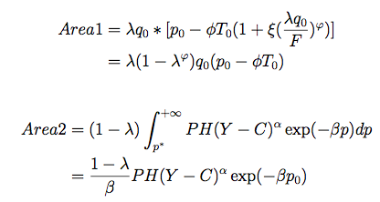
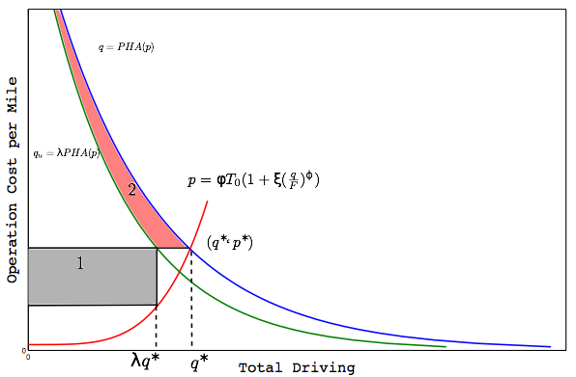
Vehicle Usage Rationing
A

Slide 16

Vehicle Usage Rationing with Induced Demand
New equilibrium point
Decide CV
Price in new equilibrium
Price in old equilibrium

Slide 17


Vehicle Usage Rationing with Induced Demand
Proposition 1: When induce demand is taken into account, vehicle usage rationing policy will always results in a user welfare loss.
CV_{u}
>0
0
1
λ

Slide 18


Vehicle Ownership Rationing
Only λ of households who are willing to buy a car can actually buy a car.

Slide 19
Comparison with Road Pricing
λq*

Slide 20


Comparison with Road Pricing
Proposition 2: When road pricing and vehicle ownership rationing are set up in such a way that both policies reduce travel demand by the same amount (or have the same congestion mitigation effects), road pricing will always generate a bigger social welfare gain.
Welfare Change of Pricing
-
Welfare Change of Ownership Rationing
h(p**₀)
<0
0
p₀
p**₀

Slide 21
Analytical Findings
Temporal Substitution of Travel
Temporal substitution of travel can affect welfare impact of vehicle usage rationing policy. (If I cannot use my vehicle on Monday for a trip, can I make that trip in another day of the week?)
Vehicle Use Rationing
Always causes welfare loss if there is perfect temporal substitution of demand
Congestion Pricing
Is better than vehicle ownership and usage rationing policies

Slide 22
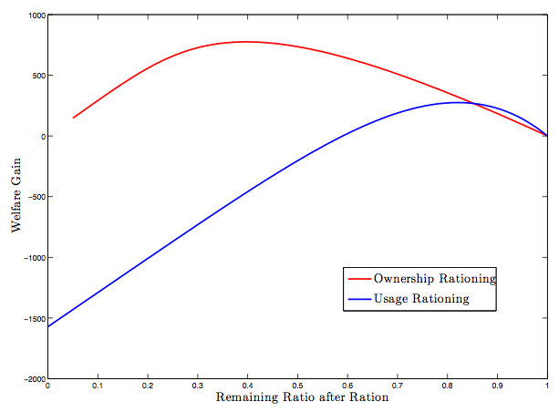
Comparing Rationing Policies w/o Sub.

Slide 23
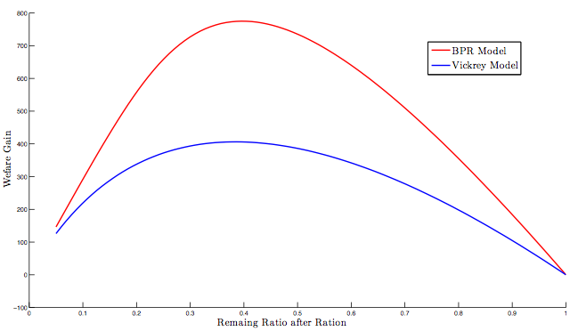
Sensitivity Analysis

Slide 24

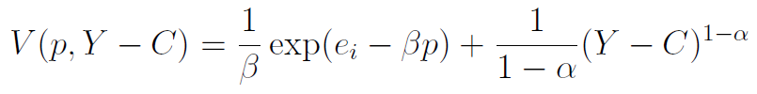

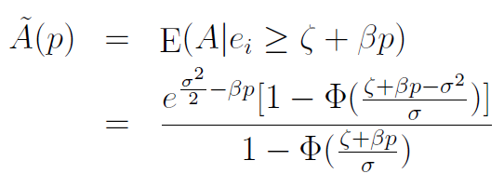
Heterogeneous Users
Individual travel decisions:
Individual utility:
Probability of owning a vehicle:
Average driving amount among vehicle owners:

Slide 25
Aggregate Demand

Slide 26
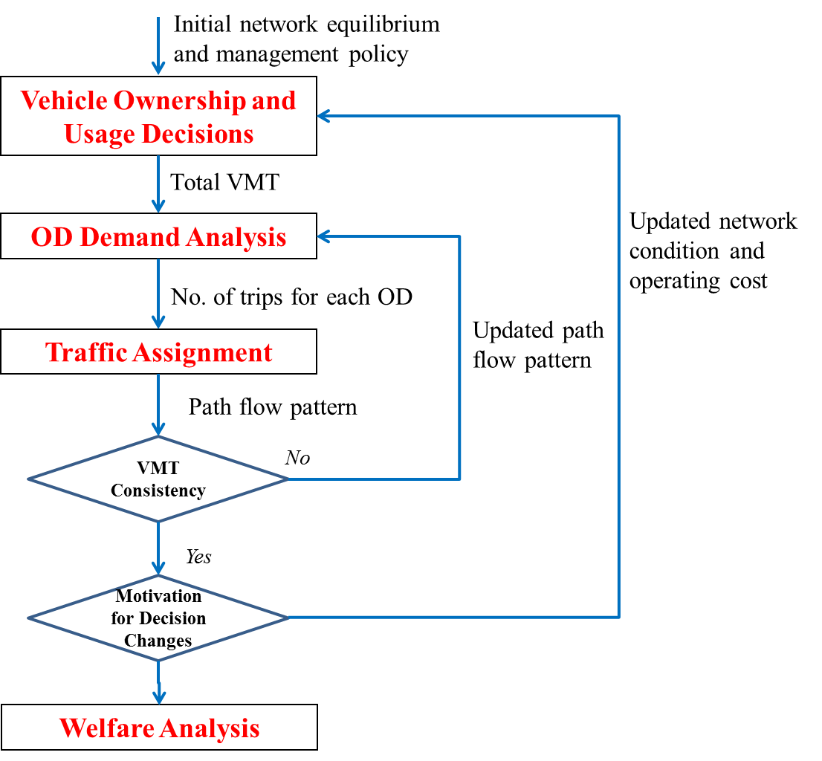
Network Analysis

Slide 27
Beijing Lottery System
Welfare changes for three user groups:
Households who should have bought a car without the rationing policy and actually won lottery
Households who should have bought a car without the rationing policy and did not win lottery
Households who would not buy a car without the policy, who were motivated after the policy implementation, and won the lottery

Slide 28
Beijing Sketch Network

Slide 29
Beijing Sketch Network

Slide 30
Conclusions and Policy Implications
Avoid Vehicle Use Restriction
If the goal is to significantly mitigate congestion.
Congestion Pricing is a Better Choice
If it can be implemented in ideal conditions.
Consider Vehicle Ownership Quota
If pricing measures are not feasible.
Rationing Policies are More Likely to Succeed
If the network is congested and operated near capacity.

Slide 31
Future Research
Relax Model Assumptions
Consider multiple time periods, multiple user types, multiple modes, and multiple OD pairs
Conduct Empirical Research
Beijing

Slide 32
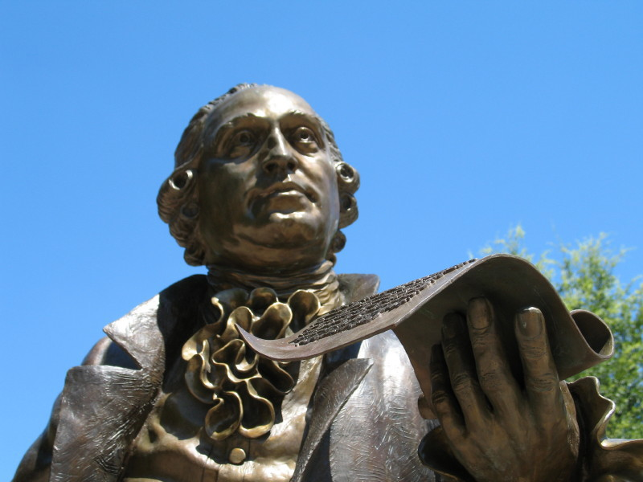
Thank You!
Questions and Comments?
Shanjiang Zhu, Ph.D., Assistant Professor
Civil, Environmental & Infrastructure Engineering
George Mason University
szhu3@gmu.edu

