Slide 1
Adaptive Vehicle Routing for Risk-averse Travelers
Lin Xiao and Hong K. Lo
Department of Civil and Environmental Engineering
The Hong Kong University of Science & Technology

Slide 2
Outline
Overview
Literature review
Objective and initial formulation
Alternative formulation
Formulation and Methodology
SSD constrained formulation
Benchmark alternative and admissible set
Solution procedure
Numerical study
Conclusion
Notes:
Current work consists of brief introduction, research plan and methodology, and Comparison between instantaneous and adaptive routing.
Finally, we will discuss some future directions

Slide 3
Literature review
 | Minimizing cost | Maximizing reliability | Multiple criteria
A prior path | Dijkstra, 1959; Hart et al, 1968; Eppstein, 1998 | Fan & Nie, 2006; Lo & Bie, 2006; Siu & Lo, 2008,2009,2013 | Wang & Ehrgott, 2013 Chen & Nie, 2013
Adaptive routing | Spiess & Florian, 1989; Lo & McCord, 1998; Fu, 2001 | Nie & Wu, 2009 | Xiao & Lo, 2013
Notes:
Among the numerous works in routing, they are summarized into different catagries according to their objectives or methodologies.
They either are aiming at mini cost, like the second column, or maximizing the reliablity, for examples the third column. Also, they may consider multiple objective, the last column.
LET: Easy to understand and implement / Concerns on the average travel cost
Reliability: take uncertainties into account / Avoids risky link/path (risk-averse) / For trips with important purposes
On the other hand, regarding to different methodologies, the routing methods some seeking for an a prior path, some following an decition matrix – or adaptive routing, AKA, hyperpath.
A priori path: Straightforward / Easy to understand and implement / Steady/static network
Adaptive policy: More complicated / More flexible / Caters for stochastic network
Our research, in particular, will focus on the bottom right corner.

Slide 4
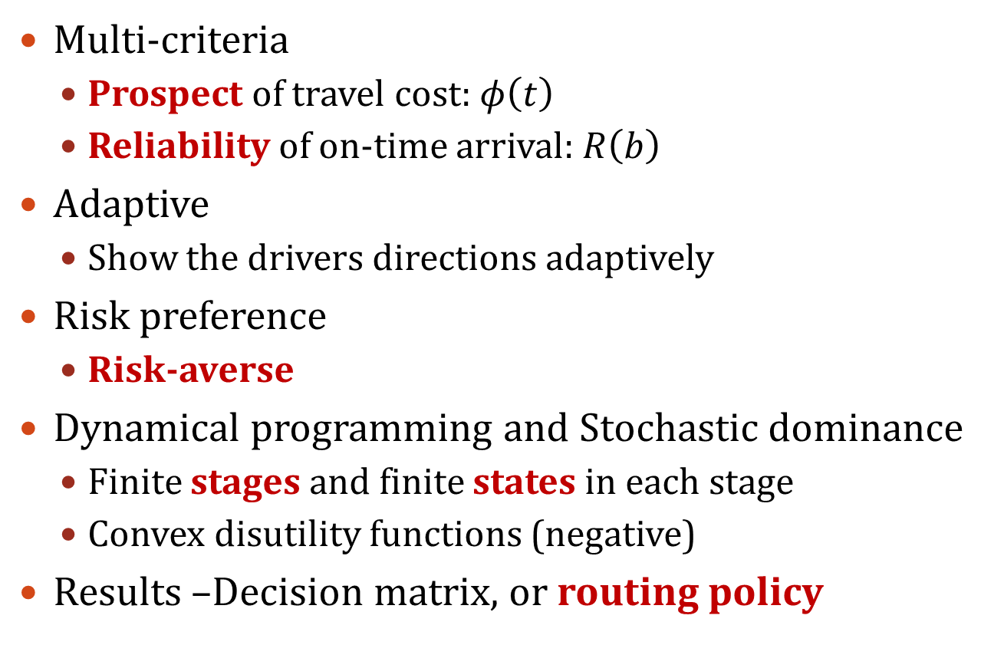
Objective
Multi-criteria
Prospect of travel cost: $φ\left(t\right)$
Reliability of on-time arrival: $R\left(b\right)$
Adaptive
Show the drivers directions adaptively
Risk preference
Risk-averse
Dynamical programming and Stochastic dominance
Finite stages and finite states in each stage
Convex disutility functions (negative)
Results –Decision matrix, or routing policy
The reference point is arbitrarily set at u(0)=0
Concave utility functions
Convex disutility functions
Notes:
We understand that the prospect theory, AKA reference based theory, is about the evaluation based on certain reference point.
We expect this method will show the drivers ***
The drivers in our formulation are considered as risk-aversion, which are the majority in all travelers. in particular, their utility functions are concave in the positive domain, and disutility functions are convex, in the negative domain
In terms of methodology, we are formulating the problem as a dynamical programming problem with finite stages and finite states in each stage.
In addition, to deal with the convex disutility functions, we employed the mathematical tool of SD. Will explain later.
This formulation will produce a decision matrix or routing policy for drivers to follow up.
t: travel time; b: travel budget

Slide 5
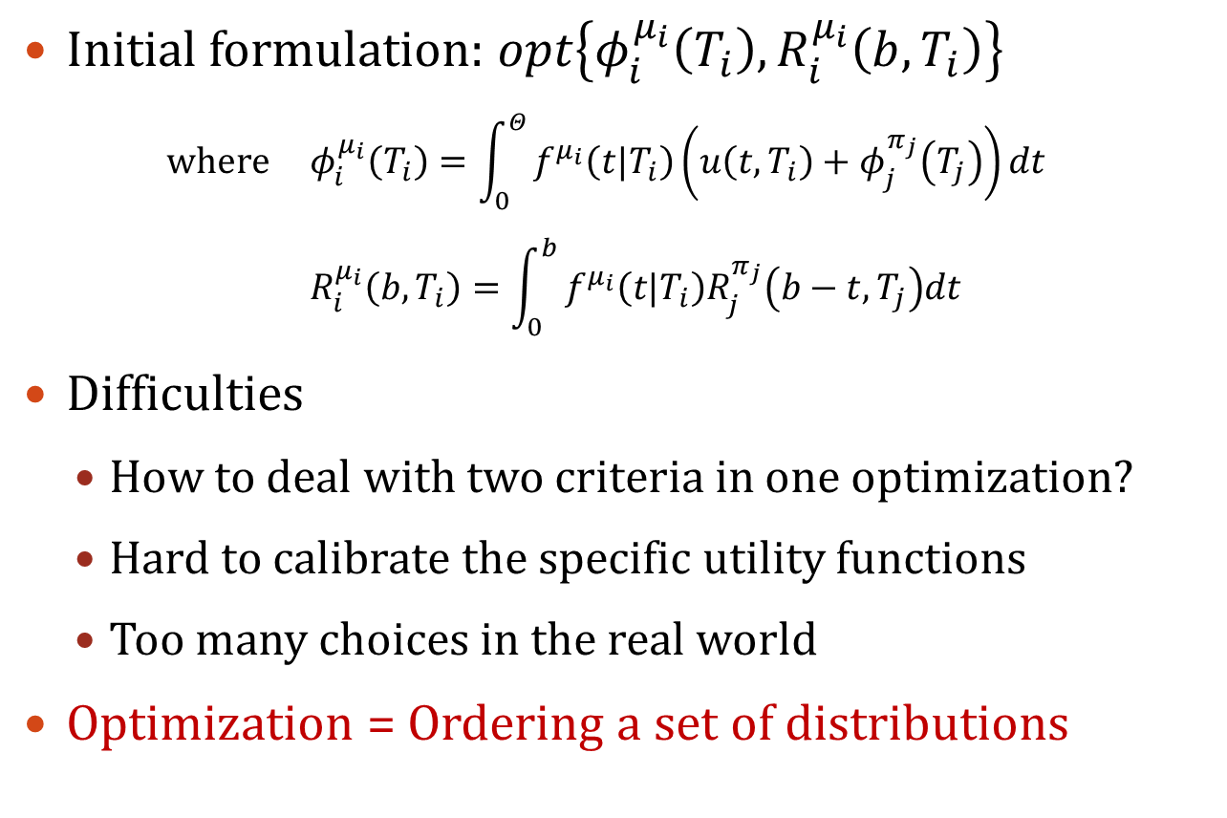
Initial formulation and difficulties
Initial formulation: $opt\left\{φ_{i}^{μ_{i}}\left(T_{i}\right),R_{i}^{μ_{i}}\left(b,T_{i}\right)\right\}$
where $φ_{i}^{μ_{i}}\left(T_{i}\right)=\int_{0}^{Θ}{f^{μ_{i}}\left(t|T_{i}\right)\left(u\left(t,T_{i}\right)+φ_{j}^{π_{j}}\left(T_{j}\right)\right)dt}$
$R_{i}^{μ_{i}}\left(b,T_{i}\right)=\int_{0}^{b}{f^{μ_{i}}\left(t|T_{i}\right)R_{j}^{π_{j}}\left(b−t,T_{j}\right)dt}$
Difficulties
How to deal with two criteria in one optimization?
Hard to calibrate the specific utility functions
Too many choices in the real world
Optimization = Ordering a set of distributions
Notes:
In the context of adaptive routing with respect to different time of day, here comes the original formulation
Where ***
Multiple criteria:
MOLP: the same question, how to weight them
Bi level: resource demanding
Yet the explicit expression of the optimization is not clear, we noted that,

Slide 6
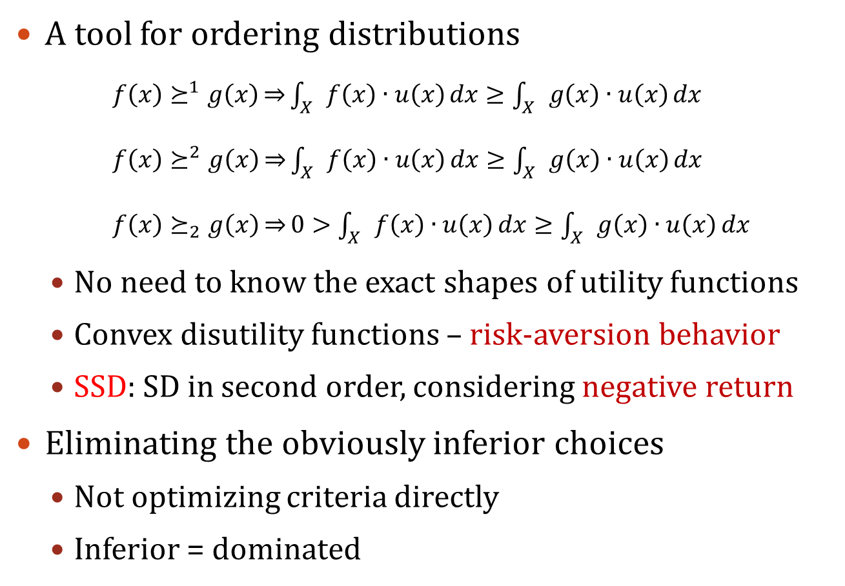
Stochastic dominance (SD)
A tool for ordering distributions
$f\left(x\right)⪰^{1}g\left(x\right)\overset{⇒}{}\int_{X}{f\left(x\right)∙u\left(x\right)}dx≥\int_{X}{g\left(x\right)∙u\left(x\right)}dx$
$f\left(x\right)⪰^{2}g\left(x\right)\overset{⇒}{}\int_{X}{f\left(x\right)∙u\left(x\right)}dx≥\int_{X}{g\left(x\right)∙u\left(x\right)}dx$
$f\left(x\right)⪰_{2}g\left(x\right)\overset{⇒}{}0>\int_{X}{f\left(x\right)∙u\left(x\right)}dx≥\int_{X}{g\left(x\right)∙u\left(x\right)}dx$
No need to know the exact shapes of utility functions
Convex disutility functions – risk-aversion behavior
SSD: SD in second order, considering negative return
Eliminating the obviously inferior choices
Not optimizing criteria directly
Inferior = dominated
Notes:
so, we employ the concept of stochastic dominance which is a tool of ordering
With help from SD, according to the properties above, there would be no longer need to know …
As long as the functions are in concave in positive domain and convex shape in negative domain.
In the following of the presentation, for simplicity, I will use the term SSD to refer the SD in second order, considering negative return
Based on this understanding, we are thinking that not to optimizing criteria directly, but to eliminating the obviously inferior choices, such that the best choice can be determined at last

Slide 7
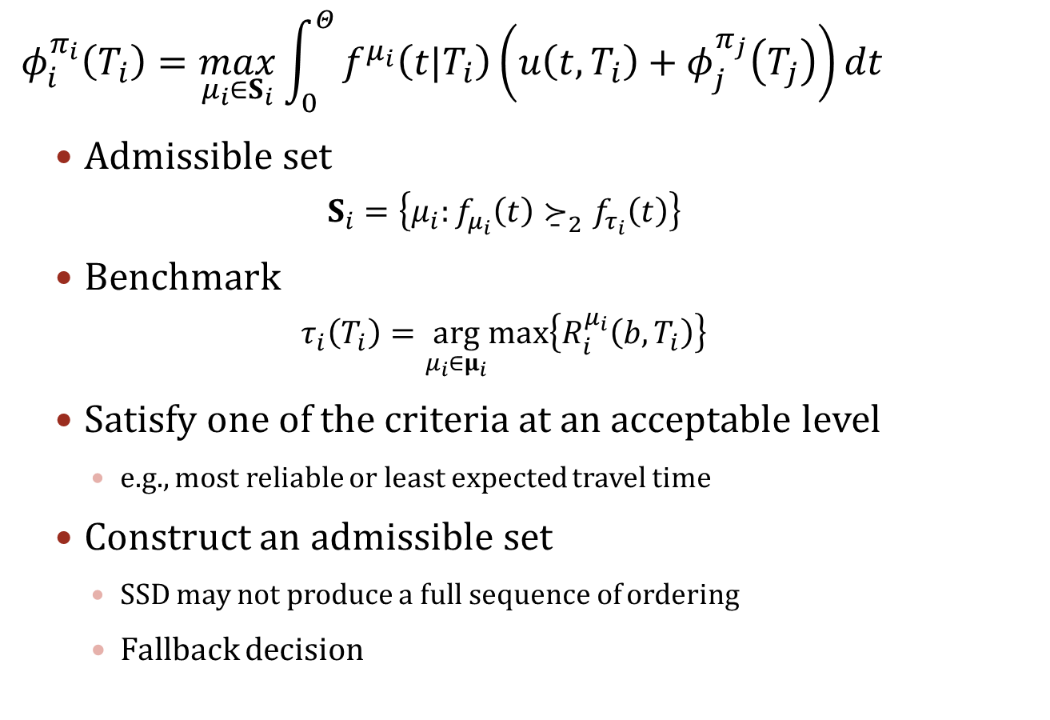
SSD constrained formulation
$${ φ}_{i}^{π_{i}}\left(T_{i}\right)=\max_{μ_{i}∈S_{i}}\int_{0}^{Θ}{f^{μ_{i}}\left(t|T_{i}\right)\left(u\left(t,T_{i}\right)+φ_{j}^{π_{j}}\left(T_{j}\right)\right)dt}$$
Admissible set
$$S_{i}=\left\{μ_{i}:f_{μ_{i}}\left(t\right){\underset{¯}{≻}}_{2}f_{τ_{i}}\left(t\right)\right\}$$
Benchmark
$$τ_{i}\left(T_{i}\right)=\arg_{μ_{i}∈μ_{i}}max\left\{R_{i}^{μ_{i}}\left(b,T_{i}\right)\right\}$$
Satisfy one of the criteria at an acceptable level
e.g., most reliable or least expected travel time
Construct an admissible set
SSD may not produce a full sequence of ordering
Fallback decision
Notes:
Here is the SSD constraint formulation. It is a backward recursion starting from the destination. In this formulation, prospect is maximized, and the criterion of reliability is taken into account in the constraint.
The tuo is the benchmark alternative which may serve as a fallback decision.
The S is called admissible set, formatted from the benchmark.
As far as formulation is concerned, one can choose a benchmark alternative based on some other criterion acceptable to the user. In the context of this navigation problem, the benchmark alternative is referred to as the one with the highest on-time arrival reliability among all the potential alternatives with respect to the travel time budget and current time of day.

Slide 8
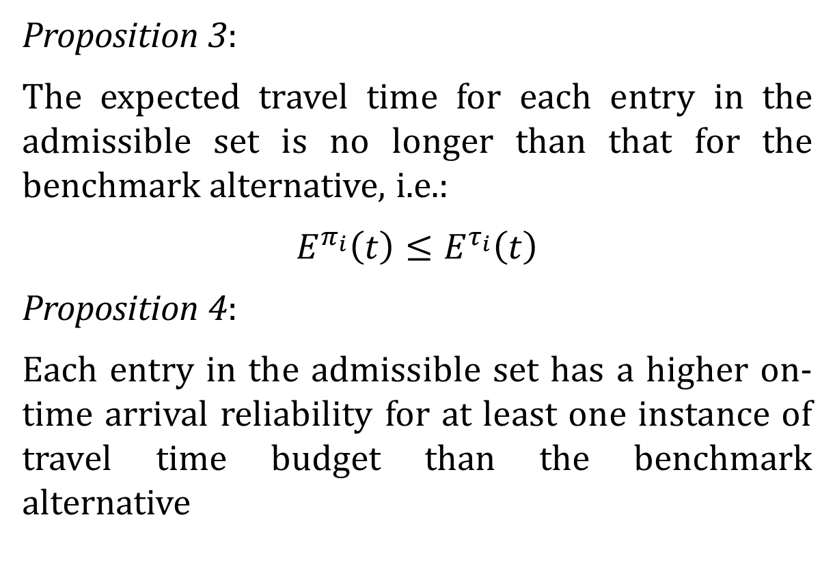
Admissible set
Proposition 3:
The expected travel time for each entry in the admissible set is no longer than that for the benchmark alternative, i.e.:
$$E^{π_{i}}\left(t\right)≤E^{τ_{i}}\left(t\right)$$
Proposition 4:
Each entry in the admissible set has a higher on-time arrival reliability for at least one instance of travel time budget than the benchmark alternative
Notes:
First,

Slide 9
Solution procedure
Input information
Benchmark
Feasible set
Eliminating obviously inferior choices
Admissible set
Feasible set = admissible set
Set size?
Update
Choose this single entry
=1
>=2
Outperforms the benchmark
=0
Benchmark
Fallback decision

Slide 10
Numerical study
link 1
link 4
link 2
link 5
link 3
link 6
node 1
node 2
node 3
link | 11:55<T<12:00 |  | 12:00<T<12:05 |  | T>12:05
 | α | β | α | β | α | β
1 | 6.8 | 0.8 | 4.8 | 0.9 | 7 | 0.6
2 | 10 | 0.6 | 5 | 0.8 | 6 | 0.65
3 | 12.5 | 0.4 | 21 | 0.2 | 5 | 0.8
4 | 18 | 0.4 | 15.5 | 0.3 | 5.6 | 0.8
5 | 6.8 | 0.8 | 4.8 | 0.9 | 7 | 0.6
6 | 10 | 0.6 | 5 | 0.8 | 6 | 0.65
Assume the link travel time on each link follows gamma distribution depends on the time of day, and they are independent of each other
Notes:
Let’s see the properties above through the numerical study

Slide 11
Results - Depart from node 2 at 11:55
Reliabilities for each link
Feasible set:
{link 4, link 5, link 6}
Travel budget b:
17 minutes
R=1 for link 4; 0.9999 for link 5, and 0.9998 for link 6.
Link 4 with the highest reliability is chosen as
benchmark alternative
The travel time budget is 17 minutes.
Notes:
The entire solution procedure is too long to be shown completely here. For instance, we explain the solution procedure for the vehicle depart from node 2 at 1155.
In this case, the feasible set ***, the travel budget is set to be 17 min
We first determine the benchmark, according to the ontime arrival reliabilities for each link
Link 4,

Slide 12
Results - Depart from node 2 at 11:55
Integral of reliability
The curve for link 4 (the benchmark) always lies under the other two, so it is dominated by link 5 and link 6.
Thus, the admissible set has two entries, link 5 and 6.
Link 6
Update
Update the feasible set to be {link 5, link 6}
Link 4
Notes:
Then we construct the admissible set.
***
As the admissible set has 2 entries, we need to update the feasible set to be ***

Slide 13
Results - Depart from node 2 at 11:55
Reliabilities for each link
Feasible set:
{link 5, link 6}
Travel budget b:
17 minutes
R=0.9999 for link 5, and 0.9998 for link 6.
Within the new feasible set, the updated benchmark is link 5
The travel time budget is 17 minutes.
Notes:
Then, within the new feasible set ***
Again, ***

Slide 14
Results - Depart from node 2 at 11:55
Integral of reliability
The curve for link 6 is always above that for link 5, which means link 6 dominates link 5.
Thus, the admissible set has only one entry
Link 6
Terminate
Link 5
Link 6, in this case, is chosen as the decision
Notes:
Then we construct the admissible set.
***
As the admissible set has 2 entries, we need to update the feasible set to be ***

Slide 15
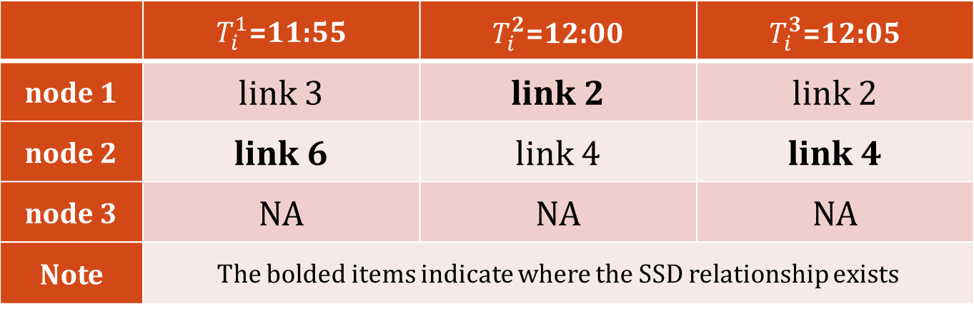
Result – Decision matrix
12:00/12:05: link 4
12:00/12:05: link 2
11:55: link 3
11:55: link 6
node 1
node 2
node 3
 | $T_{i}^{1}$=11:55 | $T_{i}^{2}$=12:00 | $T_{i}^{3}$=12:05
node 1 | link 3 | link 2 | link 2
node 2 | link 6 | link 4 | link 4
node 3 | NA | NA | NA
Note | The bolded items indicate where the SSD relationship exists
Notes:
Similar work can be done to different time of day and differnet node. Finnaly, a decisiion matrix is produced hrere.

Slide 16

Result – Compare the results
Recall a typical adaptive routing policy
Aiming at highest reliability
Aiming at least expected travel time
An absolutely risk-averse utility function is used
$$u\left(t\right)=e^{−4t}−1$$
A gain of 15.57% in ET and 13.55% in prospect compare with a drop of only 0.02% in reliability
Approach | Decision | R | ET | Prospect
SSD method | link 6 | 0.9998 | 6.07 | -0.3259
Highest R | link 4 | 1.0000 | 7.19 | -0.377
LET | link 6 | 0.9998 | 6.07 | -0.3259
Notes:
To show the tradeoff and advantage in this SSD method, we compare the solutions by applying different methods
The other two solutions are obtained from adaptive routing method respectively.
***
One may notice that the SSD and LET are always the same. Does this mean SSD is redundant? It depends.
If LET is about the travel time alone, SSD is a sufficient but not necessary condition for LET. That is to say, an SSD solution must be an LET. But a LET may not be SSD.
If LET is not purely about the travel time, but also consider other kinds of cost, SSD and LET may not have such relationship.

Slide 17
Concluding remarks
Formulated approach for risk-averse travelers
Outlined a solution algorithm
Two criteria are put into one box by employing the ordering tool of SD
Use the technique of benchmark and Admissible set
Less information required
As long as the utility function is concave in the negative domain
Equivalently, as long as the utility function belongs to a risk-averse traveler
Notes:
Concludingly, this research developed an adaptive navigation method for risk-averse travelers and outlined a solution algorithm. This method incorporates two criteria in one formulation. It optimizes the criterion of expected prospect of potential routing policies while considering on-time arrival reliability.
The salient feature of this adaptive routing algorithm is that it makes use of the second-order stochastic dominance properties to eliminate inferior choices rather than to optimize either of the criteria directly. So, there is less information about the travelers’ preferences required. As long as they are risk-averse and their resultant utility/disutility functions satisfy certain conditions.
A benchmark alternative is defined as the route that has the highest on-time arrival reliability according to the travel time budget or desired arrival time specified by the user. And all possible choices in the admissible have better performance comparing with the benchmark.
The approach has plenty of room for further improvement. Firstly, this method is designed exclusively for risk-averse travelers. It remains a research question whether it is possible to develop similar routing methods for other risk-taking behaviors. Secondly, this study focused mainly on formulating the problem and understanding its properties. Developing fast algorithms is not the present focus, but certainly this is an important aspect that deserves more studies.

Slide 18
Future research directions
Other risk-taking preferences
Faster solution algorithm
More trip decisions rather than route choices
In short run
Whether to travel (or travel frequency)
Travel mode
Departure time…
Long run
Whether to change the destination
Whether to change the origin …

Slide 19

Thank You All questions and discussions are welcome
Lin Xiao, cexiaol@ust.hk
Hong Kong University of Science and Technology

