Slide 1
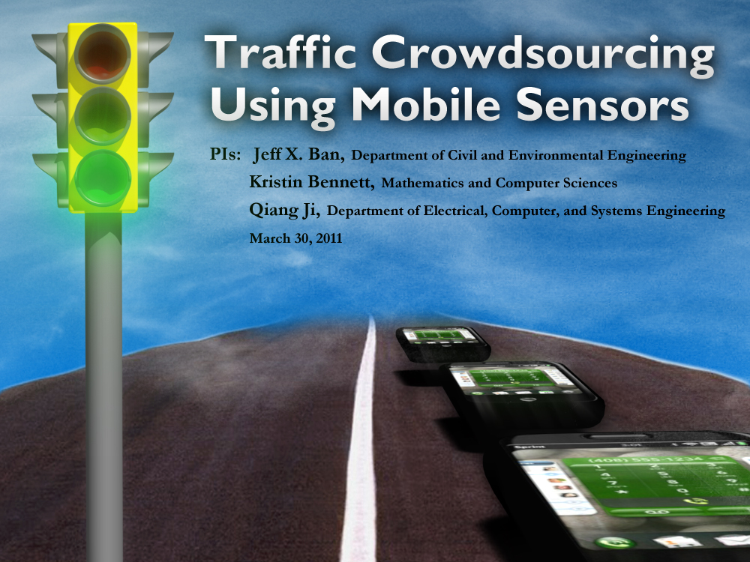
Privacy-Preserving IntelliDrive Data for Signalized Intersection Performance Measurement
Vehicle Index Estimation for Signalized Intersections Using Sample Travel Times
Peng Hao, Zhanbo Sun, Xuegang (Jeff) Ban, Dong Guo, Qiang Ji
Rensselaer Polytechnic Institute
ISTTT 20, The Netherlands
July 19, 2013
Xuegang (Jeff) Ban
Rensselaer Polytechnic Institute (RPI)
January 24, 2011
Session 228, TRB-2011

Slide 2
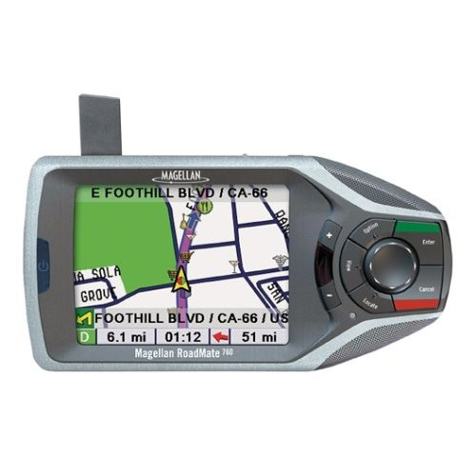
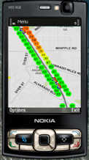
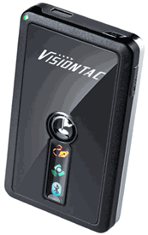
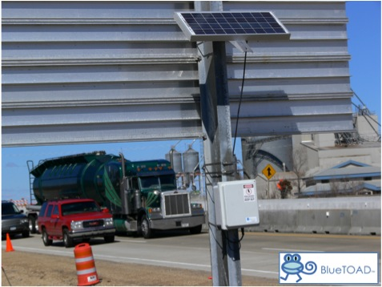
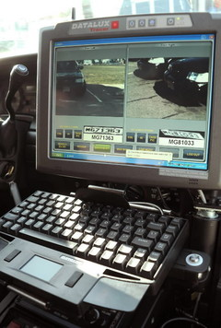
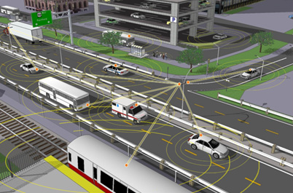
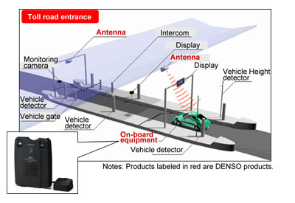
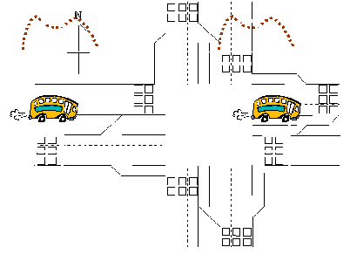
Sample Vehicle Travel Times
Technology advances have enabled and accelerated the deployment of travel time collection systems
Instead of estimating urban travel times from e.g. loop data, sample travel times are directly available

Slide 3
Sample Travel Times for Urban Traffic Modeling
Signalized intersection delay pattern estimation: Ban et al. (2009)
Cycle by Cycle Queue length estimation: Ban et al. (2011); Hao and Ban (2013)
Cycle by cycle signal timing estimation: Hao et al. (2012)
Vehicle trajectory estimation: Sun and Ban (2013)
Corridor travel times: Hofleitner et al. (2012); Hao et al. (2013)
Benefits of using sample travel times
Better to address issues related to the use of new technologies, such as privacy etc. (Hoh et al., 2008, 2011; Herrera et al., 2010; Ban and Gruteser, 2010, 2012; Sun et al., 2013)
More stable than other measures such as speeds (Work et al., 2010)
Challenges: samples only; no direct information of the entire traffic flow

Slide 4
Vehicle Index and Stochasticity of Urban Traffic
Vehicle index: the position of a sample vehicle in the departure sequence of a cycle.
It is a bridge between sample vehicles and information about the entire traffic flow
3
1
4
5
6
7
8
2
Stochasticity: Traffic arriving at an intersection is usually stochastic
Stochastic models are often applied to describe intersection traffic: arrival process, departure process, etc.
Question: how to infer sample vehicle indices from their travel times by considering stochastic arrivals and departures?

Slide 5
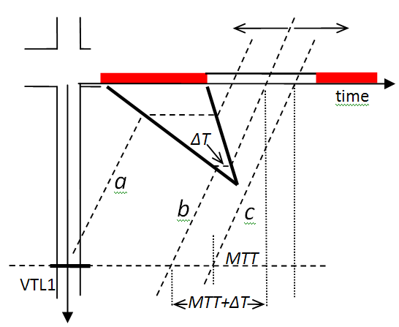
Definition of Queued Vehicles
Queued
MTT (minimum traverse
time): the measured
minimum travel time
to traverse the intersection
If the actual travel time
exceeds MTT by a pre-
defined threshold, the
vehicle is considered
“queued”

Slide 6
A Bayesian Network Model
The proposed Bayesian Network is a three layer model that integrates the arrival times, the indices, and the departure times of all sample vehicles.
The directed arcs indicate conditional dependency of variables.
Arrival Time
Index
Departure Time
Queued vehicles
Free flow vehicles

Slide 7
Arrival Process
Arrival Process: Non-homogeneous Poisson process (NHPP)
Arrival Time
Index
Non-homogeneous Poisson process is a Poisson process with a time dependent arrival rate λ_{i}. The time difference between X_{i} and X_{i-1} follows a gamma distribution with shape parameter K_{i}-K_{i-1} and scale parameter 1/λ_{i}:
Departure Time

Slide 8
Sampling Process
Sampling Process: Geometric distribution
Arrival Time
Index
Assuming each vehicle is sampled independently with a given penetration rate p, the index difference of two consecutively sample vehicles K_{i}-K_{i-1} follows a geometric distribution:
Departure Time

Slide 9
Departure Process
The departure time difference, Y_{i} -Y_{i-1}, of the (i-1)^{th} and i^{th} (i≥2) sample queued vehicles follows an index dependent log-normal distribution (Jin, 2009):
Arrival Time
Index
Departure Time
Departure Process:
First sample vehicle: Index dependent normal distribution
Other sample vehicles: Index dependent log-normal distribution (Jin et al., 2009)

Slide 10
Parameter Learning
Departure Process
The departure headway between the h^{th} and j^{th} queued vehicles at an intersection is stable for different cycles.
The location parameter μ and scale parameter σ of a log-normal distribution are estimated from 100% penetration historical data by the maximum likelihood estimation method.
Arrival Process
The arrival rate λ between two sample vehicles are estimated from sample data collected in real time by assuming constant index differences.

Slide 11
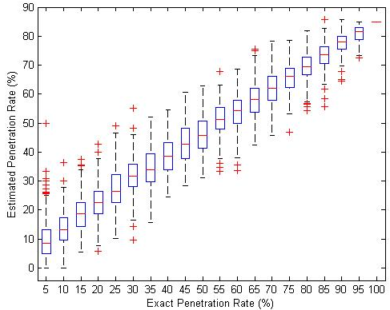
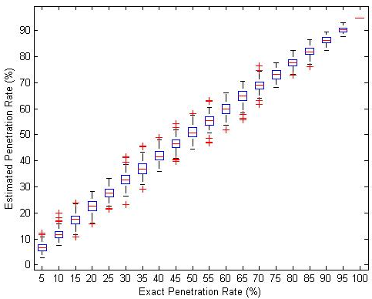
Penetration Rate Estimation
If the penetration rate is unknown, we can estimate it by computing the percentage of the sample queued vehicles (known) in the total queued vehicles (estimated via a simple queue length estimation algorithm).
NGSIM data
Field test data
Performance of the penetration estimation algorithm

Slide 12
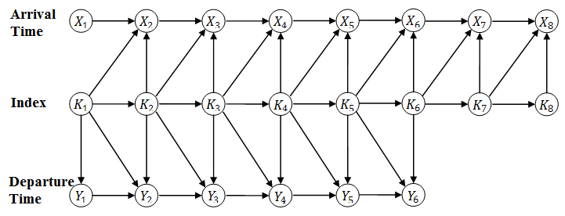
Vehicle Index Estimation (Inference)
The conditional probability of vehicle index, given the observed arrival and departure times, is derived from the graphical representation of the BN model using the chain rule.
The index inference results, such as the Most Probable Explanation (MPE) and the marginal posterior distribution can then be calculated based on the conditional probability.

Slide 13
Simplified Bayesian Network Model
The vehicle departure headway stabilizes at the saturation flow rate after the fourth or fifth headway position after the signal turns green.
The basic BN can be decomposed into 3 types of independent sub-networks to reduce computation if the number of sample vehicles is greater than 4.
First four vehicles
Other queued vehicles
Other free flow vehicles

Slide 14
Numerical Experiments (Data)
NGSIM: Peachtree St, Atlanta, Georgia (2 15-minutes; up to 100% penetration)
Field Tests: Albany, NY area (1 hour for each field test; up to 30% using tracking devices and up to 100% for travel times using video cameras)

Slide 15
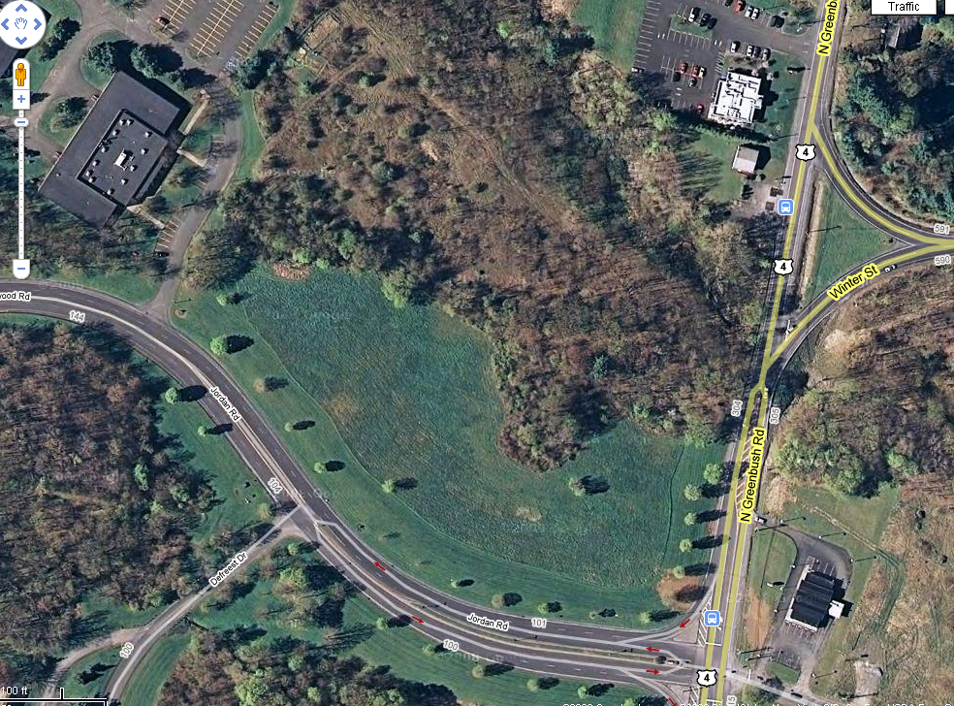

RPI Tech Park
Jordan 105/145/165
Parking Lot
(Staging Area)
Alexis Dinner
Parking Lot
Experimental Site

Slide 16
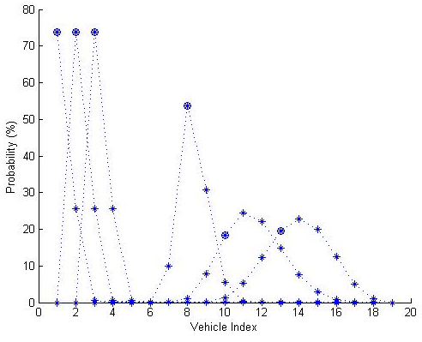
Numerical Experiments (NGSIM Data)
Marginal probability of vehicle index

Slide 17
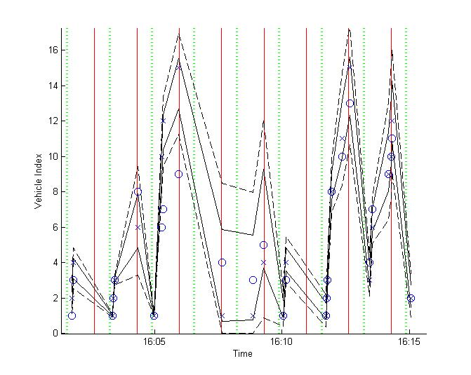
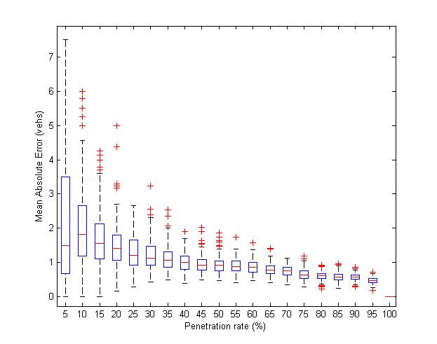
Numerical Experiments (NGSIM)
Estimated index (x) and true index (o)
Mean Absolute Error vs. Penetration rate

Slide 18
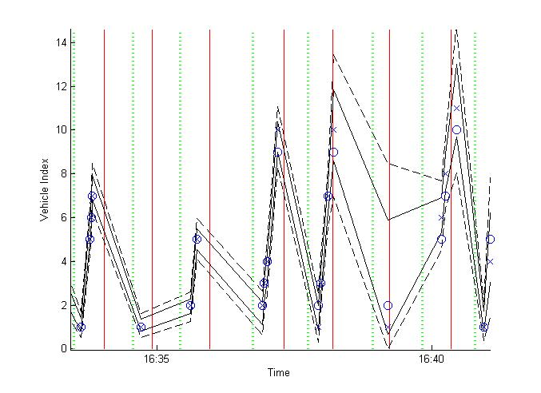
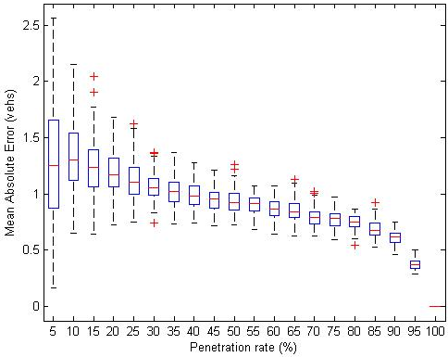
Numerical Experiments (Field Data)
Estimated index (x) and true index (o)
Mean Absolute Error vs. Penetration rate

Slide 19
Application: BN-Based Queue Length Estimation
The queue length of a cycle is the index of the last queued vehicle.
We focus on the hidden vehicles between the last queued sample vehicle and the first free flow sample vehicle
Sample vehicles
The queue length distribution is the marginal distribution of the last queued vehicle’s index given sample travel times.
The queue length model works with over-saturation and low penetration cases.
Arrival Time
Index
Queue length
Hidden vehicles
Departure Time
K₁
K₂
K₃
K₄
Stop line
Queue

Slide 20
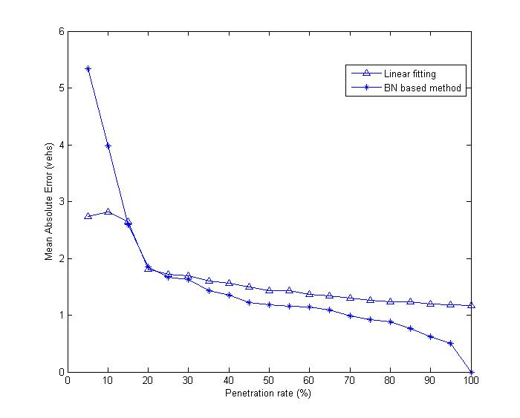
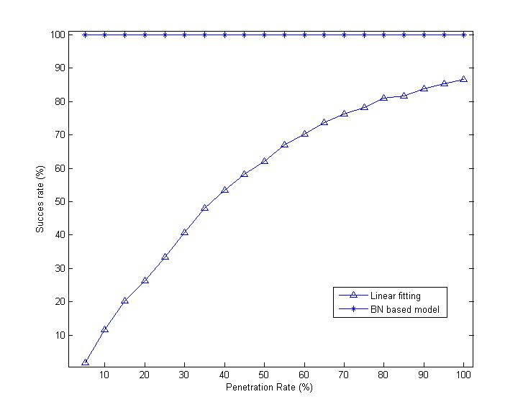
Numerical Experiments (NGSIM Data)
Error vs. Penetration Rate
Success Rate vs. Penetration Rate
Queue Length Distribution

Slide 21
Summary
The Bayesian Network model systematically integrates the major stochastic processes of an arterial signalized intersection, with sample vehicle travel times as the major input (data) to the model.
The model is a combination of learning method and domain knowledge
The model works better for queued vehicles that for free flow vehicles, and for congested intersections than for less congested intersections.
Information on queued vehicles contribute directly to performance (such as queue) estimation, while free flow vehicles contribute to selecting the proper model structure (i.e., distinguish traffic states).
The model may provide a useful framework to estimate the performance measures of a signalized intersection using emerging urban traffic data (e.g., sample travel times), such as queue length and intersection delays, as well as the performance measures of arterial corridors or even networks.

Slide 22
References
Ban, X., Gruteser, M., 2012. Towards fine-grained urban traffic knowledge extraction using mobile sensing. In Proceedings of the ACM-SIGKDD International Workshop on Urban Computing, pages 111-117.
Ban, X., Hao, P., and Sun, Z., 2011. Real time queue length estimation for signalized intersections using sampled travel times. Transportation Research Part C, 19, 1133-1156.
Ban, X., and Gruteser, M., 2010. Mobile sensors as traffic probes: addressing transportation modeling and privacy protection in an integrated framework. In Proceedings of the 7th International Conference on Traffic and Transportation Studies, Kunming, China.
Ban, X., Herring, R., Hao, P., and Bayen, A., 2009. Delay pattern estimation for signalized intersections using sampled travel times. Transportation Research Record 2130, 109-119.
Hao, P., Ban, X., Bennett, K., Ji, Q., and Sun, Z., 2011. Signal timing estimation using intersection travel times. IEEE Transactions on Intelligent Transportation Systems 13(2), 792-804.
Herrera, J.C., Work, D.B., Herring, R., Ban, X., and Bayen, A., 2010. Evaluation of traffic data obtained via GPS-enabled mobile phones: the Mobile Century field experiment. Transportation Research Part C 18(4) , 568-583.
Hofleitner, A., Herring R., and Bayen, A., 2012. Arterial travel time forecast with streaming data: a hybrid approach of flow modeling and machine learning, Transportation Research Part B, 46, 1097-1122.
Hoh, B., Gruteser, M., Herring, R., Ban, X., Work, D., Herrera, J., and Bayen, A., 2008. Virtual trip lines for distributed privacy-preserving traffic monitoring. In Proceedings of The International Conference on Mobile Systems, Applications, and Services (MobiSys).
Hoh, B., Iwuchukwu, T., Jacobson, Q., Gruteser, M., Bayen, A., Herrera, J.C., Herring, R., Work, D., Annavaram, M., and Ban, X, 2011. Enhancing Privacy and Accuracy in Probe Vehicle Based Traffic Monitoring via Virtual Trip Lines. IEEE Transactions on Mobile Computing, 11(5), 849-864.
Jin, X., Zhang, Y., Wang, F., Li, L., Yao, D., Su, Y.,& Wei, Z. (2009). Departure headways at signalized intersections: A log-normal distribution model approach, Transportation Research Part C, 17, 318-327.
Sun, Z., and Ban, X., 2012. Vehicle trajectory reconstruction for signalized intersections using mobile traffic sensors. Submitted to Transportation Research Part C.
Sun, Z., Zan, B., Ban, X., and Gruteser, M., 2013. Privacy protection method for fine-grained urban traffic modeling using mobile sensors. Accepted by Transportation Research Part B.
D. Work, S. Blandin, O. Tossavainen, B. Piccoli, and A. Bayen. A traffic model for velocity data assimilation. Applied Mathematics Research eXpress,2010(1):1-35, 2010.

Slide 23
Thanks!
Questions?
Email: banx@rpi.edu
URL: www.rpi.edu/~banx

Slide 24
How About Very Sparse Data?

Slide 25
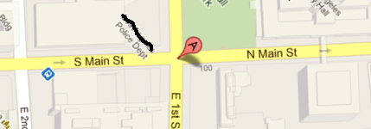
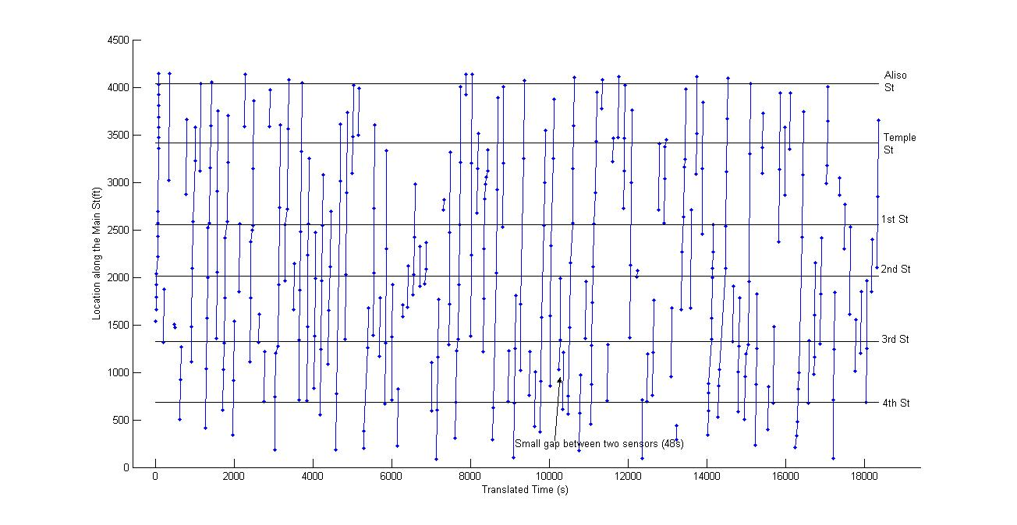
Real World Data by Industry Partners
A signalized intersection of a major US city
Very sparse data (2-9 sample vehicles per day)
Sampling frequency:
15 seconds

Slide 26
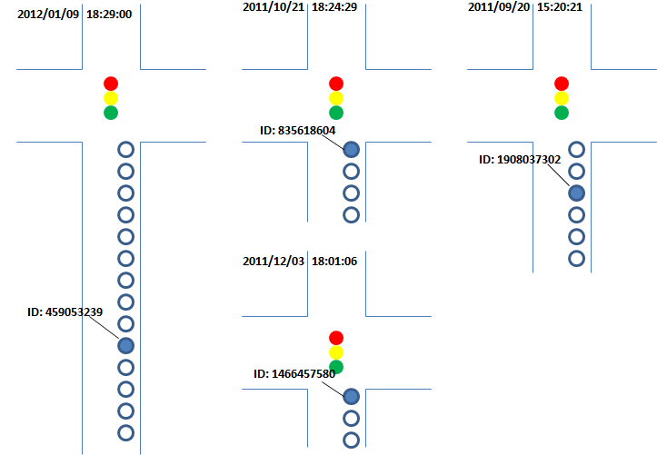
Results (I)
If there is a queued sample vehicle in a cycle, the position of the vehicle in the queue and the maximum queue length of the cycle can be estimated

Slide 27
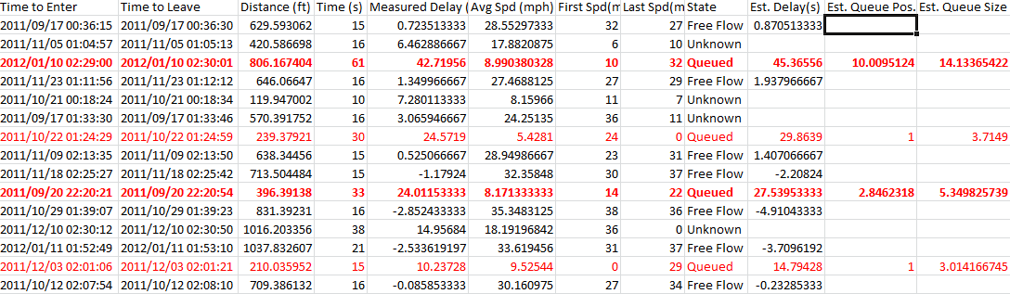
Results (II)
Observation:
We need 1 queued sample vehicle in a cycle in order to provide some estimates of the cycle

